Slide 1
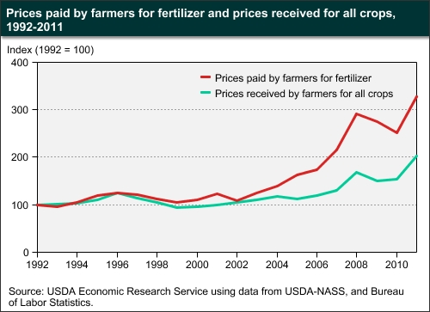
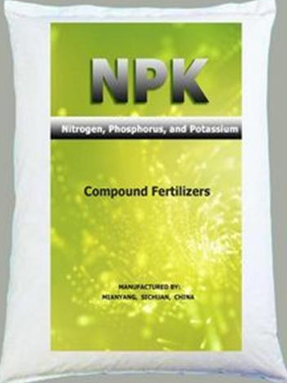
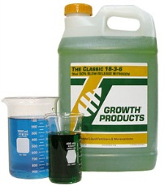
A7R6D5
CNMC - Crop Nutrient Management Calculator
A new and easy environment friendly tool for crop management
Worldwide, fertilizer prices paid by farmers has tripled in the last 10 years (ERS, USDA, 2012), and this increase outpaced the increase in crop prices received by farmers in this same period (NASS,USDA, 2012). This trend seems to keep in this way in the future. In response to record fertilizer prices, farmers reduced fertilizer consumption ,which results in lower crop yields.
Therefore, producers have a great necessity to improve nutrient use efficiency by the crops to avoid either low or over-fertilization. Applying only what is necessary for the plants means a great reduction in production costs without losing yield potential.
IDEA and BENEFITS
The idea is to create a software (for computers, tablets, and smartphones) as a fast and easy tool where users would be able to interpret their soil and/or foliar nutrient analyses and find out the necessity and rate of nutrient applications for several important crops.
Besides that, the software, based on the results, would give options for commercial products, from sponsor companies, with potential to treat the output problem. Once the user chooses a certain product, a better description and a list of sales representatives from that specific company would be given as well to better assist the user.
Once the user has the soil and/or foliar test results
- Right products at right rates favor environment sustainability
Once the user has the soil and/or foliar test results from a reliable lab, the software would have several input options to be selected in order to be obtain the output (application need, rate and products).
Database would consist of a large data set with updated information on nutrient
sufficiency ranges for all listed crops according to the region, soil type, crop
development stage, expected yield, etc.
Some of the software input options to be selected include:
State - Crop - Soil type - Analysis type
Crop development stage - Macro, Micro, or Macro+Micro
Nutrient`s value + pH, OM, and CV% - Expected yield
Click “Calculate”
To obtain the application recommendation and list o products:
- Select application type (Broadcast, Incorporation, or foliar), then select potential product to be used.
- Application rate, potential products, and sales contact information would be the final output.
Alexandre S. Barreiro Department of Plant and Soil Sciences, Oklahoma State University. 368 Ag Hall, Stillwater, OK, 74078.
alex.barreiro@okstate.edu

