Slide 1


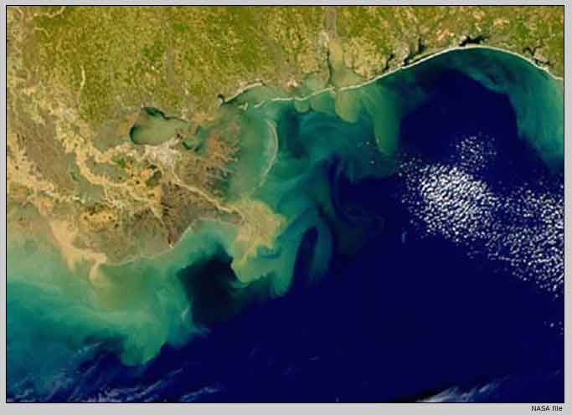
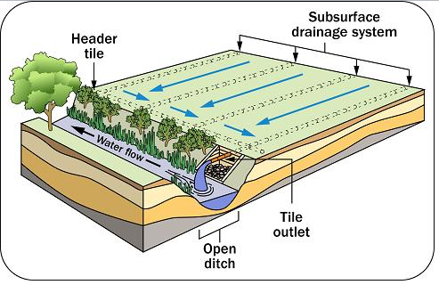
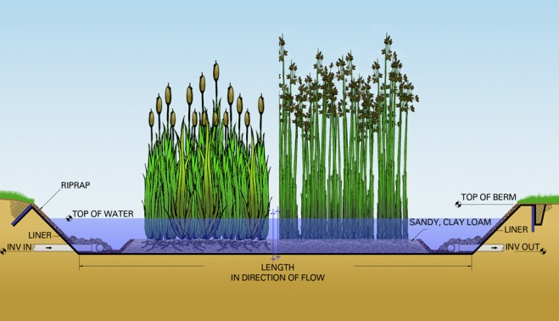
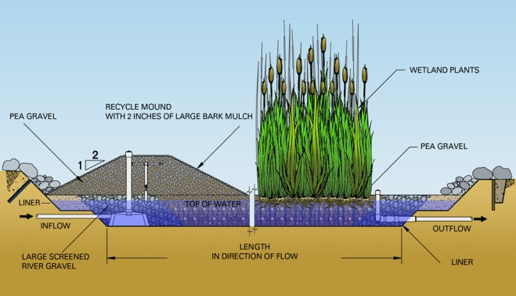
Removing Nitrate from Subsurface Drainage Water
Using Constructed Wetlands
Decreasing Hypoxia of Coastal Waters
Gulf of Mexico
Hypoxic Zone
Introduction:
Once nitrate (NO₃⁻) has leached into the soil profile, surpassing the root zone, it is considered lost from the agroecosystem and is prone to pollute surface water via subsurface tile drainage. Subsurface drainage is installed to remove excess soil water from agricultural fields to improve productivity. However, these tile drainage systems offer a direct pathway to carry contaminants, such as leached NO₃⁻, that can be discharged into surface waters, posing a direct threat to environmental quality.
Leaching of NO₃⁻ has a high potential for environmental contamination. Notice the algal bloom in the Gulf of Mexico.
Header tile
Lateral tile
A.
Adapted from: http://www.omafra.gov.on.ca/english/engineer/facts/10-091.htm
Tile outlet
Open ditch
B.
The goal of a subsurface drainage system is to provide uniform drainage to a field which is able to remove excess water from the active root zone of a crop 24 to 48 hours after a heavy rain (Wright and Sands, 2001). A well-designed tile drainage system intercepts at least 95% of the NO₃⁻ percolating through the soil (Power et al., 2000).
Images from: http://www.natsys-inc.com/resources/about-constructed-wetlands/
Benefit and Value:
- Constructive wetlands can remove NO₃⁻ prior to being discharged into surface waters.
- Removal of total NO₃⁻ reported as high as 95 to 98%.
- Plant species adapted for these systems are tolerant to water and include sedges, reeds, and cattails.
The interception of subsurface drain tile water by constructed wetlands could ultimately reduce environmental contamination by decreasing the hypoxia of coastal waters.
Constructed wetlands are designed to simulate a natural wetland for treatment of wastewater by utilizing wetland vegetation, soils, and microbial activity (Vymazal, 2007). Illustrated above is a surface flow constructed wetland (A) and a subsurface flow constructed wetland (B). Each of these systems has the treatment capacity of 100 m³ day⁻¹ (Lee et al., 2009).

