Slide 1

Soil Fertility Research and Education Advisory Board Meeting,
Friday, May 18, 2018
Building 615, Agronomy Experiment Station
Stillwater, OK 74078
Agenda
11:30 am Convene at the Soil Fertility Shop, Lunch will be served
12:00 Opening Remarks, Dr. Brian Arnall
12:15 Soil Fertility Progress Report and Overview
Raun, Arnall, Zhang
12:30 Update on current projects
12:40 Student input/progress
12:50 Agronomic applications, iPhone apps
1:00 New Projects/Approval
1:15 Open Discussion
2:00 Adjourn

Slide 2
Fertilizer Advisory Board will meet in the spring of each year. The primary purpose of the Fertilizer Advisory Board is to ensure that fertilizer dealers and fertilizer manufacturers, farmers that use fertilizers, and other clientele that SB-432 (previously SB-314) serves, have a mechanism for input to suggest priority research areas that (a) benefit agricultural producers in the state of Oklahoma; (b) promote efficient use of fertilizers in agronomic crop and forage production while protecting the environment and groundwater supplies; and (c) fulfill the spirit and intent of SB-432.
1. Fertilizer Advisory Board Chair, Rick Howard
2. Fertilizer manufacturer,
3. Fertilizer retail dealer (1) Mike Rosen, Wheeler Brothers
4. Fertilizer retail dealer (2) Kevin Brown, WB Johnston Grain Co.
5. Fertilizer retail dealer (3) Allan Nusser
6. Producer/Farmer, at large (1) Jimmy Kinder
7. Producer/Farmer, at large (2) Brent Rendel
8. CCA Board First Vice Chair, Jeff Ball
9. OARA President and CEO, Joe Neal Hampton
10. OARA Board Chair, Randy Gilbert, Bayer CropScience, Bethany, OK
11. Oklahoma Farm Bureau, Marla Peek
12. American Farmers and Ranchers, Terry Detrick
13. Oklahoma Department of Agriculture, Food and Forestry, Lance Kunneman
14. Oklahoma Department of Environmental Quality, Robert Huber

Slide 3

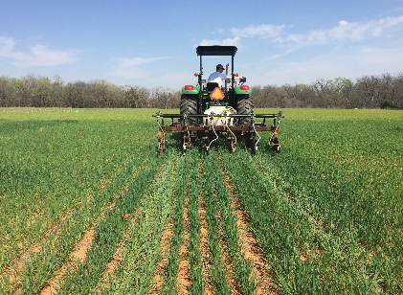

Influence of Method, Timing and N rate on Winter Wheat
(Triticum aestivum L.) Estimated Plant Nitrogen Loss
Jagman Dhillon
Objective: To determine the ideal timing and method of N placement for Winter Wheat
Year | Location | Pre-plant N | Planting | Top-dress | GDD >0
2016-17 | Efaw | 10/01/2016 | 10/14/2016 | 03/21/2017 | 118
2017-18 |  | 10/02/2017 | 10/16/2017 | 03/15/2018 | 100
2016-17 | Perkins | 10/01/2016 | 10/19/2016 | 03/09/2017 | 109
2017-18 |  | 10/02/2017 | 10/13/2017 | 03/07/2018 | 98
Jagman Dhillon

Slide 4
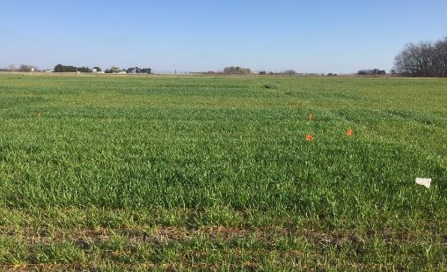

Effect of Topdress N rate at Fixed GDD on Winter Wheat (Triticum aestivum) Grain Yield
Jagman Dhillon
Objective: To determine the ideal GDD>0 to apply N fertilizer when no N is applied pre-plant
Location | Pre-plant N |  | Planting |  | Top-dress |  | GDD >0
 | 2016-17 | 2017-18 | 2016-17 | 2017-18 | 2016-17 | 2017-18
Efaw | 10/01/2016 | 10/02/2017 | 10/14/2016 | 10/20/2017 | 01/12/2017 02/06/2017 02/23/2017 03/10/2017 | 01/26/2018 02/28/2018 03/15/2018 03/15/2018 | 65 80 95 110
Perkins | 10/01/2016 | 10/02/2017 | 10/19/2016 | 10/12/2017 | 01/12/2017 02/06/2017 02/23/2017 03/10/2017 | 12/22/2017 02/09/2018 03/06/2018 03/20/2018 | 65 80 95 110

Slide 5
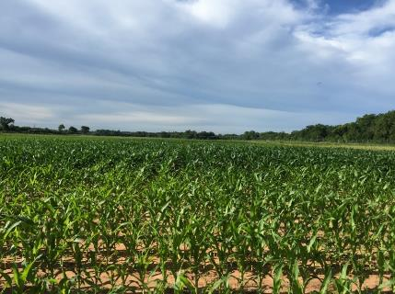

Maize Regional Trials
Jagman Dhillon
Preplant: ATV UAN spray
Sidedress: Drop down nozzles
Objective: Refinement of the OSU sensor based N rate calculator (SBNRC) and Optimum Fertilizer N rates
Treatment | Preplant N (lb N/ac) | Sidedress N (lb N/ac) | Method of Application
1 | 0 | 0 | Check
2 | 200 | 0 | N Rich Strip
3 | 40 | 0
4 | 40 | 30
5 | 40 | 60
6 | 40 | 90
7 | 40 | 120
8 | 40 | 150
9 | 40 | 180
10 | 80 | 0
11 | 120 | 0
12 | 160 | 0
Crop | Location | Preplant N | Planting | Top-dress | Sum of GDD
Maize | Efaw | 04/13/2017 | 04/13/2017 | 06/08/2017 | 915
Maize | Lake Carl Blackwell | 04/13/2017 | 04/13/2017 | 06/08/2017 | 871
Jagman Dhillon

Slide 6


Maize Grain Yield Response to Misses and Nitrogen Fertilization as
Influenced by Plant Population
Fikayo B. Oyebiyi
Objective :To evaluate maize grain yield response to misses or blanks as influenced by N rate and plant population.
Rationale: Developing world average farm size is approximately 1ha (2.2 ac). Ninety five percent of the increased world population will be in the developing world hence food production in these local regions must increase, and where the OSU hand planter can help.
Treatment | 5-Plant Sequence | N-rate | Population seeds/ac
1 | XXXXX | 70 | 18,000
2 | X0X0X | 70 | 18,000
3 | X0XXX | 70 | 18,000
4 | X000X | 70 | 18,000
5 | XXX0X | 70 | 18,000
6 | XXXXX | -- | 18,000
7 | X0X0X | -- | 18,000
8 | X0XXX | -- | 18,000
9 | X000X | -- | 18,000
10 | X0XXX | -- | 36,000
11 | X000X | -- | 36,000
12 | X0X0X | 70 | 36,000
13 | X0XXX | 70 | 36,000
Crop | Location | Planting Date | Sensor Date | Sum of GDD
Corn Efaw 04/24/2018 - -
Corn LCB 05/01/2018 - -
Fikayo B. Oyebiyi

Slide 7
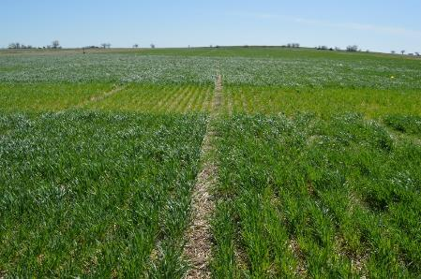
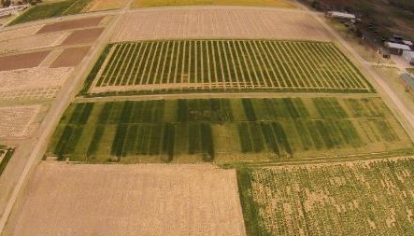

Sequential NDVI Measurements in Winter Wheat for Improved
Prediction of Winter Wheat Grain Yield and Mid-Season N Rate
Bruno Morandin Figueiredo
Experiment 222, Stillwater, OK
11 NDVI readings were taken from Dec. 21, 2015 to April 12, 2016
Experiment 502, Lahoma, OK
10 NDVI readings were taken from Dec. 18, 2015 to April 07, 2016
Bruno Morandin
Figueiredo

Slide 8



Coefficient of Determination (NDVI vs Yield) at each reading, where GDD>0 was tabulated, Exp. 222, Exp. 502, 2016 and 2017
PLATEAU | INTERCEPT | SLOPE | JOINT | RSQ
0.87955 | -0.88423 | 0.01593 | 110.723 | 0.80
X | Y
55.61006 | 0
110.723 | 0.87955

Slide 9
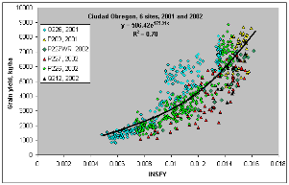
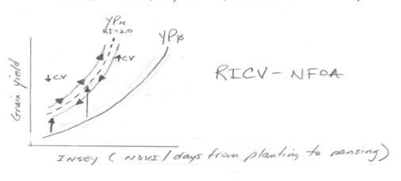
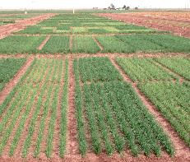
Use of Coefficient Variation (CV) from NDVI Readings, to Improve Yield Prediction
Bruno Morandin Figueiredo
Objective: To refine the use of CV (coefficient variation) data coming from Normalized Difference Vegetative Index (NDVI) readings for predicting wheat grain yield
Bruno
Morandin
Figueiredo

Slide 10

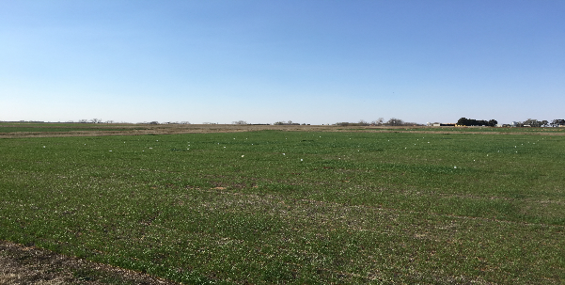

Optimum Preplant and Sidedress Nitrogen Rates for Winter Wheat
Robert Lemings
Treatment | Preplant (lb N/ ac) | Sidedress N (lb N/ac
1 | 0 | 0
2 | 15 | 0
3 | 30 | 0
4 | 45 | 0
5 | 60 | 0
6 | 90 | 0
7 | 0 | 30
8 | 30 | 30
9 | 60 | 30
10 | 60 | 60
11 | 90 | 30
12 | 0 | 60
Objective: To determine the optimum preplant and sidedress N rates for winter wheat grain yield and NUE
Crop | Location | Pre-plant N | Planting Date | Topdress N | Sensor Dates | days GDD>0
Wheat | Perkins | 9/30/2016 | 20/1/2016 | 3/8/2017 | 2/23/2017 | 125
 |  |  |  |  | 3/8/2017
Wheat | Lahoma | 10/13/2016 | 10/18/2016 | 3/17/2017 | 3/9/2017 | 100
 |  |  |  |  | 3/16/2017

Slide 11

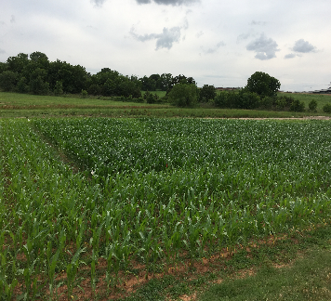

Optimum Preplant and Sidedress Nitrogen Rates for Corn
Robert Lemings
Treatment | Preplant N (lb/ac) | Sidedress N (lb/ac)
1 | 0 | 0
2 | 30 | 0
3 | 60 | 0
4 | 90 | 0
5 | 120 | 0
6 | 15 | 15
7 | 30 | 30
8 | 45 | 45
9 | 60 | 60
10 | 0 | 30
11 | 0 | 60
12 | 0 | 90
13 | 0 | 120
Objective: To determine the optimum preplant and sidedress N rates for corn grain yield and NUE
Crop | Location | Pre-plant N | Planting Date | Topdress N | Sensor Dates | Sum of GDD
Corn | Efaw | 4/13/2017 | 4/13/2017 | 6/8/2017 | 5/26/2017 | 915
 |  |  |  |  | 6/7/2017
 |  |  |  |  | 6/16/2017
Corn | LCB | 4/13/2017 | 4/13/2017 | 6/8/2017 | 5/26/2017 | 871
 |  |  |  |  | 6/7/2017
 |  |  |  |  | 6/16/2017

Slide 12

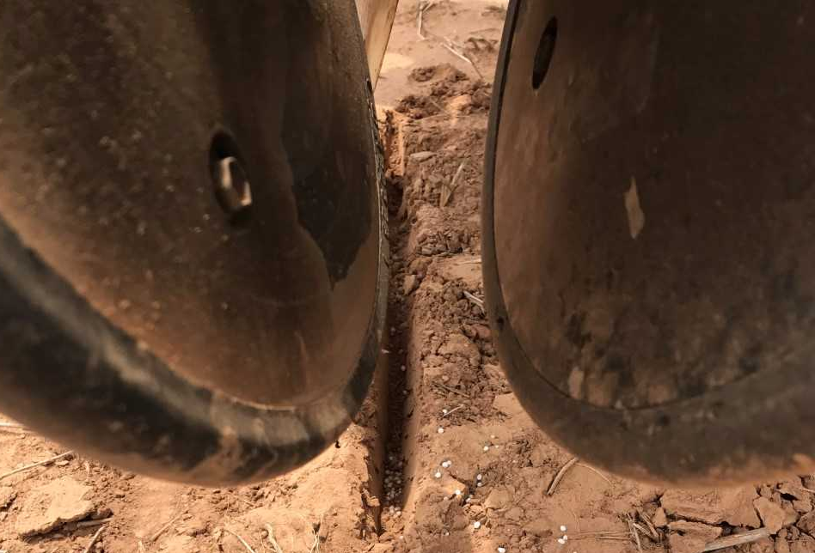

Effect of Applying Nitrogen with Sorghum Seed (Sorghum bicolor)
on Emergence and Final Grain Yield
Elizabeth Eickhoff
Objective: Evaluate the impact of applying different rates of nitrogen with the seed on seedling emergence, and final grain yield in sorghum with different populations.
Treatment | Pre-Plant N (kg/ha) | N with Seed (kg/ha) | Mid-Season N (kg/ha) | Population (seeds/ha)
1 | 0 | 0 | 0 | A
2 | 0 | 0 | 0 | B
3 | 0 | 0 | 0 | C
4 | 0 | 10 | 0 | A
5 | 0 | 10 | 0 | B
6 | 0 | 10 | 0 | C
7 | 0 | 20 | 0 | A
8 | 0 | 20 | 0 | B
9 | 0 | 20 | 0 | C
10 | 0 | 30 | 0 | A
11 | 0 | 30 | 0 | B
12 | 0 | 30 | 0 | C
13 | 30 | 0 | 0 | B
14 | 0 | 0 | 30 | B
Populations
A = 100,000 seeds / ha
B = 150,000 seeds / ha
C = 200,000 seeds / ha
Crop | Location | Preplant N Trt 13 | Planting Date | Sensor Dates | Sum of GDD
Sorghum | Efaw | 06/02/2017 | 06/02/2017 | 06/16/2017 06/21/2017 | 356 496
Sorghum | LCB | 06/02/2017 | 06/02/2017 | 06/16/2017 06/21/2017 | 368 504
Elizabeth Eickhoff

Slide 13
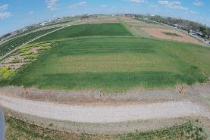
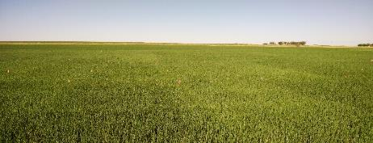

Environmental Variability in Check Plot Yields
Alimamy Fornah
Experiment 502 (Lahoma)
Objective: To evaluate the relative influence of the environment on check plot yields.
TRT | Pre-plant N rate (lb N / ac) | Pre-plant P rate (lb P2O5 / ac) | Pre-plant K rate (lb K2O / ac)
1 | 0 | 0 | 0
2 | 0 | 40 | 60
3 | 20 | 40 | 60
4 | 40 | 40 | 60
5 | 60 | 40 | 60
6 | 80 | 40 | 60
7 | 100 | 40 | 60
8 | 60 | 0 | 60
9 | 60 | 20 | 60
10 | 60 | 60 | 60
11 | 60 | 80 | 60
12 | 60 | 60 | 0
13 | 100 | 80 | 60
14 | 60 | 40 | 60 (Sul-Po-Mag)
Magruder Plots (Stillwater)
(6) Nitrogen, Phosphorus, Potash, and Lime 60-30-30+Lime
(5) Nitrogen, Phosphorus, and Potash 60-30-30
(4) Nitrogen and Phosphorus 60-30-0
(3) Phosphorus 0-30-0
(2) Check
(1) Manure every 4 years at 240 lbs N/A

Slide 14
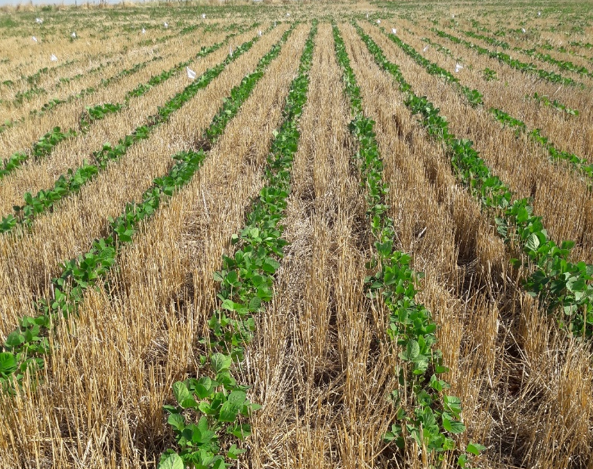
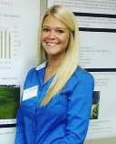
Optimum Sulfur Application for Soybeans in Oklahoma
Gwen Wehmeyer
Trt | Fertilizer | Timing | kg S ha -1 | kg carrier N ha -1 | kg/ha total product
1 | check | . | 0 | 0 | 0
2 | Ammonium Nitrate | Preplant | 0 | 14 | 68
3 | Ammonium Sulfate | Preplant | 5 | 5 | 23
4 | Ammonium Sulfate | Preplant | 11 | 10 | 45
5 | Ammonium Sulfate | Preplant | 16 | 14 | 68
6 | Ammonium Sulfate | Sidedress | 5 | 5 | 23
7 | Ammonium Sulfate | Sidedress | 11 | 10 | 45
8 | Ammonium Sulfate | Sidedress | 16 | 14 | 68
Objective: To determine the effect of applied sulfur on soybean grain yields, grain protein and oil quality.

Slide 15
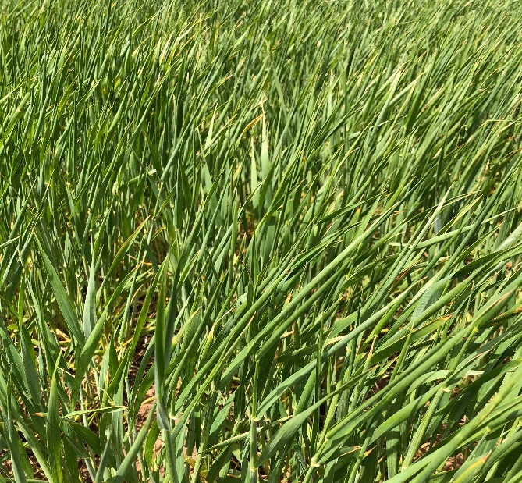
Influence of Preplant Topdress on Wheat Grain Yield
Gwen Wehmeyer
TRT | Preplant N rate lb/ac† | Top-dress N rate lb/ac‡ |  | ^{Total N}
 |  | February | March
1.** | 0 | - | 0 | 0
2. | 0 | - | 45 | 45
3. | 0 | - | 90 | 90
4. | 0 | - | 135 | 135
5.** | 45 | - | 0 | 45
6. | 45 | - | 45 | 90
7. | 45 | - | 90 | 135
8. | 45 | - | 45* | 90
9.** | 90 | - | 0 | 90
10. | 90 | - | 45 | 135
11. | 90 | - | 45* | 135
12. | 90 | - | 90 | 180
13. | 45 | 45 | 45 | 135
14. | 0 | 45 | 45 | 90
† - Pre-Plant N applied as urea (46-0-0) ‡ - Top-Dress N applied as UAN (28-0-0) * - UAN ** - YP Plot
Objective: To evaluate the effect of topdress applications in winter wheat on components of grain yield

Slide 16

Phosphorus availability and maize (zea mays l.) grain yield response to super saturation of phosphorus bands with gypsum in low pH soils
Peter Omara
Introduction: Maize grain yield can be limited in low pH soils where P deficiencies and Aluminum toxicity are present
Treatment structure
Treatment | Description | P (kg ha-1) | Ca (kg ha-1)
1 | Check | 0 | 0
2 | P | 10 | 0
3 | P | 20 | 0
4 | P | 30 | 0
5 | Ca | 0 | 10
6 | Ca | 0 | 20
7 | Ca | 0 | 30
8 | P x Ca | 10 | 10
9 | P x Ca | 20 | 20
10 | P x Ca | 30 | 30
Objective: To determine the effect of dual band application of P and gypsum on P availability and maize grain yields in low pH soils
Location: Efaw & LCB

Slide 17
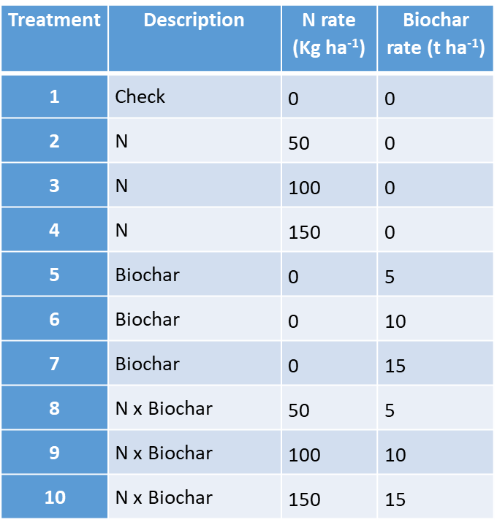
The effect of ammonium N - biochar complex on nitrogen use efficiency and yield of maize (Zea mays l.)
Peter Omara
Peter Omara
Objective: Improving NUE (currently 33%) is one of the most challenging tasks for cereal producers around the world
Treatment structure
Objective: To establish possible synergies in a biochar-N fertilizer complex for optimizing nitrogen use efficiency and maize grain yield
Location: Efaw & LCB

Slide 18

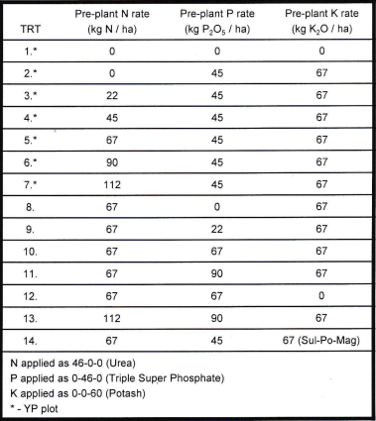
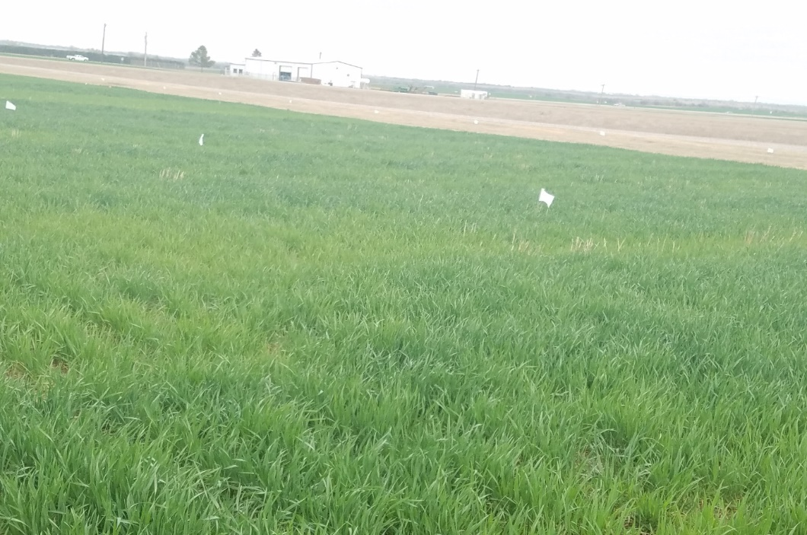

Early season sensor based NDVI readings
Eva Nambi
Objective: To determine the significance and value of early season sensor based NDVI readings, Experiment 222, and 502.
Rationale: Although early NDVI readings are below that needed to detect N response, they can be significant in terms of detecting early changes in plant biomass.

Slide 19
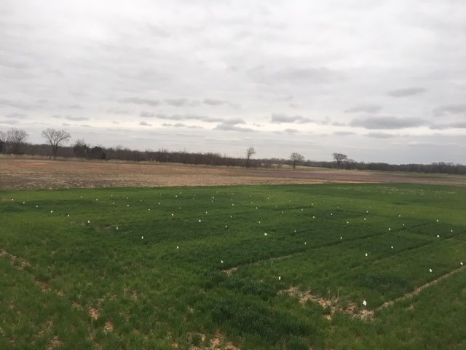

Residual N Effect Following Failed Crops (Wheat and Sorghum)
Tyler Lynch
Objective: To evaluate residual N effects following summer crops (sorghum) that fail
Treatment | Previous Crop | Previous Crop Pre N rate (lb N/ac) | Wheat Pre N Rate (lb N/ac)
1 | Sorghum | 0 | 0
2 | Sorghum | 30 | 0
3 | Sorghum | 60 | 0
4 | Sorghum | 90 | 0
5 | Sorghum | 120 | 0
6 | Sorghum | 150 | 0
7 | Sorghum | 60 | 30
8 | Sorghum | 60 | 60
9 | Sorghum | 60 | 90
10 | Sorghum | 60 | 120
11 | Sorghum | 60 | 150
Location | Pre plant sorghum | pre-plant wheat | wheat plant date | FK 5 GDD | Harvest
Efaw | 4/23/2015 | 10/8/2015 | 10/14/2015 | 100 | 6/14/2016
Efaw | 4/15/2016 | 9/30/2016 | 10/20/2016 | 95 | 6/13/2017
Efaw | 4/13/2017 | 10/2/2017 | 10/20/2017 | 90 | -
LCB | 4/13/2017 | 10/3/2017 | 10/16/2017 | 100 | -
Tyler Lynch

Slide 20


South Central Great Plains
Winter Wheat N Algorithm
Treatment | N - Rate (lb N/ac) | Yield (bu/ac) | Net Return ($/ac)
Split Application | 100 | 35 ± 16 | 154 ± 100
SBNRC | 45 ± 21 | 34 ± 16 | 172 ± 94
Average Difference |  |  | 12 ± 25
 |  |  | Max: 66
 |  |  | Min: -52
Fertilizer Price (28-0-0) = $0.56/lb N
Grain Price = $5.00/bu
29 site years from 2010-2017, from five locations in Oklahoma
Locations: Stillwater, Perkins, LCB, Lahoma and Hennessey
http://nue.okstate.edu/SBNRC/mesonet.php
Option 3: Winter Wheat, South Central Great Plains
Tyler Lynch

Slide 21
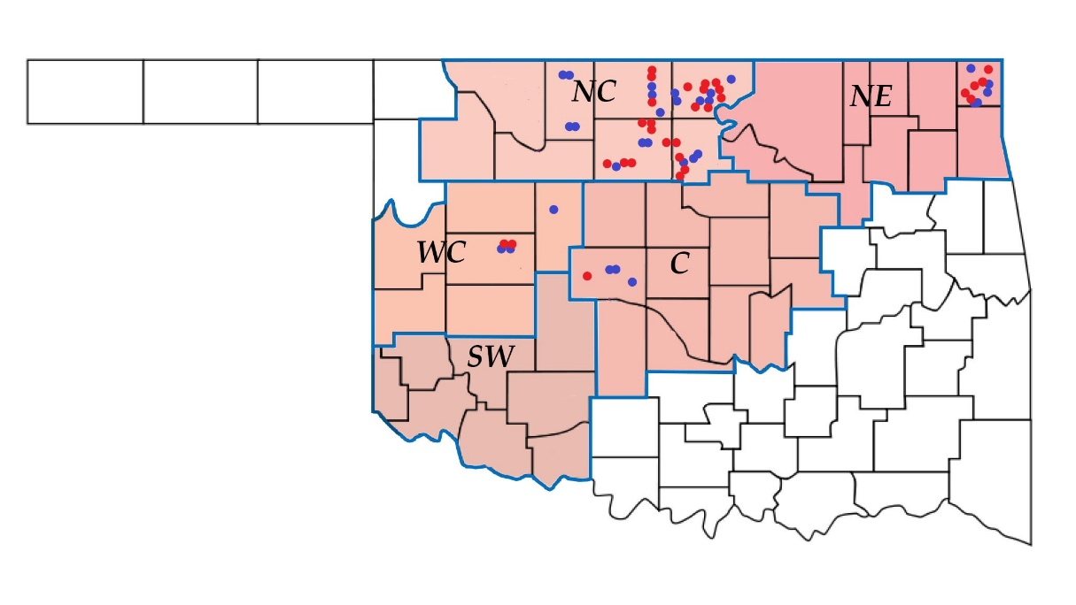

Influence of Method, Timing and N rate on Winter Wheat
(Triticum aestivum L.) Estimated Plant Nitrogen Loss
Vaughn Reed
Objective: To determine whether the addition of N, P, K, and S fertilizer above producer practice will increase yield; and whether soil test analysis could predict yield response
Crop | N | P | K | S | Total Sites
Soybean | 0 | 5 | 9 | 3 | 50
Grain Sorghum | 0 | 0 | 1 | 1 | 7
Sunflower | 0 | 0 | 0 | 0 | 4
Response Totals | 1 | 5 | 10 | 4 | 61
77% of the fields, producer maximized yield
244 comparisons, 20 responses
  92% accuracy rate
More room for improvement
Vaughn Reed

Slide 22
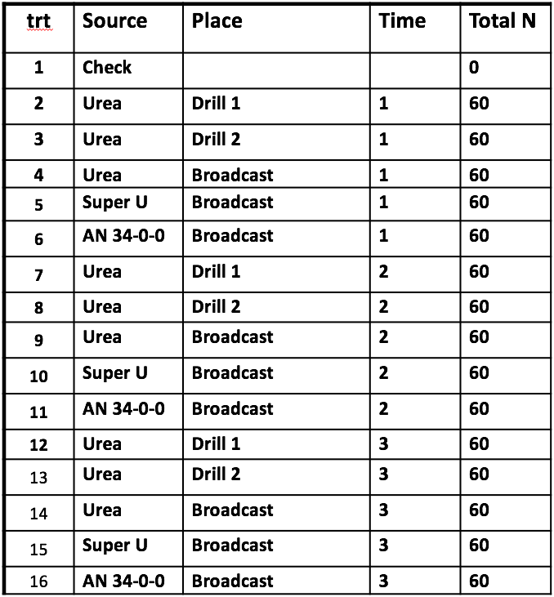
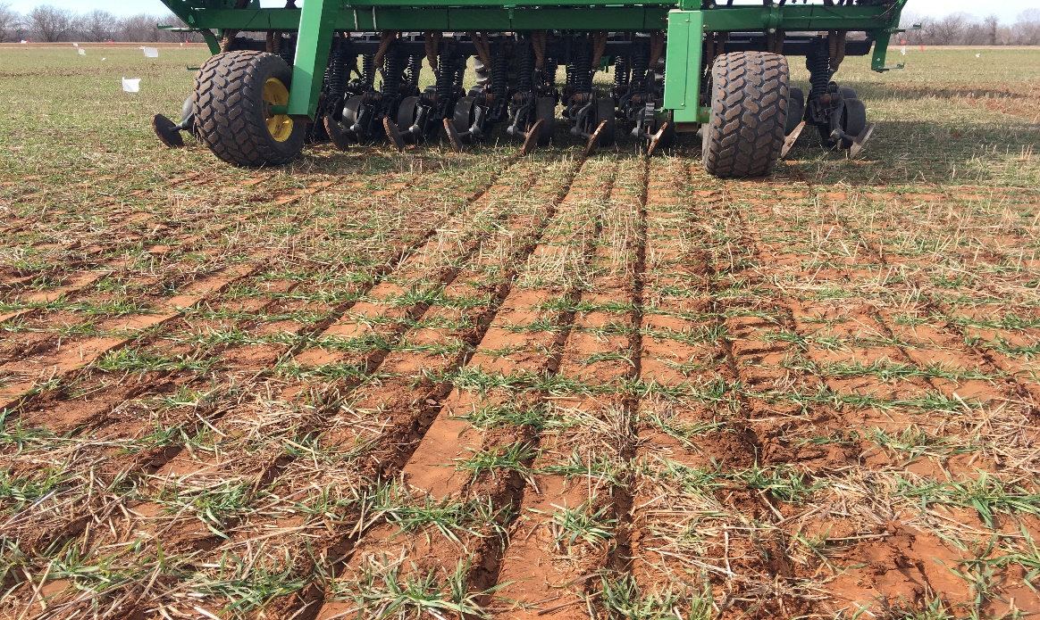

Winter Wheat Topdressing Response to Nitrogen Method Variation
Brent Ballagh
Objective:
Quantify whether there is a potential for gain in yield or protein by placing nitrogen below the soil surface of a standing wheat crop in bands with a grain drill.

Slide 23
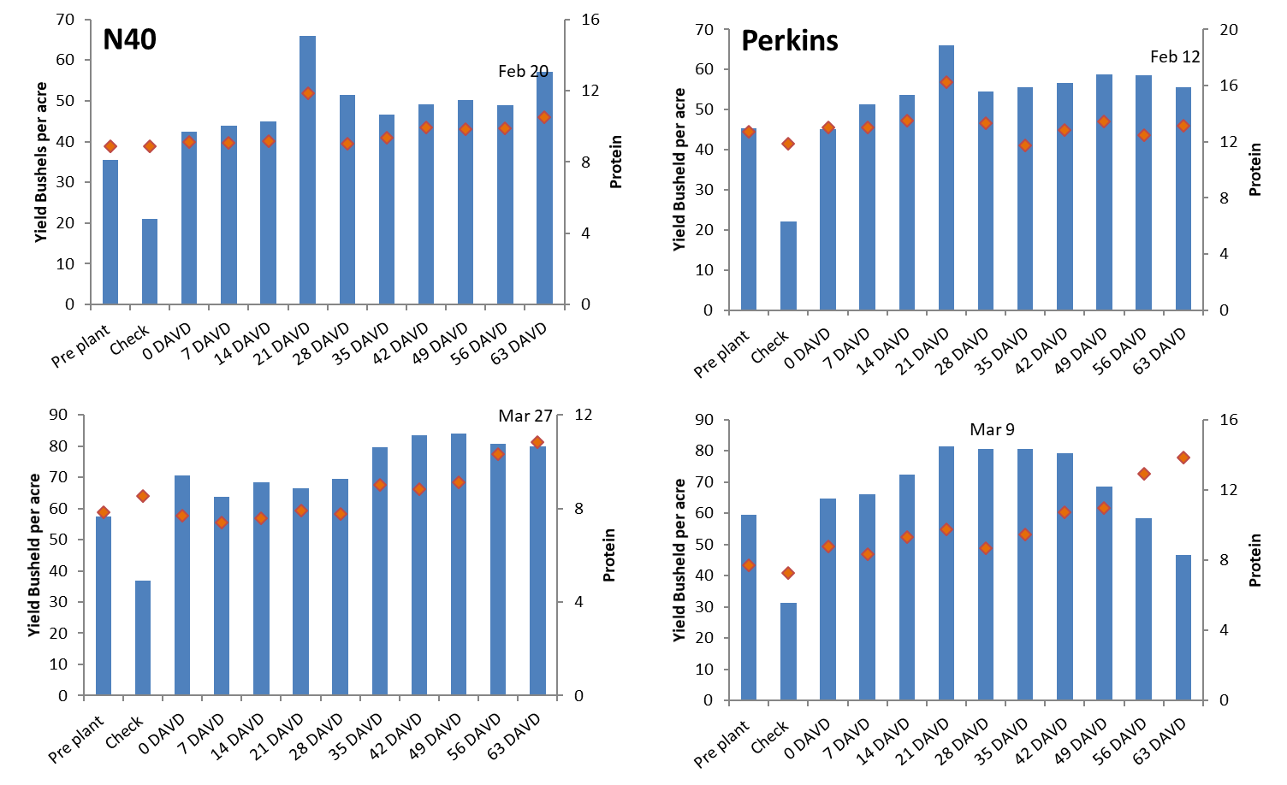

Winter Wheat Topdressing Response to Nitrogen Method Variation
Joao Bigatoa Souza
Objective:
Determine how long N fertilization can be delayed after the N-Rich Strip becomes visible.
M&M
90 lbs N as NH₄NO₃ applied, 7 GDD>0 after DAVD. Last application 63 GDD>0.
2017-18, more trts and added a mirror study (identical MM) where N source is urea (2 sites).

Slide 24
Dual Purpose Wheat
Dual Purpose Wheat: VRT x N
Dual Purpose Wheat N x Time
Trt | Variety | Lbs N ac
1 | Duster | 60
2 | Duster | 90
3 | Duster | 120
4 | Duster | 150
5 | Duster | 180
6 | Gallagher | 60
7 | Gallagher | 90
8 | Gallagher | 120
9 | Gallagher | 150
10 | Gallagher | 180
11 | Smiths Gold | 60
12 | Smiths Gold | 90
13 | Smiths Gold | 120
14 | Smiths Gold | 150
15 | Smiths Gold | 180
Trt | Pre N | Top N | Total Lbs N ac
1 | 40 | 50 | 90
2 | 40 | 80 | 120
3 | 40 | 110 | 150
4 | 40 | 130 | 180
5 | 60 | 30 | 90
6 | 60 | 60 | 120
7 | 60 | 90 | 150
8 | 60 | 120 | 180
9 | 80 | 10 | 90
10 | 80 | 40 | 120
11 | 80 | 70 | 150
12 | 80 | 100 | 180

Slide 25
Wheat Quality
Wheat Protein Progression
Wheat NUE Study
Trt | Pre N | Top-Dress | Flag Leaf | Anthesis
1 | 0% | 0%
2 | 50% | 0%
3 | 100% | 0%
4 | 50% | 50% N
5 | 25% | 75% N
6 | 25% | 75% N + S
7 | 25% | 75% N | N
8 | 25% | 75% N + S | N
9 | 25% | 75% N |  | N
10 | 25% | 75% N + S |  | N
11 | 25% | 75% N |  | N + S
12 | 25% | 75% N + S |  | N + S
Trt | Line | N-Rate lb ac⁻¹
1 | Gallagher | 40
2 | Gallagher | 80
3 | Gallagher | 120
4 | Gallagher | 150
5 | Smiths Gold | 40
6 | Smiths Gold | 80
7 | Smiths Gold | 120
8 | Smiths Gold | 150
9 | OK13209 | 40
10 | OK13209 | 80
11 | OK13209 | 120
12 | OK13209 | 150
13 | Lone Rider | 40
14 | Lone Rider | 80
15 | Lone Rider | 120
16 | Lone Rider | 150
Total N – 60 BPA = 120 N
Top-Dress S = 10 lbs
Flag Leaf N = 24 lbs
Anthesis = 10 lbs
Pre-Plant N : Urea
Top-dress N: UAN (28-0-0)
Top-dress S: Ammonium Thiosulfate (12-0-0-26)
Flag and Anthesis N: UAN + H20 (14-0-0)
Flag and Anthesis N + S: UAN + Ammonium Thiosulfate+ H2O
Anthesis- UAN 6.4 GPA, ATS 3.8 GPA H20 9.8 GPA

Slide 26
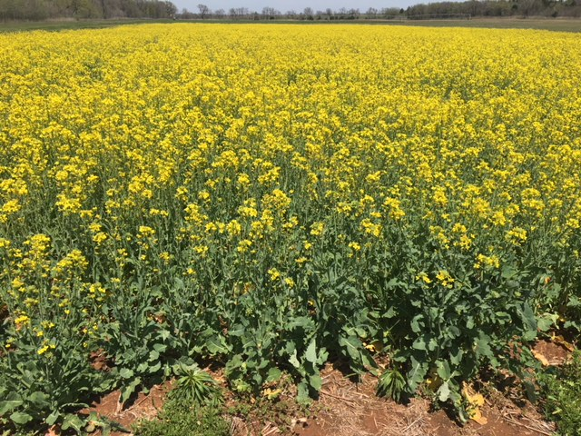
Canola
K:S Interaction Study
Trt | K (lbs/ac) | S (lbs/ac) | Description
1 | 0 | 0 | Check
2 | 0 | 12 | S-response
3 | 0 | 24 | S-response
4 | 60 | 0 | K-response
5 | 60 | 12 | K:S
6 | 60 | 24 | K:S
7 | 120 | 0 | K-response
8 | 120 | 12 | K:S
9 | 120 | 24 | K:S

Slide 27
Bermudagrass
Chickasha Bermudagrass Fertility Study
Established Spring 2012
Chickasha Bermudagrass
KCl CaCL
TRT | N Lb/ac | P Lb/ac | K lb/ac
1 | 0 | 0 | 0
2 | 50 | 0 | 0
3 | 100 | 0 | 0
4 | 150 | 0 | 0
5 | 200 | 0 | 0
6 | 150 | 26* | 0
7 | 150 | 29* | 108*
8 | 50 | 0 | 0
9 | 100 | 0 | 0
TRT | KCL Lb/ac | CaCl Lb/ac
1 | 0 | 0
2 | 42 | 0
3 | 125 | 0
4 | 208 | 0
5 | 292 | 0
6 | 0 | 33
7 | 0 | 97
8 | 0 | 161
9 | 0 | 225

Slide 28
Sorghum and Cotton
Relative Yield Trial
Cotton- 4 Cultivars
Sorghum Delayed N
Trt | Timing | Rate
1 | Pre | 0
2 | Pre | 120
3 | 0DAVD | 120
4 | 7 DAVD | 120
5 | 14 DAVD | 120
6 | 21 DAVD | 120
7 | 28 DAVD | 120
8 | 35 DAVD | 120
9 | 42 DAVD | 120
10 | 49 DAVD | 120
Treatment | Cultivar | Target pH
1 |  | 4.0
2 |  | 4.5
3 |  | 5.0
4 |  | 5.5
5 |  | 6.0
6 |  | 7.0
7 |  | 4.0
8 |  | 4.5
9 |  | 5.0
10 |  | 5.5
11 |  | 6.0
12 |  | 7.0

Slide 29
NEW PROJECTS
N Source, Method and Timing on Yield and Protein (Wheat)
Phosphorus Rich strip for P recommendations (Wheat and Corn)
Use of data from UAVs for Sensor Based Nitrogen Rate Calculator (Wheat and Corn )
Refinement of sumGDD, days from planting to sensing GDD>0, threshold temperature for GDD, use of live Mesonet data in SBNRC (Wheat and Corn)
On Farm NPKS Response strips (Wheat, Corn, Sorghum)
Timing of cover crop termination/impact on Nutrient cycling and weed control
On Farm NPKS Response strips
Dual Purpose Wheat Fertility
Cotton fertilizer management.
Sulfur and Potassium Fertilization, Response and yield prediction (Soybean)
Impact of soil acidity on new herbicides (different chemistry)
Expanding SBNRC Algorithms (outreach)

Slide 30
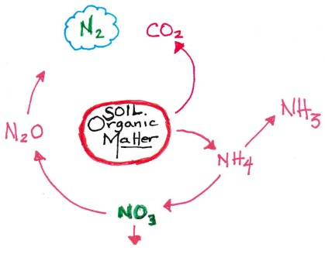
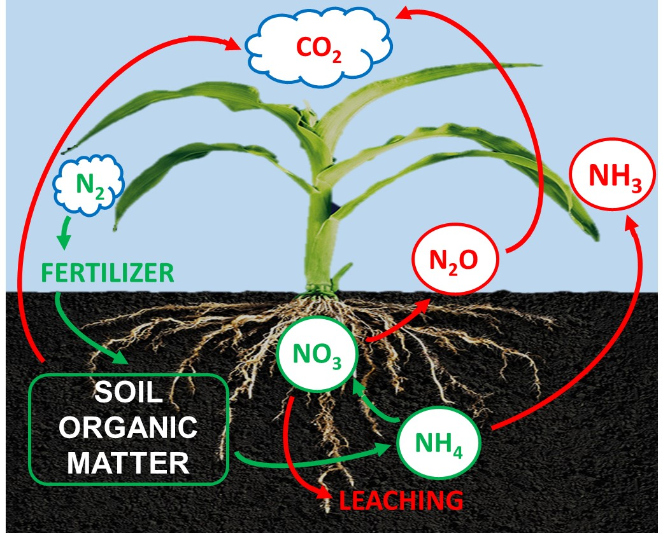
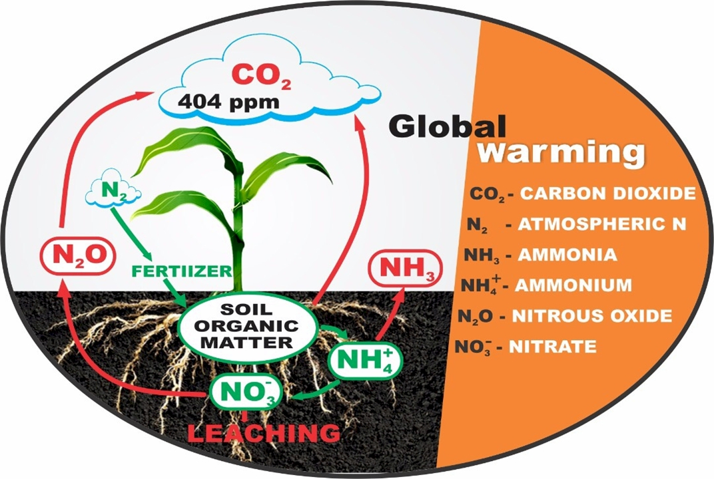


Slide 31
Hand Planter (uses)
Mosquito abatement USEPA, Northfield, IL
https://www.epa.gov/mosquitocontrol
Squash production, Valley Center, KS
Pumpkin production, Stillwater, OK
Wildlife food plots,
Home gardeners
Mid-row, maize, coffee plantations, Colombia

