Slide 1

Soil Fertility Research and Education Advisory Board Meeting,
Wednesday, May 15, 2019
Building 615, Agronomy Experiment Station
Stillwater, OK 74078
Agenda
11:30 am Convene at the Soil Fertility Shop, Lunch will be served
12:00 Opening Remarks, Dr. Brian Arnall
12:15 Soil Fertility Progress Report and Overview
Raun, Arnall, Zhang
12:30 Update on current projects
12:40 Student input/progress
12:50 Agronomic applications, iPhone apps
1:00 New Projects/Approval
1:15 Open Discussion
2:00 Adjourn

Slide 2
Fertilizer Advisory Board will meet in the spring of each year. The primary purpose of the Fertilizer Advisory Board is to ensure that fertilizer dealers and fertilizer manufacturers, farmers that use fertilizers, and other clientele that SB-432 (previously SB-314) serves, have a mechanism for input to suggest priority research areas that (a) benefit agricultural producers in the state of Oklahoma; (b) promote efficient use of fertilizers in agronomic crop and forage production while protecting the environment and groundwater supplies; and (c) fulfill the spirit and intent of SB-432.
1. Fertilizer Advisory Board Chair, Rick Howard
2. Fertilizer manufacturer, Adam Wood, KOCH Ind.
3. Fertilizer retail dealer (1) Mike Rosen, Wheeler Brothers
4. Fertilizer retail dealer (2) Kevin Brown, WB Johnston Grain Co.
5. Fertilizer retail dealer (3) Allan Nusser
6. Producer/Farmer, at large (1) Jimmy Kinder
7. Producer/Farmer, at large (2) Brent Rendel
8. CCA Board First Vice Chair, Jeff Ball
9. OARA President and CEO, Joe Neal Hampton
10. OARA Board Chair, Randy Gilbert, Bayer CropScience, Bethany, OK
11. Oklahoma Farm Bureau, Marla Peek
12. American Farmers and Ranchers, Terry Detrick
13. Oklahoma Department of Agriculture, Food and Forestry, Lance Kunneman
14. Oklahoma Department of Environmental Quality, Robert Huber

Slide 3

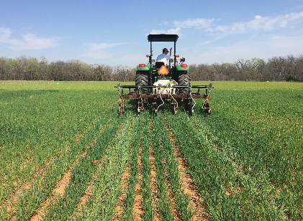
Influence of Method, Timing and N rate on Winter Wheat (Triticum aestivum L.) Grain yield and Estimated Plant Nitrogen Loss
Jagman dhillon
Objective: To determine the ideal timing and method of N placement for winter wheat.
Year | Location | Pre-plant N | Planting | Top-dress N | GDD>0
2016-17 | Efaw | 10/01/2016 | 10/14/2016 | 03/21/2017 | 118
2017-18 |  | 10/02/2017 | 10/16/2017 | 03/15/2018 | 100
2016-17 | Perkins | 10/01/2016 | 10/19/2016 | 03/09/2017 | 109
2017-18 |  | 10/02/2017 | 10/13/2017 | 03/07/2018 | 98

Slide 4
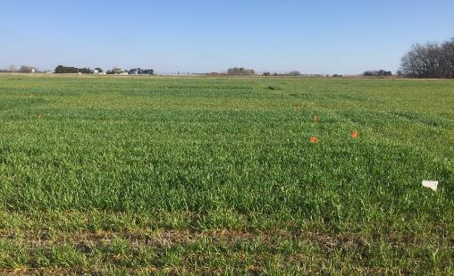
Influence of Method, Timing, and N rate on Winter Wheat (Triticum aestivum L.) Grain yield and Estimated Plant Nitrogen Loss
Jagman dhillon
Objective: To determine the ideal GDD>0 to apply N fertilizer when no pre-plant N is applied.
Location | Pre-plant N |  | Planting |  | Top-dress
 | 2016-17 | 2017-18 | 2016-17 | 2017-18 | 2016-17
Efaw | 10/01/2016 | 10/02/2017 | 10/14/2016 | 10/20/2017 | 01/12/2017 02/06/2017 02/23/2017 03/10/2017
Perkins | 10/01/2016 | 10/02/2017 | 10/19/2016 | 10/12/2017 | 01/12/2017 02/06/2017 02/23/2017 03/10/2017

Slide 5
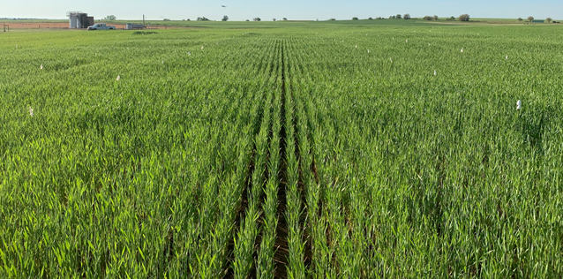
Dual Top-dress Nitrogen in winter wheat (Triticum aestivum L.) tyler carpenter
Objective: To determine the optimum dual-purpose top-dress strategies and nitrogen rate for winter wheat.
Locations: Lahoma and Hennessey
Rationale: GreenSeeker readings every two weeks near feekes 3, 4, 5, and 7. Early top-dress applied before visible N response. Late top-dress applied after visible N response is noticed.
Treatment | Early Top-dress (lbs ac-¹) | Late Top-dress (lbs ac-¹) | N Source
1 | 0 | 0 | ----
2 | 0 | 30 | UAN
3 | 0 | 60 | UAN
4 | 0 | 90 | UAN
5 | 30 | 0 | UAN
6 | 30 | 30 | UAN
7 | 30 | 45 | UAN
8 | 30 | 60 | UAN
9 | 30 | 60 | Urea
10 | 45 | 30 | UAN
11 | 60 | 30 | UAN
12 | 60 | 0 | UAN
13 | 90 | 0 | UAN

Slide 6
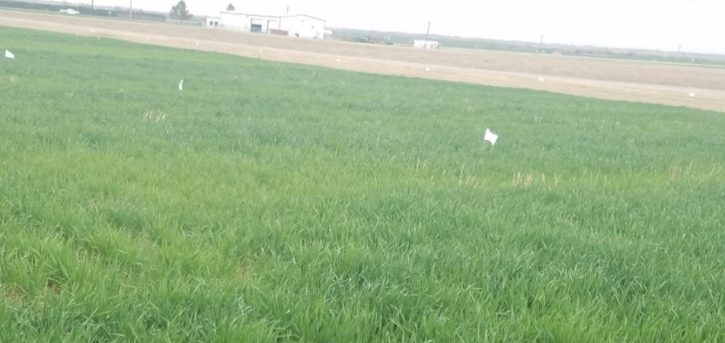
EARLY SENSOR BASED NDVI READINGS FOR DETECTING EARLY CHANGES IN PLANT BIOMASS IN WINTER WHEAT
EVA NAMBI
Objective: To determine the significance and value of early season sensor based NDVI readings, Experiment 222, and 502.
Rationale: Although early NDVI readings are below that needed to detect N response, they can be significant in terms of detecting early changes in plant biomass. Reading are taken from November to March.
Trt | Pre-plant N (lbs N ac⁻¹) | Pre-plant P (lb P₂O₅ ac⁻¹) | Pre-plant K (lb K₂O ac⁻¹)
1 | 0 | 0 | 0
2 | 0 | 40 | 60
3 | 20 | 40 | 60
4 | 40 | 40 | 60
5 | 60 | 40 | 60
6 | 80 | 40 | 60
7 | 100 | 40 | 60
8 | 60 | 0 | 60
9 | 60 | 20 | 60
10 | 60 | 60 | 60
11 | 60 | 80 | 60
12 | 60 | 60 | 0
13 | 100 | 80 | 60
14 | 60 | 40 | 60(Sul-Po-Mag)

Slide 7
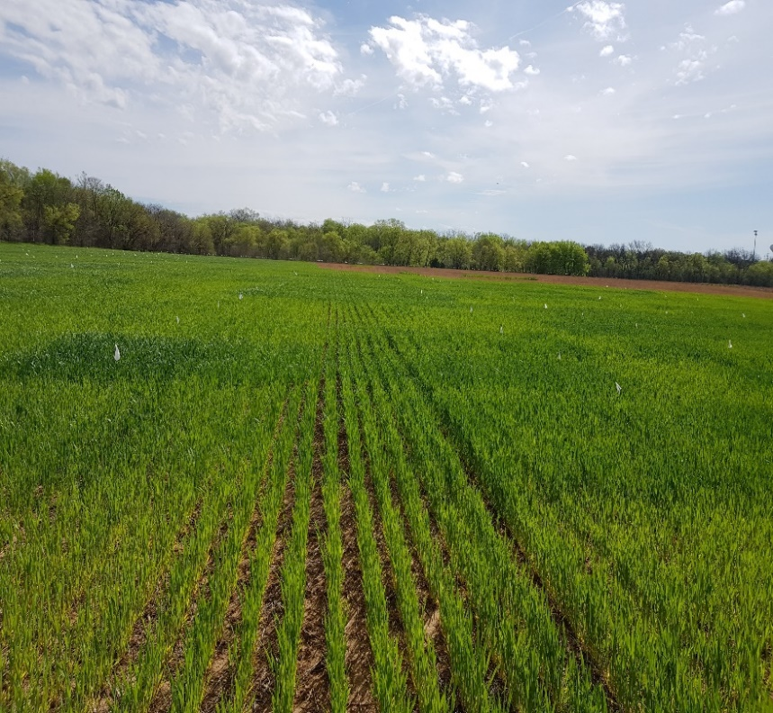
winter wheat response to time of nitrogen application
Lawrence Aula
Objective: Evaluate the effect of time of N application on winter wheat grain yield and NUE
Treatment | Preplant N (30 days) | Preplant N (7 days) | Side dress N (lbs ac⁻¹) | Total N (lbs ac⁻¹)
1 | 0 | 0 | 0 | 0
2 | 40 | 0 | 0 | 40
3 | 80 | 0 | 0 | 80
4 | 120 | 0 | 0 | 120
5 | 0 | 40 | 0 | 40
6 | 0 | 80 | 0 | 80
7 | 0 | 120 | 0 | 120
8 | 0 | 0 | 40 | 40
9 | 0 | 0 | 80 | 80
10 | 40 | 0 | 40 | 80
11 | 0 | 40 | 40 | 80
12 | 80 | 0 | 40 | 120
13 | 0 | 80 | 40 | 120
14 | 40 | 40 | 40 | 120
Urea (46-0-0)

Slide 8
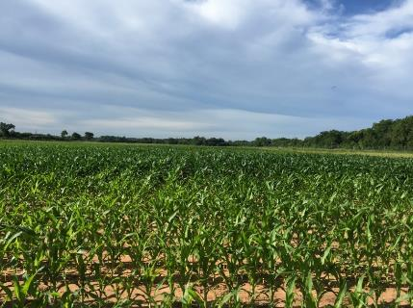
Maize Regional Trials
Tyler Lynch, Jagman Dhillon
Objective: Refinement of the OSU sensor based N rate calculator (SBNRC) and optimum fertilizer N rates.
Pre-plant: ATV UAN spray
Top-dress: Drop down nozzles
Treatment | Pre-plant N (lb N ac⁻¹) | Top-dress N (lb N ac⁻¹)
1 | 0 | 0
2 | 200 | 0
3 | 40 | 0
4 | 40 | 30
5 | 40 | 60
6 | 40 | 90
7 | 40 | 120
8 | 40 | 150
9 | 40 | 180
10 | 80 | 0
11 | 120 | 0
12 | 160 | 0
Crop | Location | Pre-plant N | Planting | Top-dress | Sum of GDD
Maize | Efaw | 04/16/2018 | 04/24/2018 | 06/06/2018 | 972
 | Lake Carl Blackwell | 04/19/2018 | 05/1/2018 | 06/06/2018 | 936

Slide 9
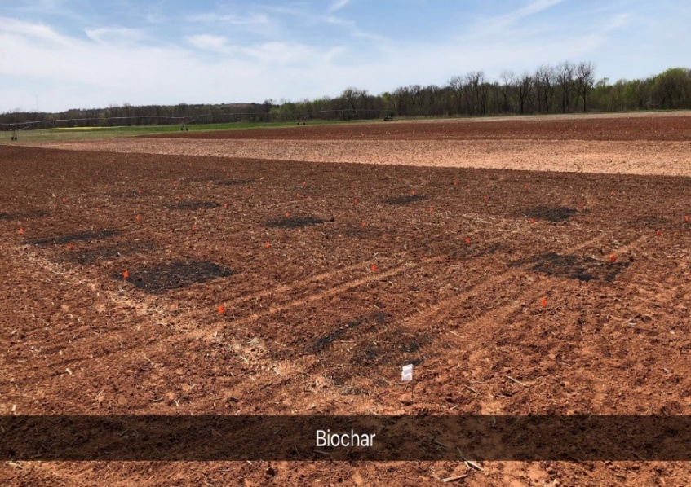
THE EFFECT OF AMMONIUM N – FAST PYROLYSIS PINE WOOD BIOCHAR COMPLEX ON NITROGEN USE EFFICIENCY AND YIELD OF MAIZE (Zea mays L.)
PETER OMARA
Objective: To evaluate the effect of increasing rate of biochar-ammonium N fertilizer complex on maize grain yield, NUE and soil chemical properties
Treatment |  | N rate (lbs ac⁻¹) | Biochar (ton ac⁻¹)
1 | Check | 0 | 0
2 | N | 45 | 0
3 | N | 90 | 0
4 | N | 135 | 0
5 | Biochar | 0 | 4.5
6 | Biochar | 0 | 9
7 | Biochar | 0 | 13.5
8 | N x Biochar | 45 | 4.5
9 | N x Biochar | 90 | 9
10 | N x Biochar | 135 | 13.5

Slide 10
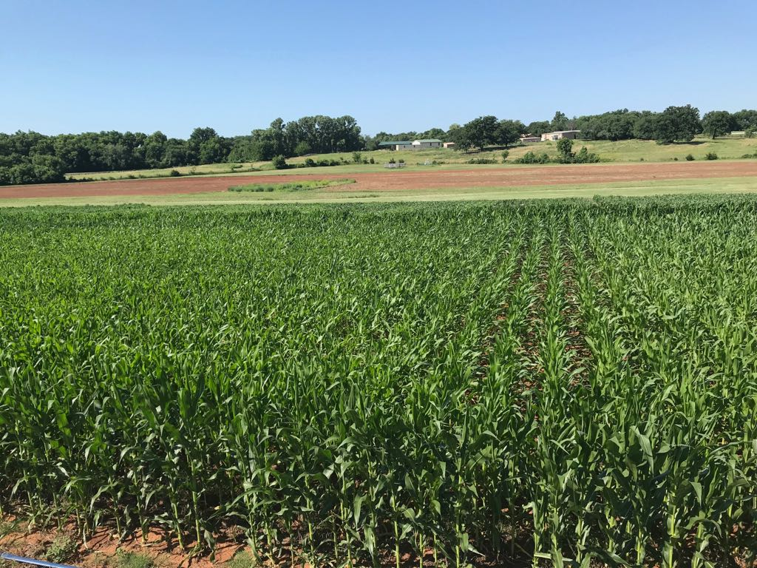
PHOSPHORUS AVAILABILITY AND MAIZE (ZEA MAYS L.) GRAIN YIELD RESPONSE TO SUPER SATURATION OF PHOSPHORUS BANDS WITH GYPSUM IN LOW PH SOIL
PETER OMARA
Objective: To determine the effect of dual band application of P and gypsum on P availability and maize grain yields in acidic soils.
Treatment | Description | P (lbs ac⁻¹) | Ca (lbs ac⁻¹)
1 | Check | 0 | 0
2 | P | 9 | 0
3 | P | 18 | 0
4 | P | 27 | 0
5 | Ca | 0 | 9
6 | Ca | 0 | 18
7 | Ca | 0 | 27
8 | P x Ca | 9 | 9
9 | P x Ca | 18 | 18
10 | P x Ca | 27 | 27

Slide 11
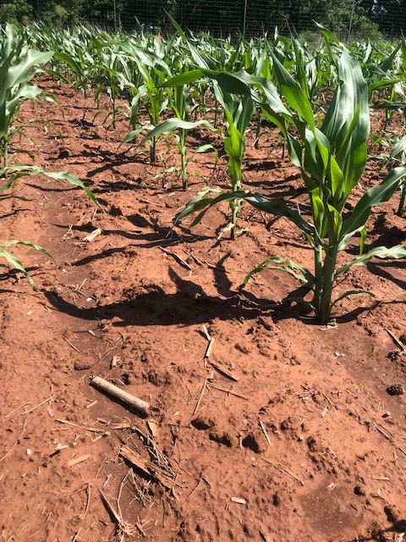
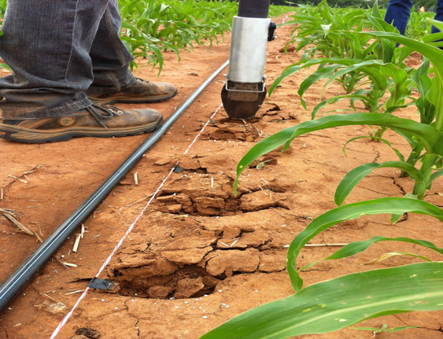
MAIZE GRAIN YIELD RESPONSE TO MISSES AS INFLUENCED BY NITROGEN AND PLANT POPULATION
Fikayo Oyebiyi
Objective: To evaluate the effect of misses or blanks as influenced by N rate and plant population.
Treatment | 5-plant Sequence | N-Rate (lbs ac⁻¹) | Population (seeds ac⁻¹)
1 | XXXXX | 0 | 18,000
2 | XXOXX | 0 | 18,000
3 | XOXOX | 0 | 18,000
4 | XOOOX | 0 | 18,000
5 | XXXXX | 62 | 18,000
6 | XXOXX | 62 | 18,000
7 | XOXOX | 62 | 18,000
8 | XOOOX | 62 | 18,000
9 | XXXXX | 0 | 36,000
10 | XXXXX | 62 | 36,000
11 | XOXOX | 0 | 36,000
12 | XOXOX | 62 | 36,000

Slide 12

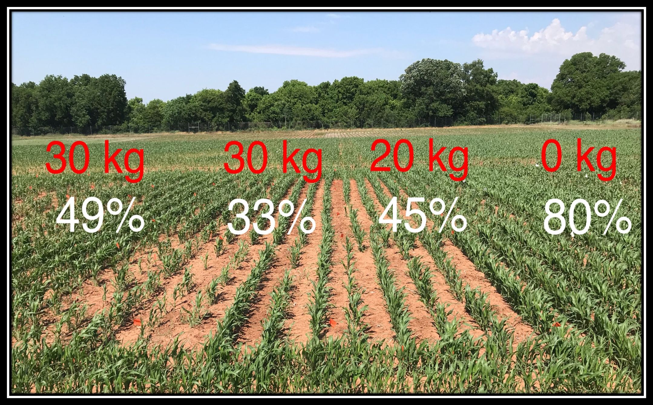
Effect of applying Nitrogen with
Sorghum Seed (Sorghum bicolor) on Emergence and Grain yield
Elizabeth Eickhoff
Objective: Evaluate the impact of applying different rates of nitrogen with the seed on seedling emergence, and final grain yield in sorghum with different populations.
Trt | Pre-Plant N (lbs ac⁻¹) | N with Seed (lbs ac⁻¹) | Mid-Season N (lbs ac⁻¹) | Population (seeds ac⁻¹)
1 | 0 | 0 | 0 | 40,485
2 | 0 | 0 | 0 | 80,971
3 | 0 | 0 | 0 | 80,971
4 | 0 | 9 | 0 | 40,485
5 | 0 | 9 | 0 | 60,728
6 | 0 | 9 | 0 | 80,971
7 | 0 | 18 | 0 | 40,485
8 | 0 | 18 | 0 | 60,728
9 | 0 | 18 | 0 | 80,971
10 | 0 | 27 | 0 | 40,485
11 | 0 | 27 | 0 | 60,728
12 | 0 | 27 | 0 | 80,971
13 | 27 | 0 | 0 | 60,728
14 | 0 | 0 | 27 | 60,728
Emergence Results (2017 & 2018)
  10 kg N ha⁻¹ – 16% loss
  20 kg N ha⁻¹ – 22% loss
  30 kg N ha⁻¹ – 38% loss

Slide 13

Optimum Preplant Nitrogen in
Sorghum (Sorghum bicolor)
Gwen WehmeyeR
Objective: To evaluate the effect of different preplant and side-dress nitrogen applications in sorghum.
Treatment | Pre-plant N (lbs N ac⁻¹) | Side-dress N (lbs N ac⁻¹) | Total N (lbs N ac⁻¹)
1 | 0 | 0 | 0
2 | 15 | 0 | 15
3 | 30 | 0 | 30
4 | 45 | 0 | 45
5 | 60 | 0 | 60
6 | 90 | 0 | 90
7 | 0 | 30 | 30
8 | 15 | 30 | 45
9 | 30 | 30 | 60
10 | 45 | 30 | 75
11 | 60 | 30 | 90
12 | 90 | 30 | 120

Slide 14
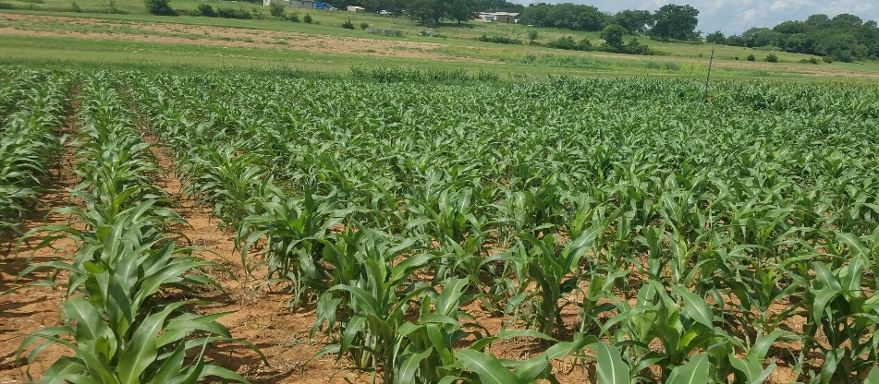
EFFECT OF PRE-PLANT NITROGEN AND PHOSPHORUS APPLICATION ON SORGHUM (SORGHUM BICOLOR) GRAIN YIELDS
EVA NAMBI
Objective: To determine NH4+, NO3- effects on sorghum growth when dual knifed preplant with APP and the effect of dual knife applications of NH4+-N and APP on sorghum leaf P concentration and grain yield.
Rationale: Different studies have been carried out to determine the effect of N and P placement methods on the P nutrition and final grain yield of wheat both in the field and greenhouse conditions, however information is limited with sorghum.
Trt | App. | Source | DAP lbs P₂O₅ ac-¹ | APP lbs P₂O₅ac⁻¹ | UAN lbs N ac⁻¹
1 | No N, No P |  | - | -
2 | N, No P | UAN | - | - | 100
3 | Broadcast | DAP | 20 | - | 92.2
4 | Broadcast | DAP | 40 | - | 84.3
5 | Broadcast | DAP | 60 | - | 76.5
6 | Dribble surface band | APP | - | 20 | 94.1
7 | Dribble surface band | APP | - | 40 | 88.2
8 | Dribble surface band | APP | - | 60 | 82.4
9 | Dual placement | APP | - | 20 | 94.1
10 | Dual placement | APP | - | 40 | 88.2
11 | Dual placement | APP | - | 60 | 82.4

Slide 15
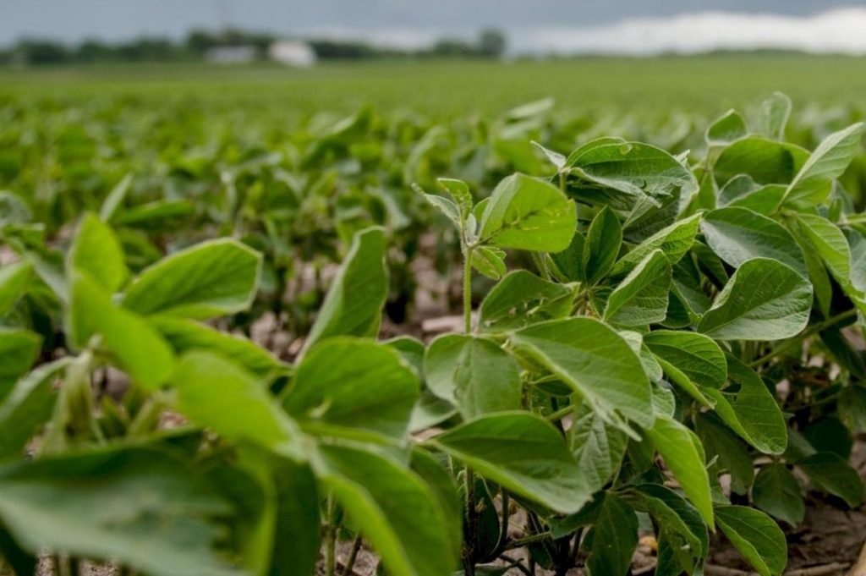
Seed treatment effect on
Nodulation and Yield of Soybean (Glycine max)
Elizabeth Eickhoff
Objective: Evaluate the impact of molybdenum and inoculant seed treatments on nodulation, N uptake, and yield of soybeans. Additionally, a broadcast N application will be evaluated.
Locations: Lake Carl Blackwell, Lahoma, and Bixby
Treatment |  | Molybdenum Rate (oz/100lbs) | Inoculant Rate (oz/100lbs) | Broadcast N Planting (lbs ac⁻¹) | Broadcast N Mid-season (lbs ac⁻¹)
1 | Check | 0 | 0 | 0 | 0
2 | Mo | 4 | 0 | 0 | 0
3 | Inoc | 0 | 1.8 | 0 | 0
4 | Inoc x2 | 0 | 3.6 | 0 | 0
5 | Urea | 0 | 0 | 40 | 0
6 | Mo+Inoc | 4 | 1.8 | 0 | 0
7 | Mo+ Inoc x2 | 4 | 3.6 | 0 | 0
8 | Mo + Urea | 4 | 0 | 40 | 0
9 | Inoc +Urea | 0 | 1.8 | 40 | 0
10 | Inoc x2 + Urea | 0 | 3.6 | 40 | 0
11 | Mo+ Inoc+Urea | 4 | 1.8 | 40 | 0
12 | Mo+Inoc x2+Urea | 4 | 3.6 | 40 | 0
13 | Mo+Inoc+ Urea @R2 | 4 | 1.8 | 0 | 40

Slide 16
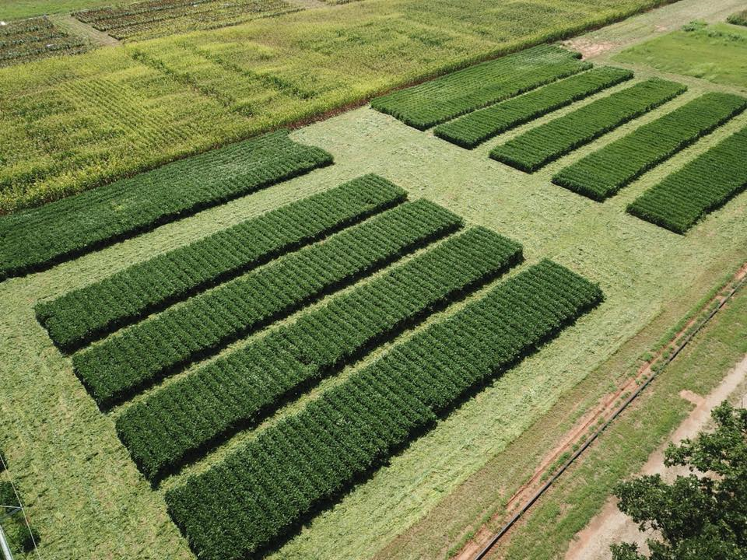
Optimum Sulfur Application for
Soybeans in Oklahoma
Gwen WehmeyeR
Objective: Effect of sulfur application rate and timing on soybeans to further increase oil content and grain protein.
Treatment | Fertilizer | Timing | lbs S ac -1 | Lbs carrier N ac⁻¹ | lbs ac⁻¹ total product
1 | check | . | 0 | 0 | 0
2 | Ammonium Nitrate | Preplant | 0 | 12.5 | 60.7
3 | Ammonium Sulfate | Preplant | 4.5 | 4.5 | 20.5
4 | Ammonium Sulfate | Preplant | 9.8 | 8.9 | 40.1
5 | Ammonium Sulfate | Preplant | 14.3 | 12.5 | 60.7
6 | Ammonium Sulfate | Sidedress | 4.5 | 4.5 | 20.5
7 | Ammonium Sulfate | Sidedress | 9.8 | 8.9 | 40.1
8 | Ammonium Sulfate | Sidedress | 14.3 | 12.5 | 60.7

Slide 17
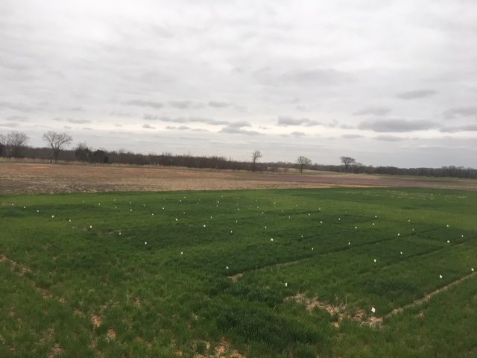
Residual N effect following a failed crop
Tyler lynch
Objective: Evaluate residual N effect on the following crop from a failed summer sorghum crop.
Treatment | Previous Crop | Previous Crop Pre N rate (lb N/ac) | Wheat Pre N Rate (lb N/ac)
1 | Sorghum | 0 | 0
2 | Sorghum | 30 | 0
3 | Sorghum | 60 | 0
4 | Sorghum | 90 | 0
5 | Sorghum | 120 | 0
6 | Sorghum | 150 | 0
7 | Sorghum | 60 | 30
8 | Sorghum | 60 | 60
9 | Sorghum | 60 | 90
10 | Sorghum | 60 | 120
11 | Sorghum | 60 | 150

Slide 18

South Central great plains winter wheat (n) algorithm
Treatment | N - Rate (lb N ac⁻¹) | Yield (bu ac⁻¹) | Net Return ($ ac⁻¹)
Split Application | 100 | 35 ± 16 | 154 ± 100
SBNRC | 45 ± 21 | 34 ± 16 | 172 ± 94
Average Difference |  |  | 12 ± 25
 |  |  | Max: 66
 |  |  | Min: -52
Fertilizer Price (28-0-0) = $0.56/lb N
Grain Price = $6.00/bu
34 site years
  2010-2018
  5 Oklahoma locations
Locations: Stillwater, Perkins, LCB, Lahoma and Hennessey
http://nue.okstate.edu/SBNRC/mesonet.php
Option 3: Winter Wheat, South Central Great Plains

Slide 19

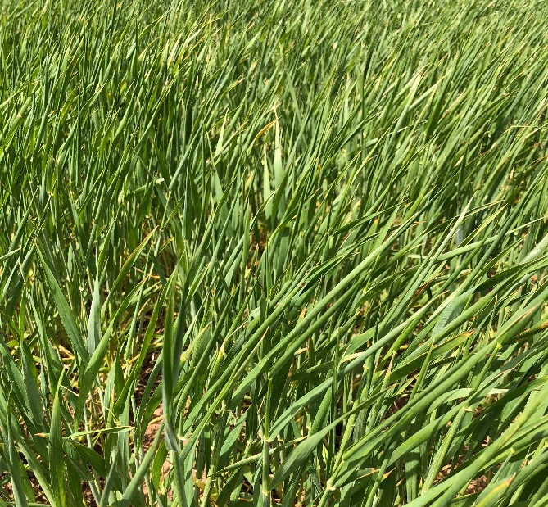
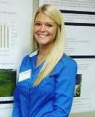
Influence of Preplant Topdress on Wheat Grain Yield
Gwen Wehmeyer
TRT | Preplant N rate lb/ac† | Top-dress N rate lb/ac‡ |  | ^{Total N}
 |  | February | March
1.** | 0 | - | 0 | 0
2. | 0 | - | 45 | 45
3. | 0 | - | 90 | 90
4. | 0 | - | 135 | 135
5.** | 45 | - | 0 | 45
6. | 45 | - | 45 | 90
7. | 45 | - | 90 | 135
8. | 45 | - | 45* | 90
9.** | 90 | - | 0 | 90
10. | 90 | - | 45 | 135
11. | 90 | - | 45* | 135
12. | 90 | - | 90 | 180
13. | 45 | 45 | 45 | 135
14. | 0 | 45 | 45 | 90
† - Pre-Plant N applied as urea (46-0-0) ‡ - Top-Dress N applied as UAN (28-0-0) * - UAN ** - YP Plot
Objective: To evaluate the effect of topdress applications in winter wheat on components of grain yield

Slide 20
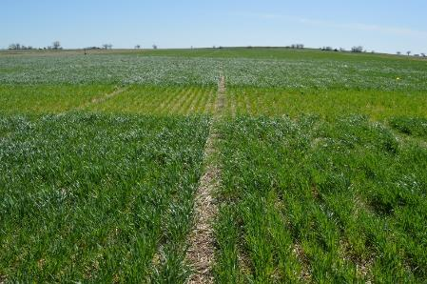
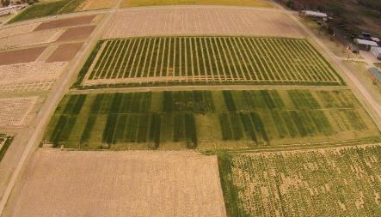

Sequential NDVI Measurements in Winter Wheat for Improved
Prediction of Winter Wheat Grain Yield and Mid-Season N Rate
Bruno Morandin Figueiredo
Experiment 222, Stillwater, OK
11 NDVI readings were taken from Dec. 21, 2015 to April 12, 2016
Experiment 502, Lahoma, OK
10 NDVI readings were taken from Dec. 18, 2015 to April 07, 2016
Bruno Morandin
Figueiredo

Slide 21



Coefficient of Determination (NDVI vs Yield) at each reading, where GDD>0 was tabulated, Exp. 222, Exp. 502, 2016 and 2017
PLATEAU | INTERCEPT | SLOPE | JOINT | RSQ
0.87955 | -0.88423 | 0.01593 | 110.723 | 0.80
X | Y
55.61006 | 0
110.723 | 0.87955

Slide 22
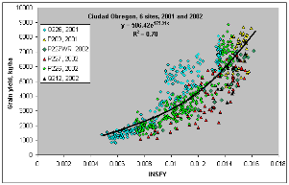
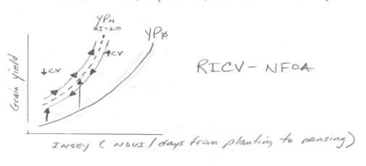
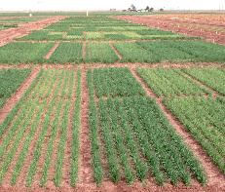
Use of Coefficient Variation (CV) from NDVI Readings, to Improve Yield Prediction
Bruno Morandin Figueiredo
Objective: To refine the use of CV (coefficient variation) data coming from Normalized Difference Vegetative Index (NDVI) readings for predicting wheat grain yield
Bruno
Morandin
Figueiredo

Slide 23
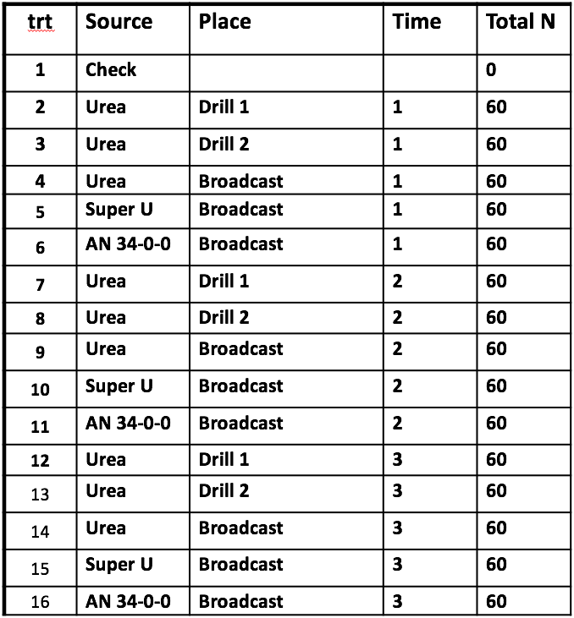
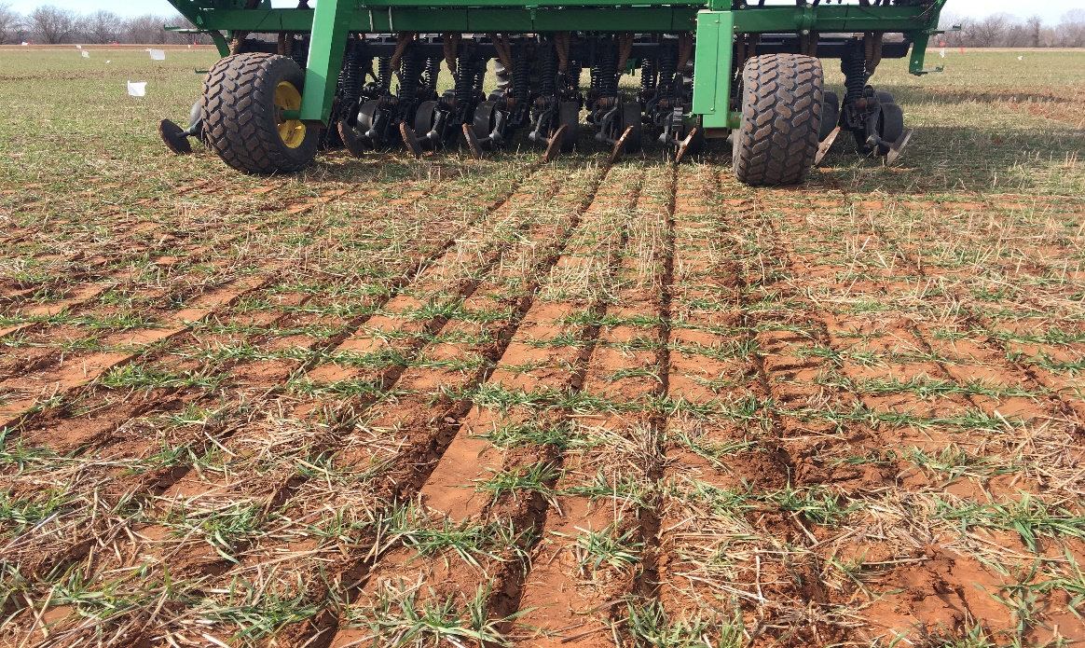

Winter Wheat Topdressing Response to Nitrogen Method Variation
Brent Ballagh
Results
In most scenarios benefits were negligible but
drilling fertilizer did not have a negative impact.
Drill employed did impact results and row closure.
Under high loss environments drilling N increased
yield by 10%, 5-8 bushel per acre.
Objective:
Quantify whether there is a potential for gain in yield or protein by placing nitrogen below the soil surface of a standing wheat crop in bands with a grain drill.

Slide 24
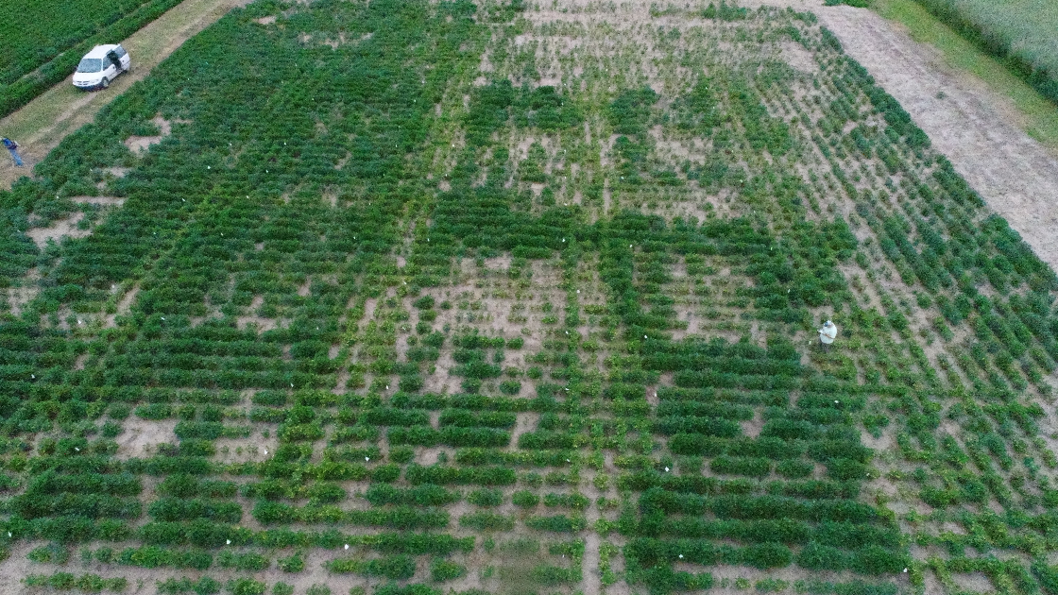
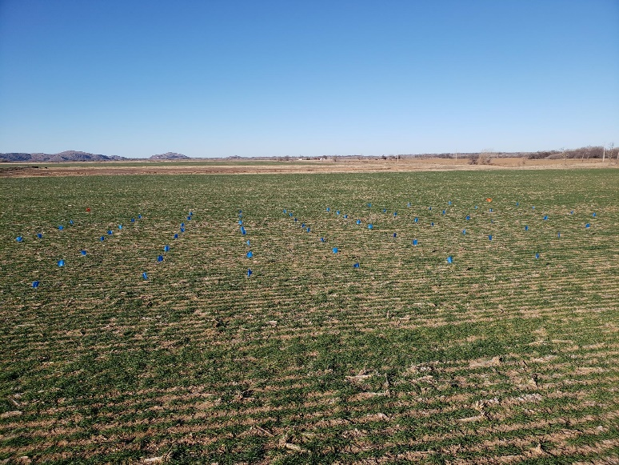

¹Evaluation of SBNRC and associated Impact in the Region
²Evaluation of OSU Potassium Recommendations on Soybeans
Vaughn Reed
In 2018, 3 locations
  Check, ½ x, 1x, and 2x rate, at preplant and topdress, plus foliar treatments
In 2019, looking towards adding another type of foliar treatment, and another location.
Considering if there could be a regional impact on SBNRC
Evaluating two OSU sensors, and their correlation to yield and each other
Optimum N Rate
Vaughn Reed

Slide 25
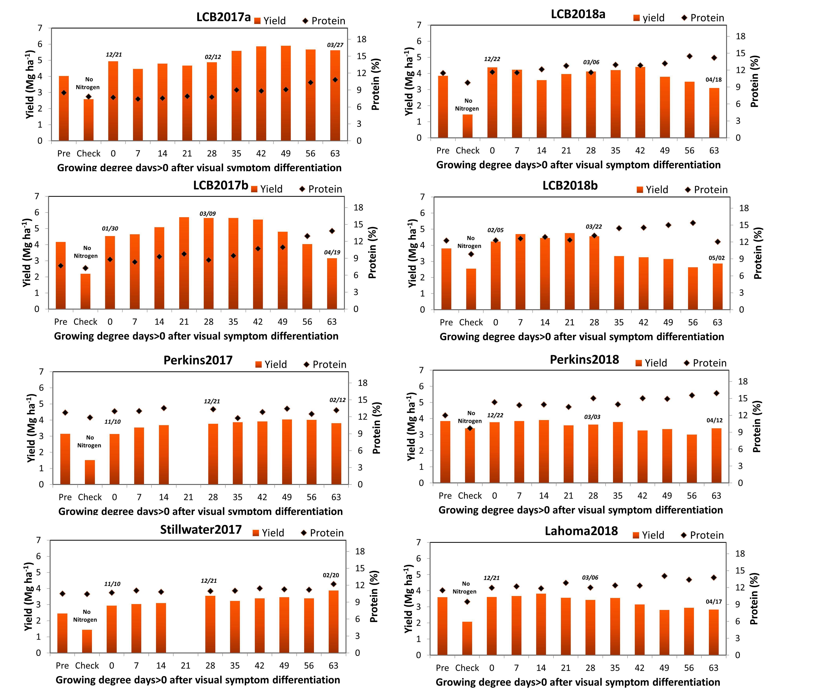
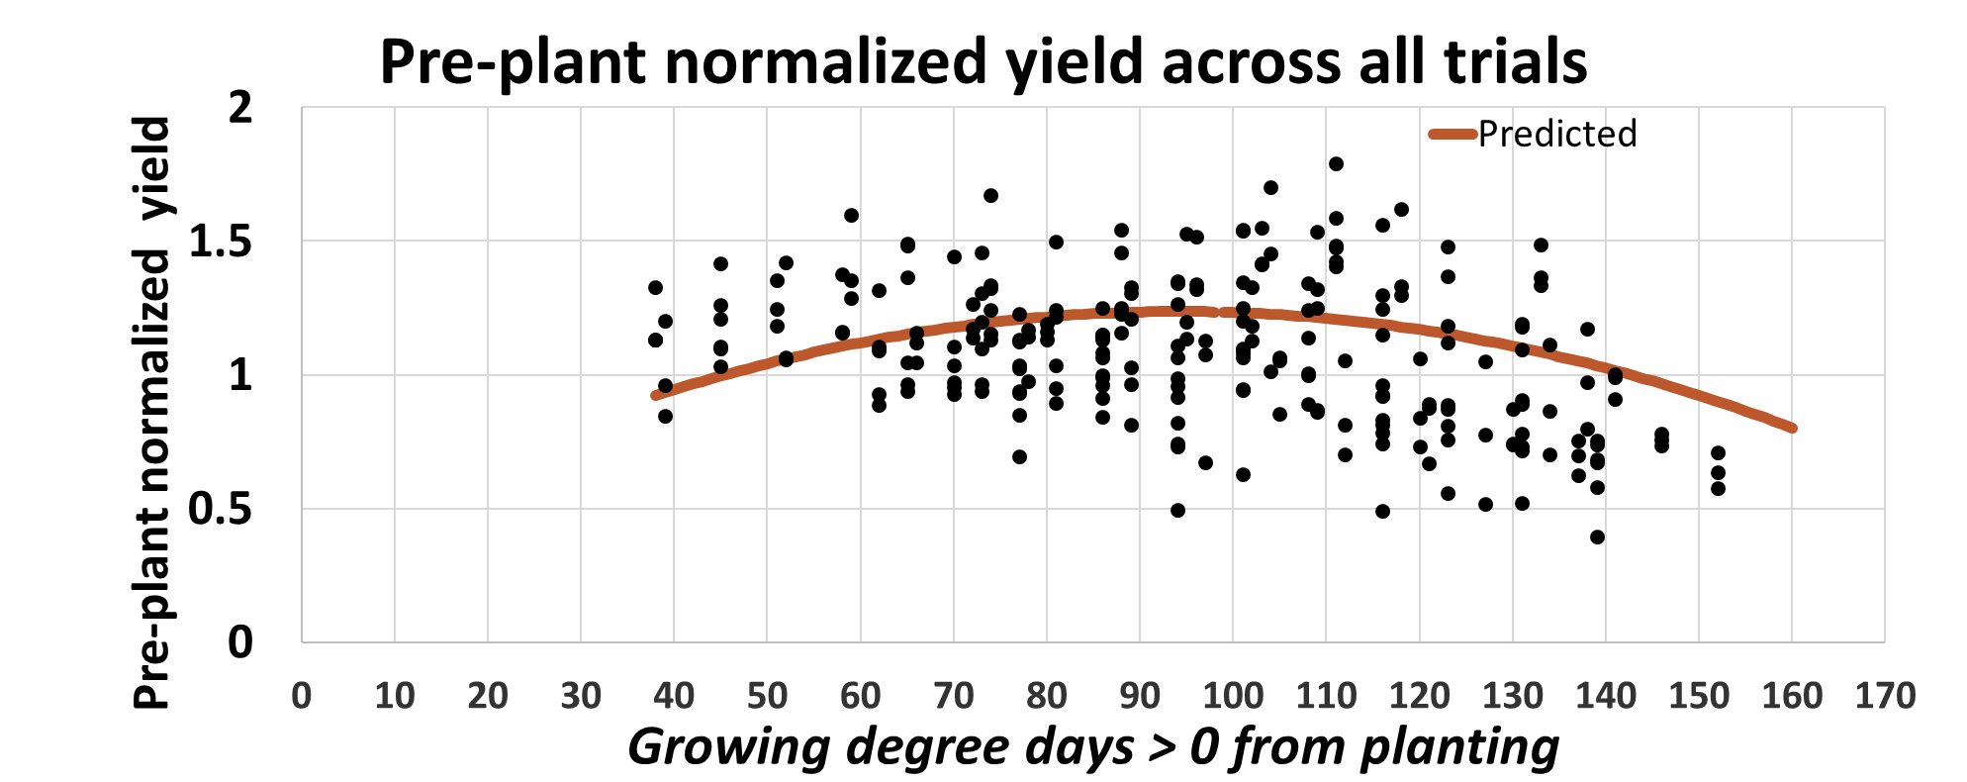
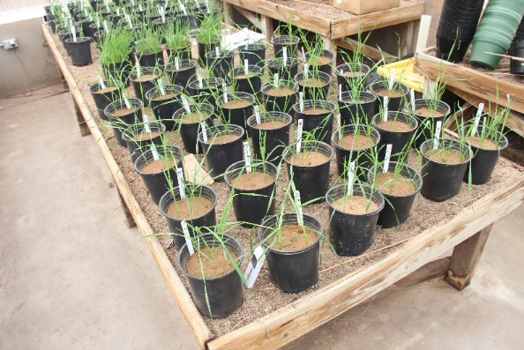
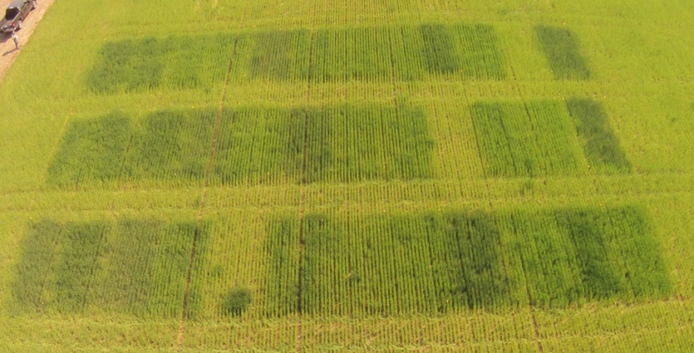

Nitrogen and Phosphorus Top-dress Timing
Joao Souza
Objective: Investigate the impact of delaying a top-dress N and P application in winter wheat
Joao Souza

Slide 26
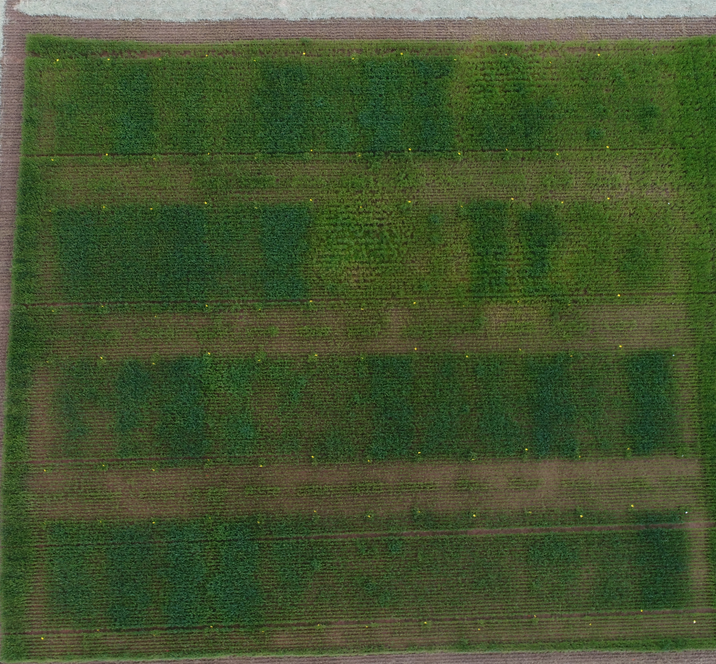
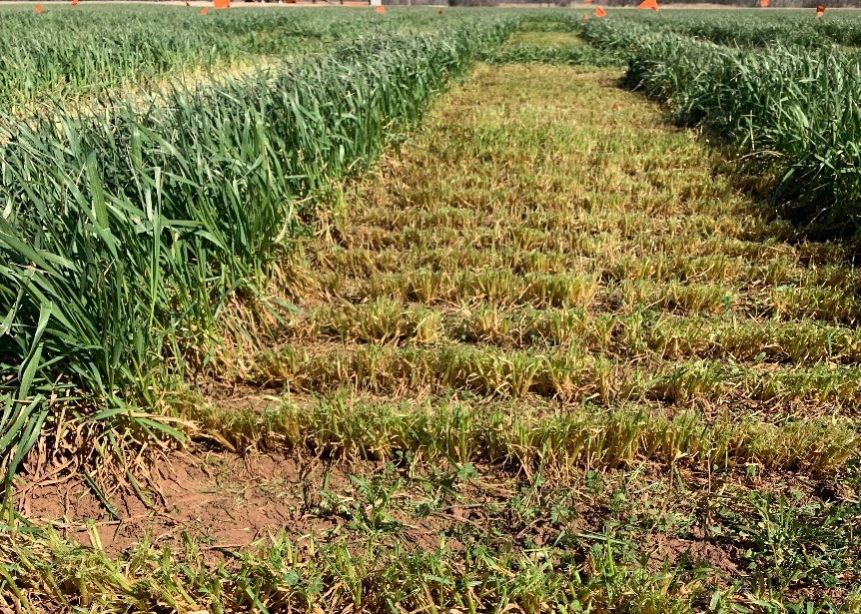

Evaluation of Nitrogen Management in Graze Out Wheat and Summer Cover Crops
Bronc Finch
In 2019, 3 locations
  60 and 120 lbs N applied pre-plant
  60/60 N at pre and top-dress
Summer crops
  Millet and Cowpeas
  30 or 0 lbs N applied pre-plant
Determining the ideal combination of Nitrogen rate, timing and summer crop to achieve best producing forage.
Bronc Finch

Slide 27
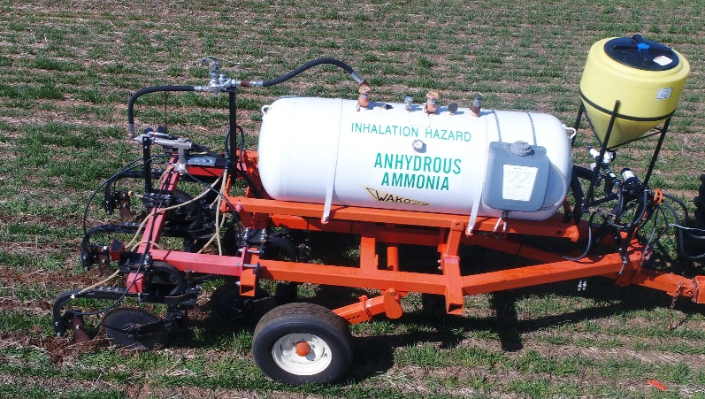
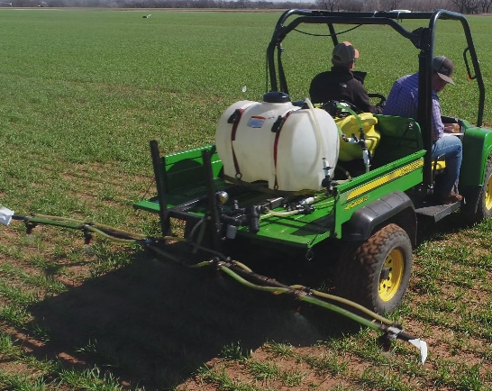
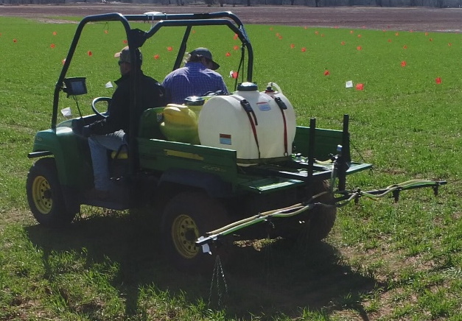
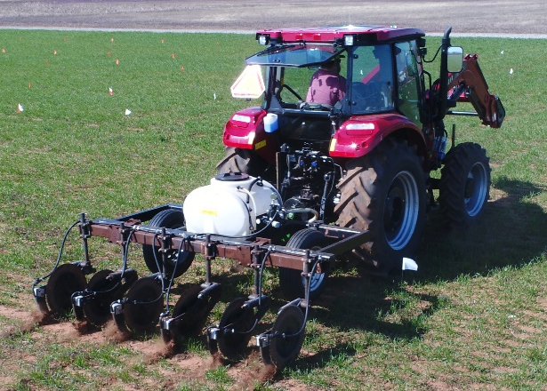
Nitrogen Sources and Methods in Winter Wheat
Wheat Top-dress Method
Trt | N Rate | Fert
1 | 0 | N/A
2 | 60 | Urea
3 | 60 | Super U
4 | 60 | ANVOL
5 | 60 | A.N.
6 | 60 | UAN-Stream
7 | 60 | UAN-Flat Fan
8 | 60 | UAN-Knife
9 | 60 | ANVOL-UAN-stream
10 | 60 | ANVOL-UAN-Fan
11 | 120 | UAN-stream
12 | 60 | Anhydrous Ammonia

Slide 28
Wheat Quality
Wheat Protein Progression
Wheat NUE Study
Trt | Pre N | Top-Dress | Flag Leaf | Anthesis
1 | 0% | 0%
2 | 50% | 0%
3 | 100% | 0%
4 | 50% | 50% N
5 | 25% | 75% N
6 | 25% | 75% N + S
7 | 25% | 75% N | N
8 | 25% | 75% N + S | N
9 | 25% | 75% N |  | N
10 | 25% | 75% N + S |  | N
11 | 25% | 75% N |  | N + S
12 | 25% | 75% N + S |  | N + S
Trt | Line | N-Rate lb ac⁻¹
1 | Gallagher | 40
2 | Gallagher | 80
3 | Gallagher | 120
4 | Gallagher | 150
5 | Smiths Gold | 40
6 | Smiths Gold | 80
7 | Smiths Gold | 120
8 | Smiths Gold | 150
9 | OK13209 | 40
10 | OK13209 | 80
11 | OK13209 | 120
12 | OK13209 | 150
13 | Lone Rider | 40
14 | Lone Rider | 80
15 | Lone Rider | 120
16 | Lone Rider | 150
Total N – 60 BPA = 120 N
Top-Dress S = 10 lbs
Flag Leaf N = 24 lbs
Anthesis = 10 lbs
Pre-Plant N : Urea
Top-dress N: UAN (28-0-0)
Top-dress S: Ammonium Thiosulfate (12-0-0-26)
Flag and Anthesis N: UAN + H20 (14-0-0)
Flag and Anthesis N + S: UAN + Ammonium Thiosulfate+ H2O
Anthesis- UAN 6.4 GPA, ATS 3.8 GPA H20 9.8 GPA

Slide 29
Bermudagrass
Chickasha Bermudagrass Fertility Study
Established Spring 2012
TRT | N Lb/ac | P Lb/ac | K lb/ac
1 | 0 | 0 | 0
2 | 50 | 0 | 0
3 | 100 | 0 | 0
4 | 150 | 0 | 0
5 | 200 | 0 | 0
6 | 150 | 26* | 0
7 | 150 | 29* | 108*
8 | 50 | 0 | 0
9 | 100 | 0 | 0

Slide 30
Bermudagrass
Chickasha Bermudagrass
KCl, CaCl
TRT | KCL Lb/ac | CaCl Lb/ac
1 | 0 | 0
2 | 42 | 0
3 | 125 | 0
4 | 208 | 0
5 | 292 | 0
6 | 0 | 33
7 | 0 | 97
8 | 0 | 161
9 | 0 | 225
 | KCl | CaCl | Yield
1 | 0 |  | 2.71
2 | 42 |  | 3.02
3 | 125 |  | 3.61
4 | 208 |  | 3.77
5 | 292 |  | 3.58
6 |  | 33 | 2.92
7 |  | 97 | 2.96
8 |  | 161 | 2.53
9 |  | 225 | 3.18

Slide 31
Sorghum and Cotton 2019
Sorghum Delayed N
Potassium use in Cotton
Trt | Timing | Rate
1 | Pre | 0
2 | Pre | 120
3 | 0DAVD | 120
4 | 7 DAVD | 120
5 | 14 DAVD | 120
6 | 21 DAVD | 120
7 | 28 DAVD | 120
8 | 35 DAVD | 120
9 | 42 DAVD | 120
10 | 42 DAVD | 120
Trt | Pre-plant |  | Pin Head Sq
 | Prod | Rate (K₂O) | Prod | Rate (K₂O)
1 | Check | - | - | -
2 | MOP | 30 | - | -
3 | Aspire | 30 | - | -
4 | MOP | 60
5 | Aspire | 60
6 | MOP | 30 | MOP | 30
7 | Aspire | 30 | Aspire | 30
8 | MOP | 0 | Foliar
9 | MOP | 30 | Foliar
10 | MOP | 60 | Foliar

Slide 32
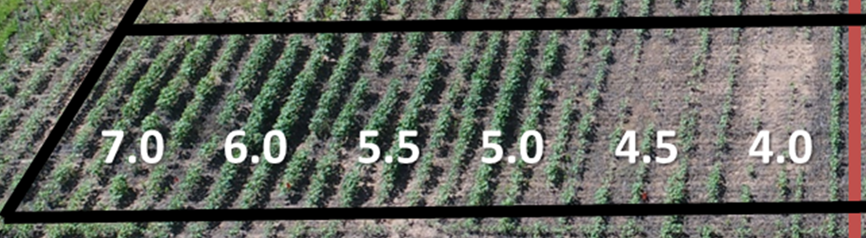
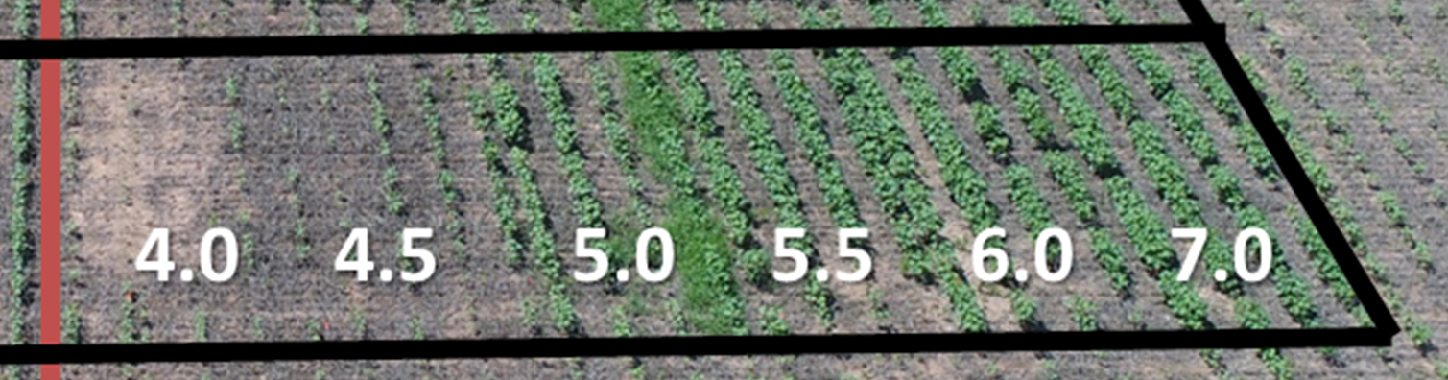
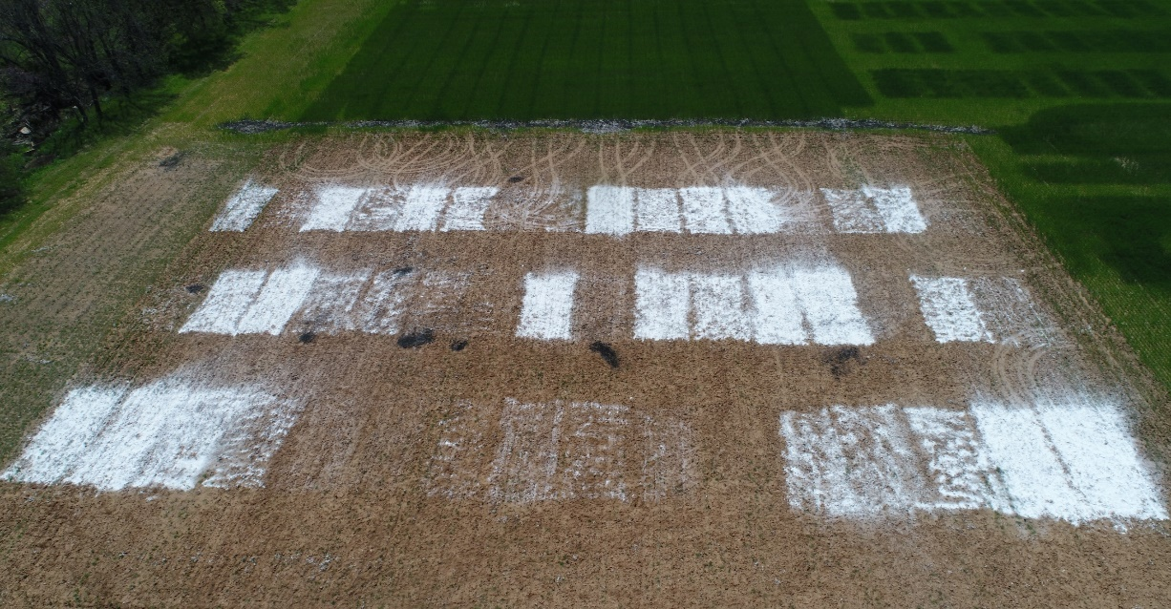
Soil pH in Cotton
Relative Yield Trial
Cotton- 2 Cultivars
Treatment | Cultivar | Target pH
1 | 1 | 4.0
2 | 1 | 4.5
3 | 1 | 5.0
4 | 1 | 5.5
5 | 1 | 6.0
6 | 1 | 7.0
7 | 1 | 7.5
8 | 1 | 8.0
9 | 2 | 4.0
10 | 2 | 4.5
11 | 2 | 5.0
12 | 2 | 5.5
13 | 2 | 6.0
14 | 2 | 7.0
15 | 2 | 7.5
16 | 2 | 8.0

Slide 33
NEW PROJECTS
Delayed Phosphorus Application
Phosphorus Rich strip for P recommendations (Wheat and Corn)
Refinement of sumGDD, days from planting to sensing GDD>0, threshold temperature for GDD, use of live Mesonet data in SBNRC (Wheat and Corn)
Dual Purpose Wheat Fertility
Double Crop Fertilization Strategies.
Cotton fertilizer management.
Expanding SBNRC Algorithms High Plains Corn

