Slide 1
Soil Fertility Research and Advisory Board
SB314

Slide 2
SB 314 Update Submitted to The Soil Fertility Research and Education Advisory Board
Bill Raun, John Solie, Marvin Stone, Randy Taylor, Hailin Zhang, David Porter, Robert L. Westerman
1. SB 314, amending the Oklahoma Fertilizer Law, signed by Governor Bellmon 1 May 1989, became effective 1 November 1989, raising the inspection fee to sixty-five cents ($0.65) per ton of fertilizer "of which thirty cents ($0.30) per ton shall be forwarded directly to a special Soil Fertility Research Account in the Agronomy Department of the Division of Agriculture at Oklahoma State University for the sole purpose of conducting soil fertility research involving efficient fertilizer use for agronomic crops and forages and groundwater protection from plant food nutrients. The Agronomy Department of the Division of Agriculture shall present an annual report to the Agriculture Committee of the Legislature on the use of the special Soil Fertility Research Account Fund."
2. Inspection fees on sales of fertilizer are assessed on a quarterly basis. Fees for sales for each quarter are collected by the State Department of Agriculture and the portion of the fee designated for research is forwarded to the Special Soil Fertility Account in the Department of Plant and Soil Sciences at Oklahoma State University. Normally, there is approximately a two to three month lag period after each quarter before receipt of funds at OSU because of the billing and accounting processes involved.
3. Fertilizer Advisory Board. The fertilizer Advisory Board will meet in the spring and fall of each year. The primary purpose of the Fertilizer Advisory Board is to ensure that fertilizer dealers and fertilizer manufacturers, farmers that use fertilizers, and other clientele that SB-314 serves have a mechanism for input to suggest priority research areas that (a) benefit agriculture producers in the state of Oklahoma; (b) promote efficient use of fertilizers in agronomic crop and forage production while protecting the environment and groundwater supplies; and (c) fulfill the spirit and intent of SB-314. The state was divided into four major quadrants using I-35 and I-40 as boundary lines. One active OARA (Oklahoma Agribusiness Retailers Association) member that is a fertilizer dealer who has knowledge and understanding of the Certified Crop Advisory (CCA) program endorsed by the American Society of Agronomy will be appointed to represent each quadrant. In the event there is not an active member in OARA to represent a quadrant, the Chair of OARA shall appoint a member from OARA's active membership that meets the above criteria. Although the appointment and makeup of the Fertilizer Advisory Board was not mentioned in SB-314 at the time of passage of the bill, OPFES directors agreed that a Fertilizer Advisory Board should be formed and limited to nine voting mebers. Those nine members were as follows; (Note, OARA has been substituted for OPFES throughout)
Oklahoma Agribusiness Retailers Association
a) OARA Chairman.
b) OARA Member from Northeast Quadrant-IV.
c) OARA Member from Southeast Quadrant-III.
d) OARA Member from Southwest Quadrant-II.
e) OARA Member from Northwest Quadrant-I.
f) OARA Member that is a Manufacturer or a Manufacturer's Representative.
g) A Representative of Farm Bureau.
h) A Representative of Farmer's Union.
i) A representative from the Oklahoma Department of Agriculture.

Slide 3
4. Ex-Officio Members shall include but not limited to the following:
a) A representative from Oklahoma State University.
b) A representative of the Oklahoma Conservation Commission.
c) A representative from the Oklahoma Department of Environmental Quality
d) President, Oklahoma Agribusiness Retailers Association
5. All OARA positions will be appointed by the OARA chair. All members of the Fertilizer Advisory Board representing the four quadrants of the state shall be active members of OARA and have knowledge and understanding of the Certified Crop Advisory program in Oklahoma sponsored by the American Society of Agronomy.
6. The four quadrant seats will expire alternately, with the first seat expiring December 31, (four year cycle), beginning with Quadrant I, followed by Quadrants II, III, and IV. The term for each member is four years. Individuals representing quadrants may be appointed for successive terms.
7. The fertilizer manufacturer representative term will be four years. The individual appointed may be appointed for successive terms.
8. Representatives from Farm Bureau, Farmer's Union and Oklahoma State Department of Agriculture have standing appointments as members on the Fertilizer Advisory Board.
9. The Chairman of the Fertilizer Advisory Board will be elected annually during the fall meeting by the other eight voting members of the board. The term of appointment will be for one year. The Chairman may serve successive terms with the approval of the board.

Slide 4
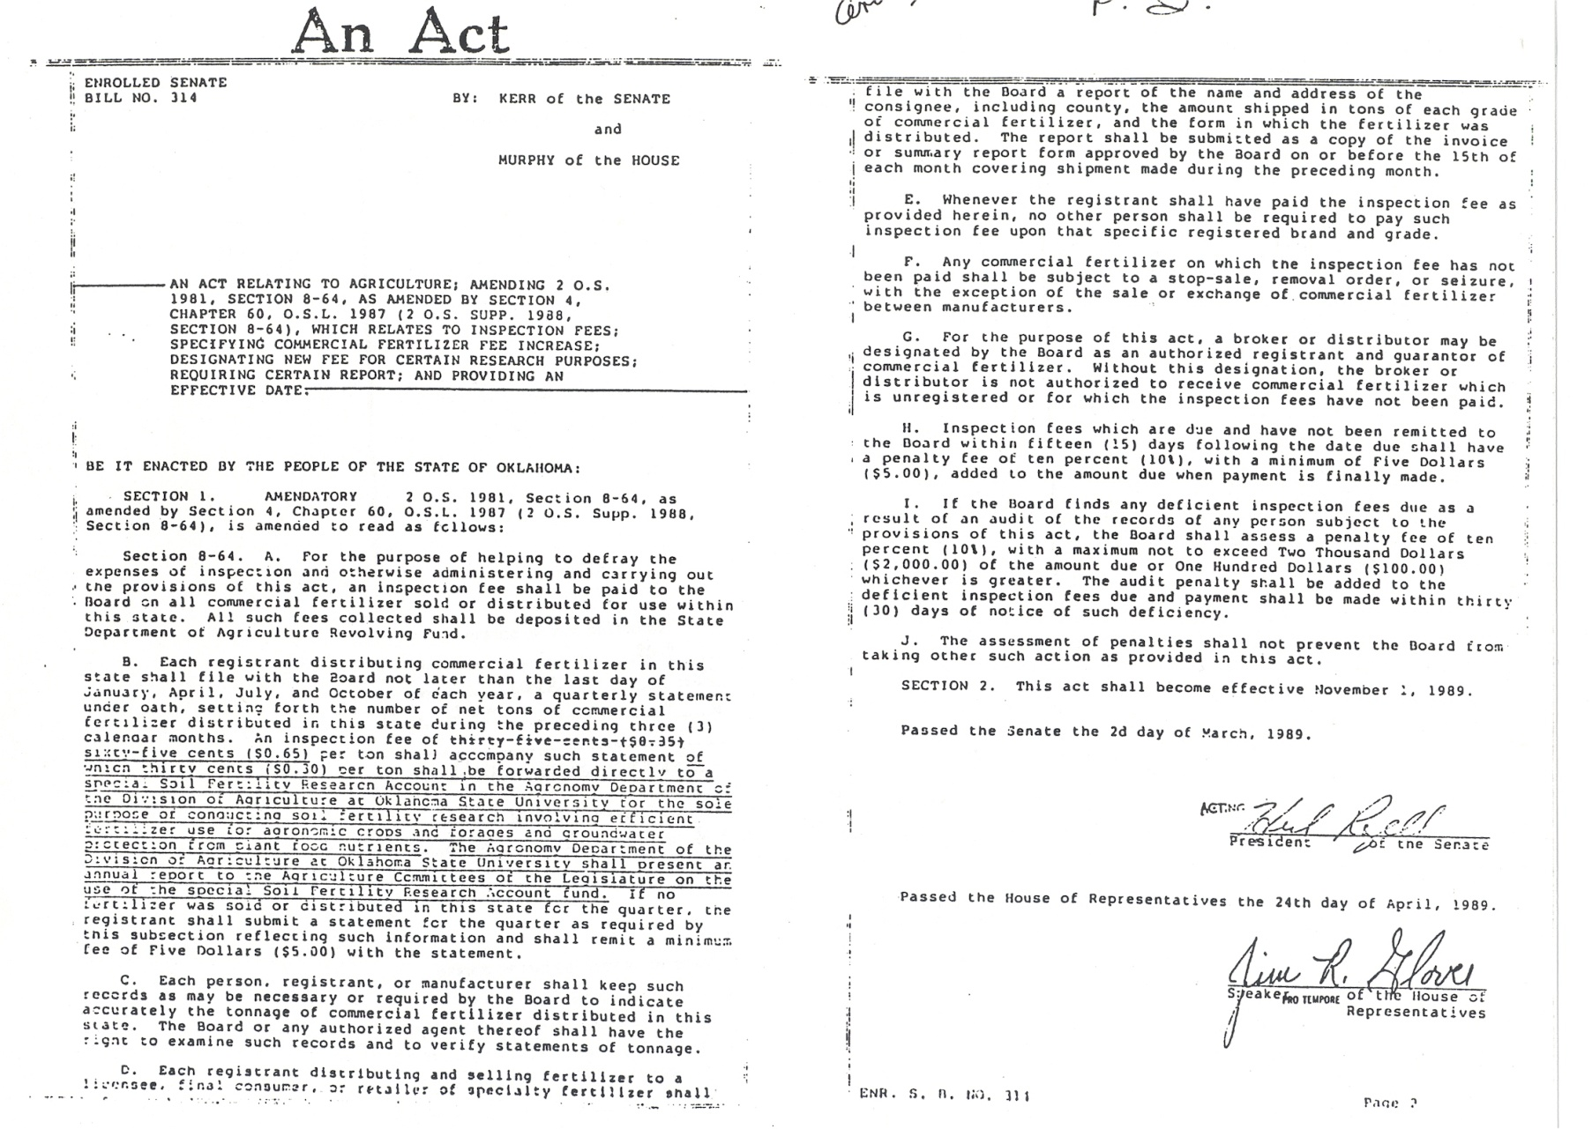
SB314, 1989

Slide 5
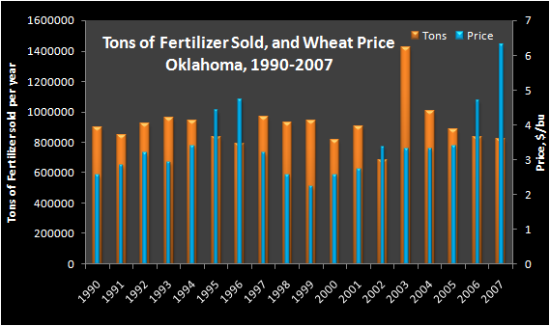
Tons of Fertilizer Sold, 1990-2007

Slide 6
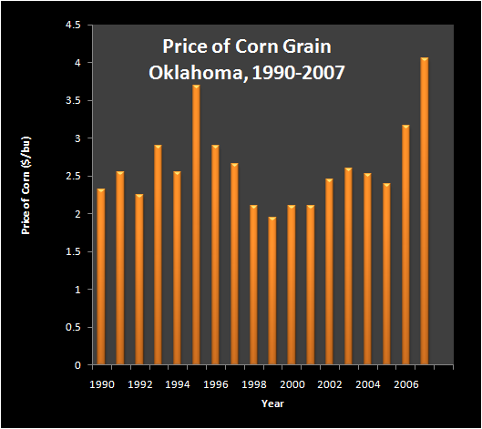
Corn Price, 1990-2007

Slide 7
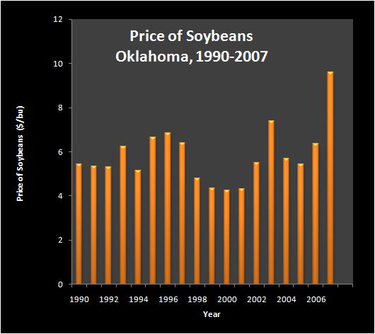
Soybean Price, 1990-2007

Slide 8
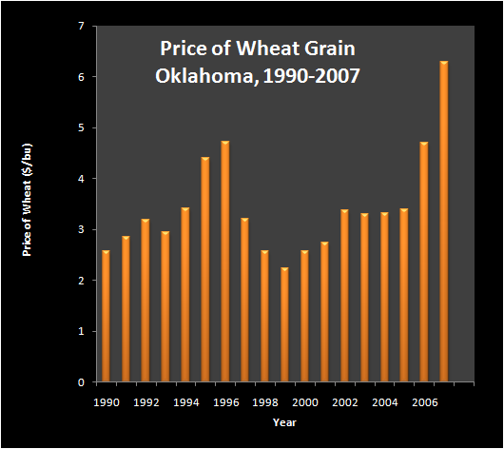
Wheat Price, 1990-2007

Slide 9
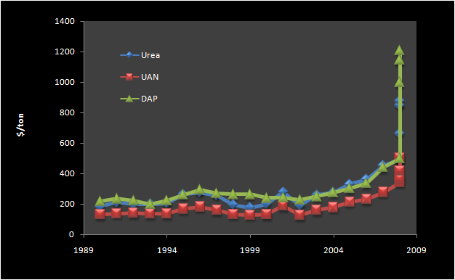
Fertilizer Prices, 1990-2008

Slide 10
GreenSeeker Adoption
  Average of $15.00 increase in revenue using OSU-SBNRC
  Year N Rich Strips Area, acres Est. Value, $
2005 > 1000 100,000 1,500,000
2006 > 2500 250,000 3,750,000
2007 > 3500 350,000 5,250,000
If we could achieve 20% of adoption of the OSU-SBNRC practice for wheat farmers in Oklahoma this would equal
approximately 1,000,000 acres = $15,000,000
** in 2008, we had sites where the N rate recommendation could have been greater since some producers encountered average yields in excess of 70 bu/ac

