Slide 1

Soil Fertility Research and Education Advisory Board

Slide 2
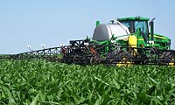


RT200
>100 dealers

Slide 3
1989-present
67 graduates MS, PHD
18 – faculty level positions
 | Graduated Students (1992-2011) | Where are they Now?
1 | Ascencio, Edgar Noel. 1992. M.S. | CARE, San Salvador, El Salvador
2 | Attefat, Mehdi. 1992. M.S. | Iraq,
3 | Sembiring, Hasil. 1993. M.S. | Indonesia, National Program
4 | Jojola, Michael E. 1994. M.S.
5 | Morales, Sonia. 1994. M.S.
6 | Kanampiu, Fred Kaburu. 1995. Ph.D. | CIMMYT, Kenya
7 | Ascencio, Edgar Noel. 1995. Ph.D. | CARE, San Salvador, El Salvador
8 | Gavi-Reyes, Francisco. 1995. Ph.D. | Univ. Post Graduados, Chapingo
9 | Ball, Jeff B. 1995. M.S. | Bayer Crop Science
10 | Phillips, Steven B. 1995. M.S. | Staff, IPNI
11 | Taylor, S.L. 1996. M.S. | USDA-ARS
12 | Chen, J. 1997, M.S. | Ford Motor Co.
13 | Keahey, D.A., 1997, M.S. | Private Enterprise
14 | Lees, H.L., 1997, M.S.
15 | Sembiring, H. 1997, Ph.D. | Indonesia, National Program
16 | Thomason, W.E. 1998, M.S. | Faculty, Virginia Tech
17 | Lukina, E.V. 1998, M.S. | Lab Assistant
18 | LaRuffa, Joanne M. 1999, M.S.
19 | Phillips, S.B. 1999, Ph.D. | Staff, IPNI
20 | DeLeon, Micah, 1999, M.S. | Graduate Student
21 | Dennis, Jeremy, 1999, M.S. | NRCS
22 | Woolfolk, Curt, 1999, M.S. | SST, Stillwater, OK
23 | Cossey, Doug, 1999, M.S. | Servi-Tech, Dodge City, KS
24 | Mullen, R.W. 2001, M.S. | Prof. Ohio State University
25 | Wynn, K. 2001, M.S. | SCS
26 | Thomason, W.E. 2001, Ph.D. | Faculty, Virginia Tech
27 | Lukina.E.V. 2001, Ph.D. | Lab Assistant
28 | Freeman, Kyle W. 2001, M.S. | Mosaic, MN
29 | Teal, Roger, 2002, M.S.
30 | Moges, Shambel, 2002, M.S. | Accurate Environmental Labs
31 | Mullen, Robert, 2002, Ph.D. | Prof. Ohio State University
32 | Micah Humphreys, 2003, M.S. | Faculty, Northwest College, Wyoming
33 | Paul Hodgen, 2003, M.S.
34 | Jason Lawles, 2004, M.S. | Western Mechanical, Weatherford, OK
35 | Jagadeesh Mosali, 2004, Ph.D. | Noble Foundation, Ardmore, OK
36 | Keri, Brixey, 2004, M.S. | NRCS Kansas
37 | Brian Arnall, 2004, M.S. | Faculty, Oklahoma State University
38 | Kefyalew Desta, 2004, Ph.D. | Faculty, Oklahoma State University
39 | Roger Teal, 2005, Ph.D.
40 | Kent Martin, 2005, M.S. | Faculty, Kansas State University
41 | Kyle Freeman, 2005, Ph.D. | Mosaic, MN
42 | Shambel Moges, 2005, Ph.D | Accurate Labs
43 | Clint Mack, 2006, M.S. | Farmer/Consultant, OK
44 | Kyle Lawles, 2006, M.S. | Monsanto, Iowa
45 | Olga Walsh, 2006, M.S. | Faculty, Montana State Univeristy
46 | Brenda Tubana, 2007, Ph.D. | Faculty, Louisiana State University
47 | Byungkyun, Chung, 2007, Ph.D. | Faculty, McNeese State University
48 | Clint Dotson, 2007, M.S. | Monsanto, Kansas
49 | Starr Holtz, 2007, M.S. | Monsanto, Nebraska
50 | Brian Arnall, 2008, Ph.D. | Faculty, Oklahoma State University
51 | Pam Turner, 2008, M.S. | Dept. Environmental Quality
52 | Brandon England, 2008, M.S. | OSDA
53 | Cody Daft, 2008, M.S. | Pioneer, Nebraska
54 | Daniel Edmonds, 2008, M.S. | Private
55 | Brian Arnall, 2008, Ph.D. | Faculty, Oklahoma State University
56 | Birehane Desta, 2009, M.S. | Univ. Minnesota
57 | Olga Walsh, 2009, Ph.D. | Faculty, Montana State University
58 | Yumiko Kanke, 2009, M.S. | Louisiana State University
59 | Jake Vossenkemper, 2009, M.S. | Pioneer, Missouri
60 | Guilherme Torres, 2010, M.S. | Graduate Student, OSU

Slide 4
Students
Argentina
Brazil
China
El Salvador
Ethiopia
India
Indonesia
Iraq
Kenya
Korea
Mexico
Philippines
Russia
Suriname
Uzbekistan
Asst., Assoc, Full Professors
  Brenda Tubana, Louisiana State University
  Robert Mullen, Ohio State University
  Wade Thomason, Virginia Tech
  Olga Walsh, Montana State University
  Kent Martin, Kansas State University
  Byungkyun Chung, McNeese State University
  Brian Arnall, Oklahoma State University
  Kefyalew Desta, Washington State University
  Steve Phillips, IPNI
  Fred Kanampiu, CIMMYT-Kenya
  Shannon Osborne, USDA-ARS
  Edgar Ascencio, CARE- El Salvador
  Erna Lukina, Lab Director, AZ
  Hasil Sembiring, NARS Indonesia
  Francisco Gavi-Reyes, Chapingo, MX
  Kyle Freeman, Mosaic
  Paul Hodgen, Monsanto
  Jagadeesh Mosali, Noble Foundation
  Shambel Moges, Accurate Labs
NRCS, Pioneer, Monsanto, John Deere, Servi-Tech, SST, SCS

Slide 5
Faculty Level Staff

Slide 6
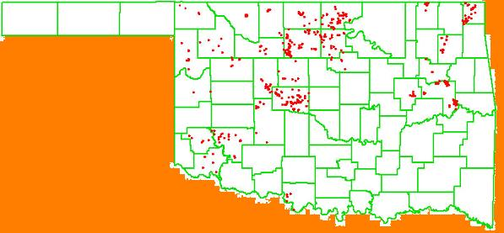
Year OSU Dealer/Producer
2005 80 400
2006 586 Ramps -
2007 512 Ramps 2000
2008 15 -
2009 20 3500
2010 20 3800
2011 60 4000 (includes canola)
Strategy: Have to have experience seeing the different responses from one year to the next
2006

Slide 7
Mexico: Results of the validation trials showed that on an average over all locations, farmers were able to save 69 kg N/ha, without any yield reduction. At the price of US$0.9 per unit of N in the Yaqui valley when these experiments were established, this represented savings to the farmers of US$62/ha ($25/ac).

Slide 8
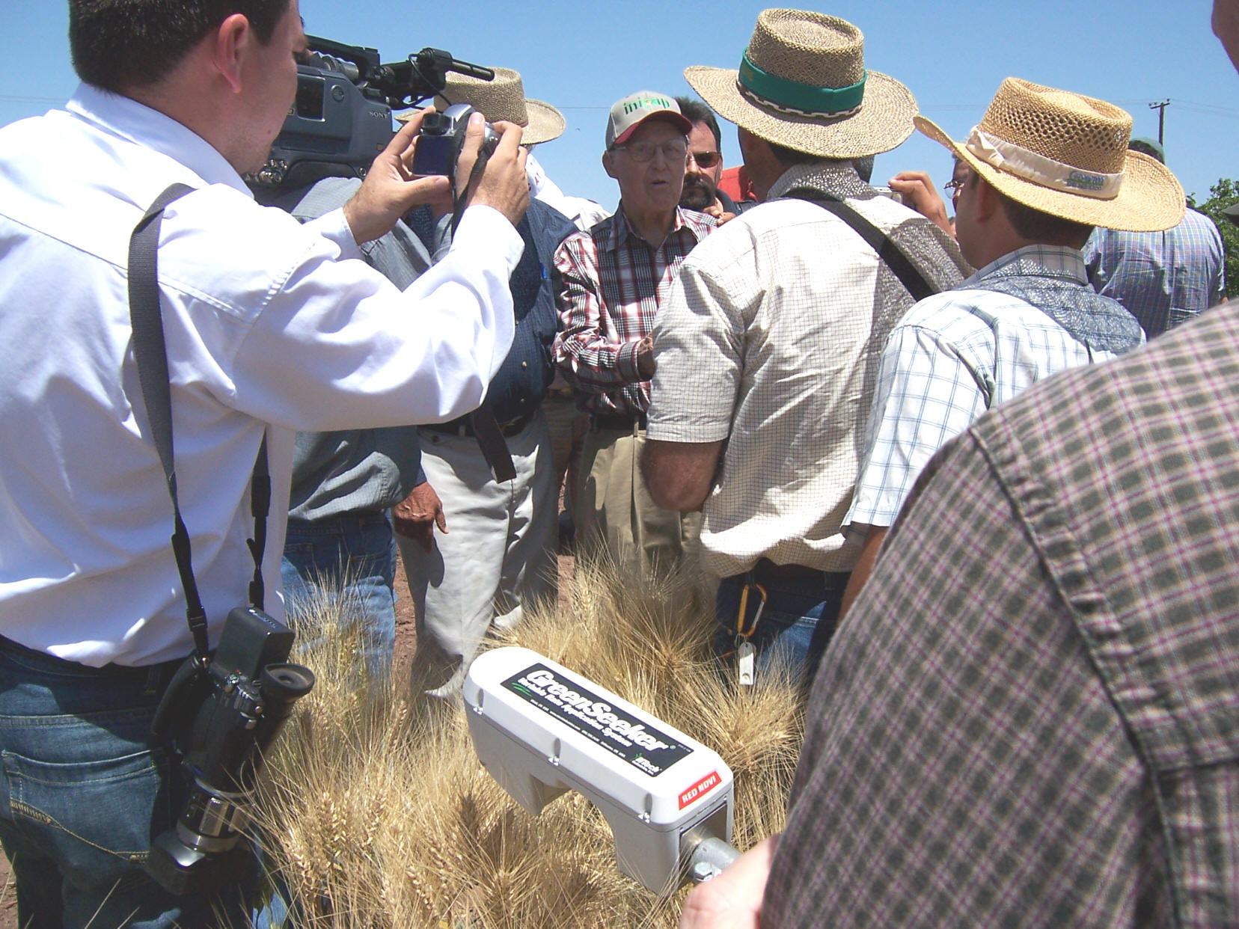
April 16, 2007
Dr. Norman Borlaug
Ciudad Obregon, MX

Slide 9
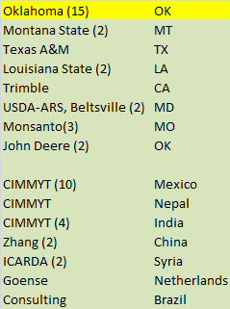
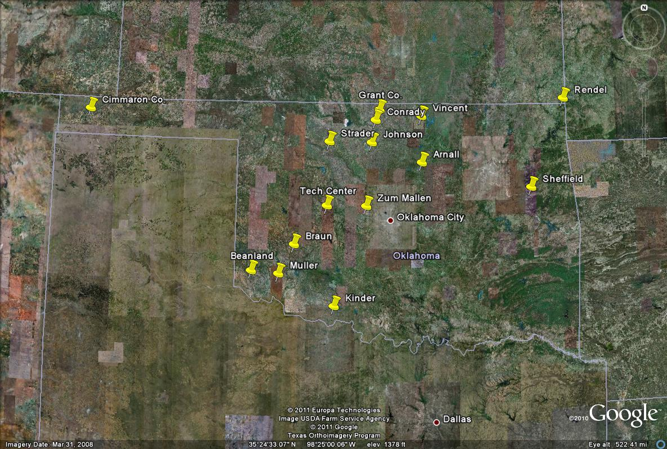
Pocket Sensor Locations

Slide 10
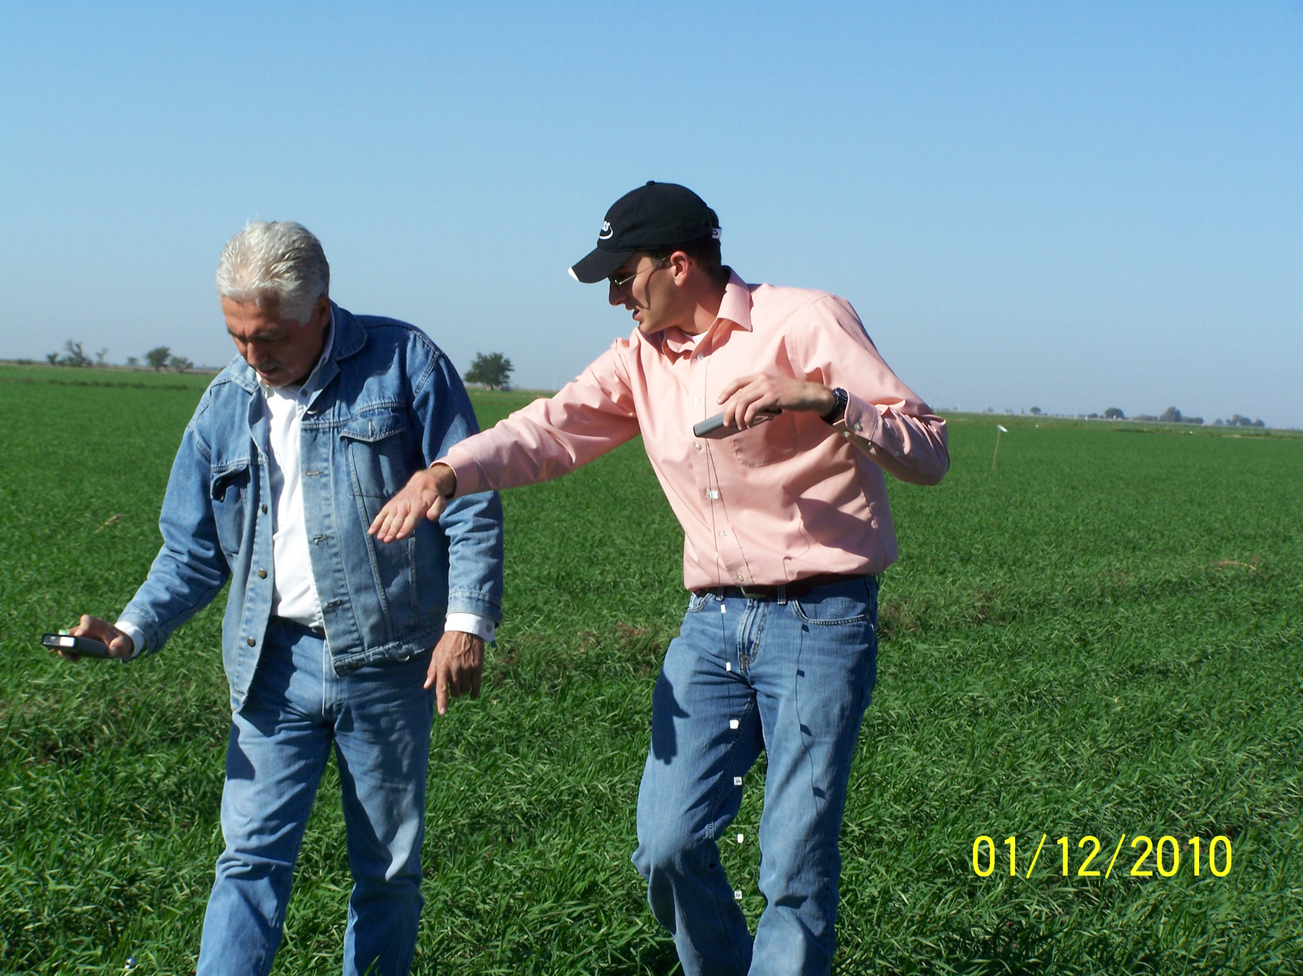
Farm advisor in Ciudad Obregon, manages 1000 ha using GreenSeeker technology

Slide 11
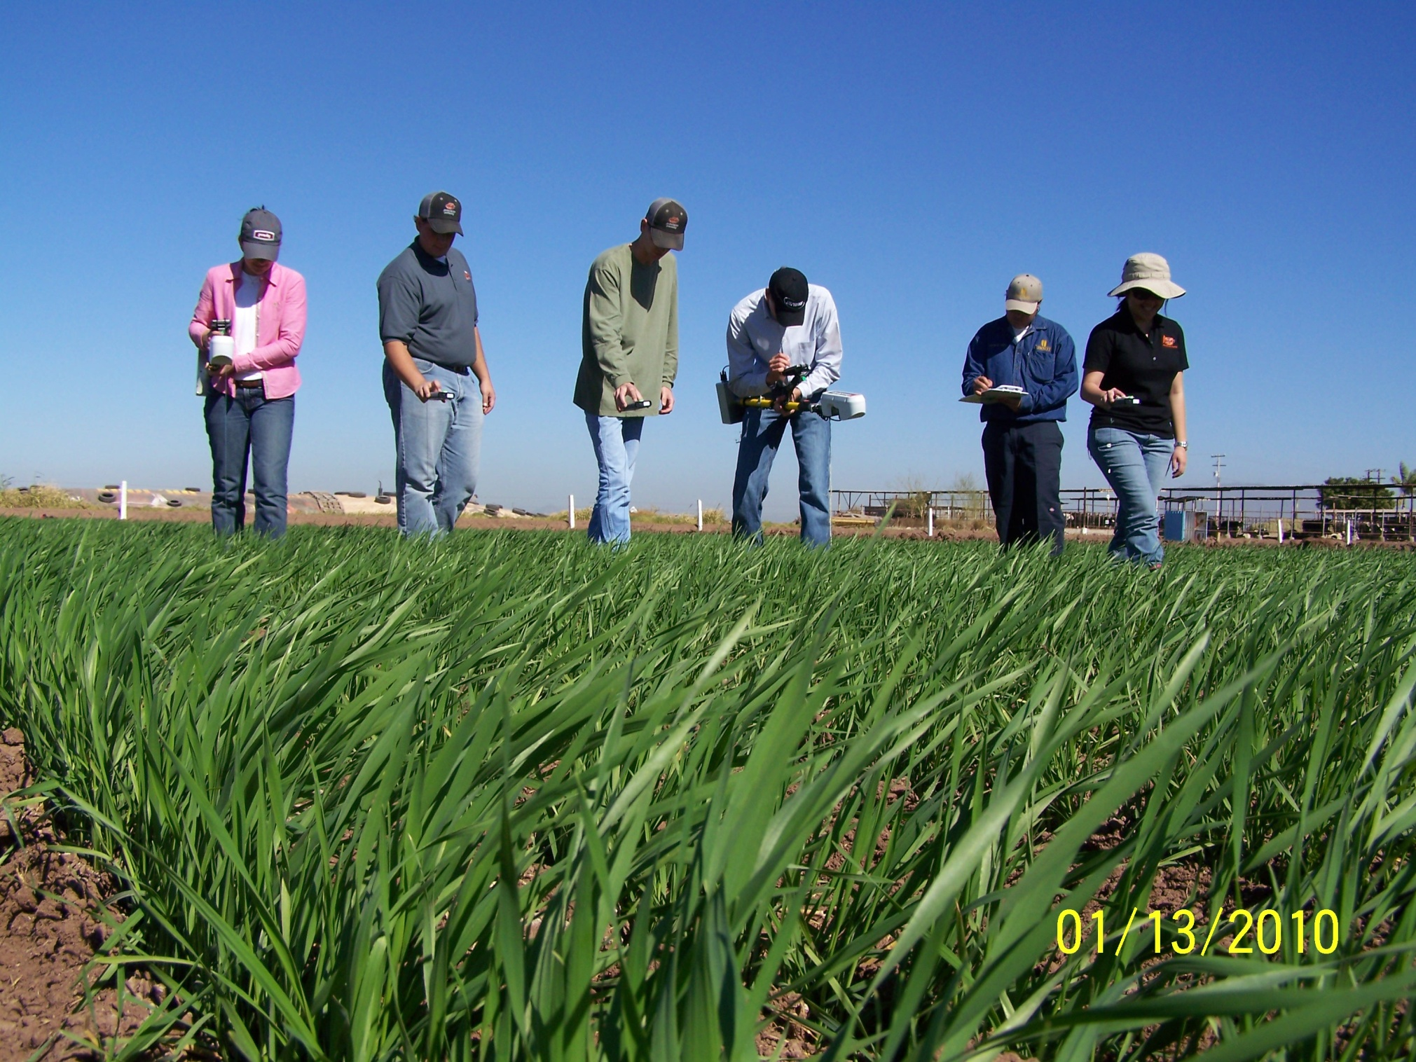

Slide 12
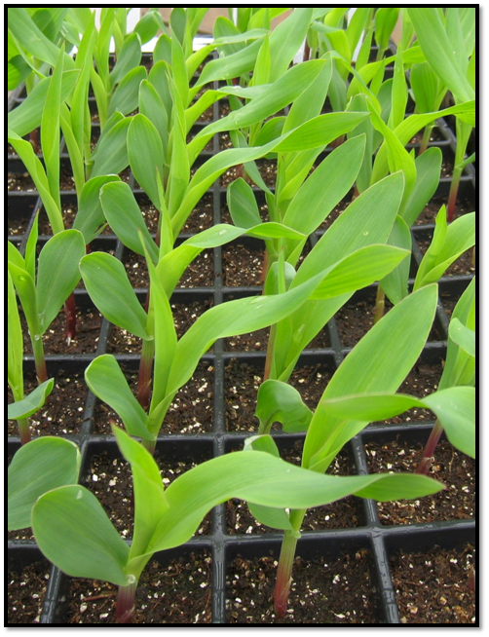
Seed Placement and Leaf Orientation

Slide 13
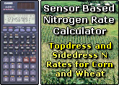
else
{
//Calculating
//$NewRichStrip=$RichStrip;
//$NewFarmerPractice=$FarmerPractice;
//$RI = $NewRichStrip/$NewFarmerPractice;
// if (($RichStrip/$FarmerPractice)< 1.72) $RI = ($RichStrip/$FarmerPractice)*1.69 - 0.7;
// $YP0 = ((1.659*EXP(($NewFarmerPractice/$Day)*732.62))*1000)/$CRate1/$CRate2;
// if ($RI<1) $RI=1;
// $YPN = $YP0*$RI;
// $YPNRS = (((1.659*EXP(($NewRichStrip/$Day)*732.62)))*1000)/$CRate1/$CRate2;
// if ($YP0>$MaxYield) $YP0=$MaxYield;
// if ($YPN>$MaxYield) $YPN=$MaxYield;
// if ($YPNRS>$MaxYield) $YPNRS=$MaxYield;
// $NRate = (($YPN-$YP0)*$CRate2*0.0223/0.6);
$Conversion=60;
$K_SLP=0.15/(1-$BSF);
$K_Inter=($K_SLP*$BSF);
$INF_SLP=0.73/(1-$BSF);
$INF_Inter=($INF_SLP*$BSF);
$infPt = $RichStrip*$INF_SLP-$INF_Inter;
$Curve = $RichStrip*$K_SLP-$K_Inter;
$RI = $RichStrip/$FarmerPractice;
$YP0 = $Conversion*($MaxYield/(1+EXP(-($FarmerPractice-$infPt/$Curve))));
$YPN = $Conversion*($MaxYield/(1+EXP(-($FarmerPractice*$RI-$infPt/$Curve)))); // MaxYield automatically takes care of the mertric/english conversion
$NRate = (($YPN-$YP0)*$PercentN/(0.01*$NUE))/$Conversion*$CRate2;
//echo "INF_SLP =: $INF_SLP";
//echo "NUE =: $NUE";
//echo "INF_Inter =: $INF_Inter";
//echo "infPt =: $infPt";
//echo "Curve =: $Curve";
//echo "YP0 =: $YP0";
//echo "YPN =: $YPN";
//echo "Nrate =: $NRate";
//echo "CRate1 =: $CRate1";
//echo "CRate2 =: $CRate2";
//echo "Conversion=: $Conversion";
//Rounding
$RI = 0.01*round($RI*100);
$YP0 = 0.1*round($YP0*10);
$YPN = 0.1*round($YPN*10);
// $YPNRS = 0.1*round($YPNRS*10);
$NRate=0.1*round($NRate*10);
28 options

Slide 14
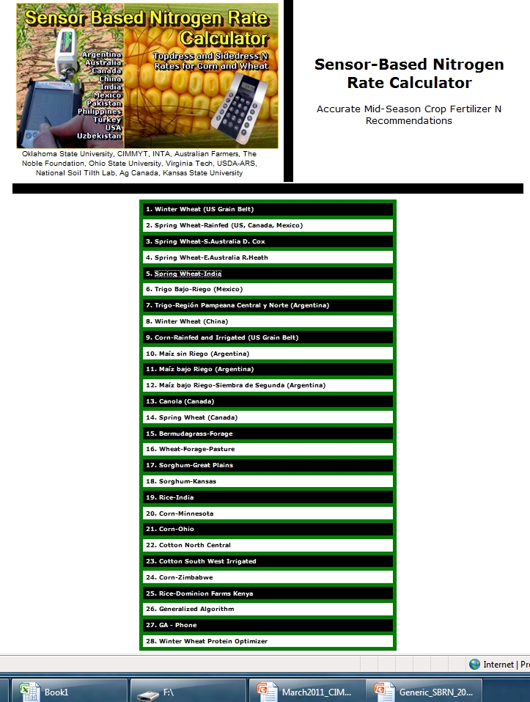
http://www.soiltesting.okstate.edu/SBNRC/SBNRC.php
currently 28 options,

Slide 15
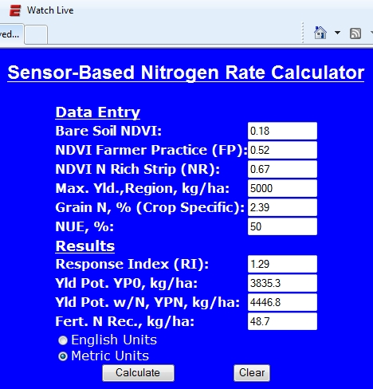
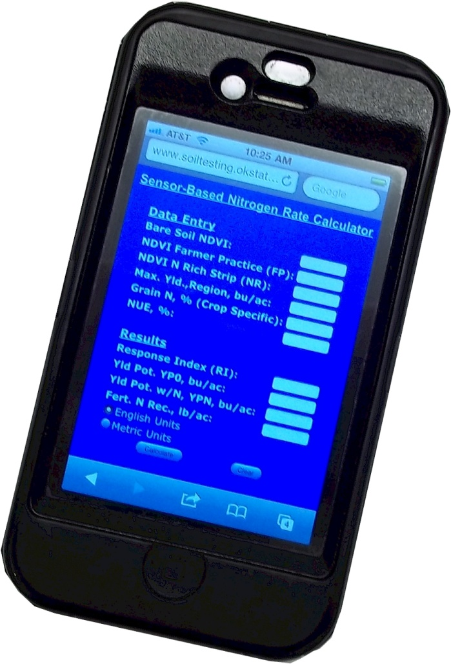

Slide 16
Research Highlights
Alfalfa, Late Season N: Soil Sci. Soc. Am. J. 63:1237
Switchgrass, N Timing: J. Plant Nutr. 27:1199
Rye-wheat-ryegrass: J. Plant Nutr. 25:2285;
Rye-wheat-ryegrass: J. Prod. Agric 9:510
Bermudagrass: Agron J. 91:438-444.
Bermudagrass: J. Plant Nutr. 21:1253
Cheat Control: J. Plant Nutr. 22:1541
Interseeded bermudagrass mixtures: J. Plant Nutr. 23:673
Corn, Canopy Reduction: J. Plant Nutr. 26:1335
Corn, Growth Stage, Development: J. Plant Nutr. 28:173
Corn, Foliar P Applications: J. Plant Nutr. (in press)
Cheat, Ryegrass Detection, Crop Sci. 45:477
Bluestem: J. Prod Agric. 12:254
CO₂ Increase: Commun. Soil Sci. Plant Anal. 30:1713
Phosphorus, Foliar application, J. Plant Nutr (in press)
Sulfur, Wheat forage production, J. Plant Nutr. (in press)
Chloride, Take-all suppression J. Plant Nutr. 24:683
Electrical Conductivity, VERIS, Commun. Soil Sci. Plant Anal. 35:2639
158 Refereed Journal Publications
9 Patents
2 Books
Proceedings, abstracts, popular press

Slide 17
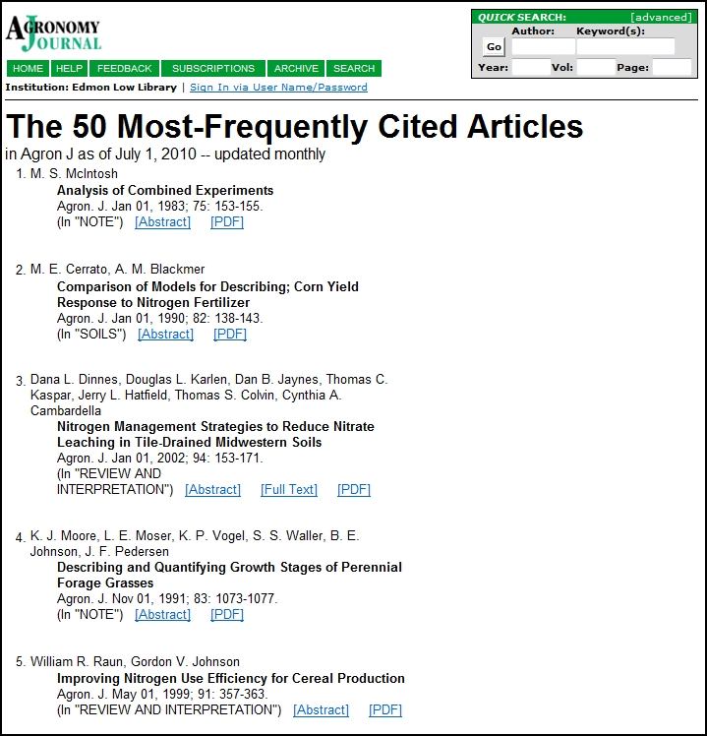
Cited 397 times

Slide 18
Commun. Soil Sci. Plant Anal. 30:1713
Long-term trials: Decrease in soil organic matter from 4 to 1% globally on lands under cultivation has led to 6-25% of the 110 ppm increase (260-370 ppm) in atmospheric CO₂

Slide 19
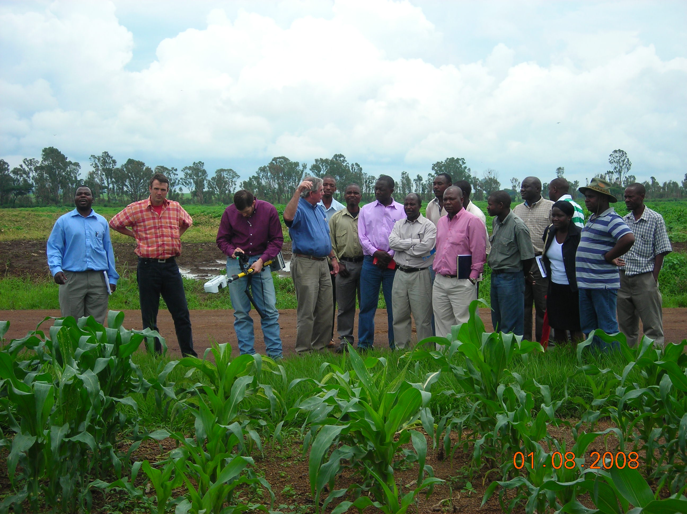
For SSA, NUE’s exceed 100%. In light of the low N application rates, high NUE’s speak to a much bigger and potentially damaging situation for cereal production in SSA. High NUE’s for SSA are a direct result of applying so little fertilizer N, at the ultimate expense of mining an already depleted soil resource.

Slide 20
Hosted the Int. NUE Conference, 2010
http://nue.okstate.edu/International_Student_Activities.htm 88 Students, sent abroad on short and long-term study with CIMMYT

Slide 21
No-till production
By-plant nutrient management
  Stalk diameter-yield prediction
Seed-leaf orientation
  Agronomy, Engineering
Pocket Sensor
Hand Planter

