Slide 1

Soil Fertility Research and Education Advisory Board

Slide 2
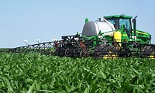


RT200
>100 dealers

Slide 3
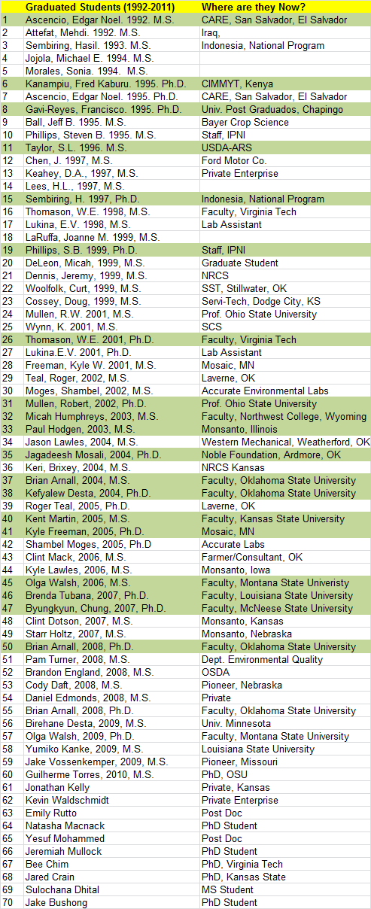
1989-present
74 graduates MS, PHD
18 – faculty level positions

Slide 4
Students
Argentina
Brazil
China
El Salvador
Ethiopia
India
Indonesia
Iraq
Kenya
Korea
Mexico
Philippines
Russia
Suriname
Uzbekistan
Asst., Assoc, Full Professors
  Brenda Tubana, Louisiana State University
  Robert Mullen, Potash Corp
  Wade Thomason, Virginia Tech
  Olga Walsh, Montana State University
  Kent Martin, Adjunt, Kansas State University
  Byungkyun Chung, McNeese State University
  Brian Arnall, Oklahoma State University
  Kefyalew Desta, Washington State University
  Steve Phillips, IPNI
  Fred Kanampiu, CIMMYT-Kenya
  Shannon Osborne, USDA-ARS
  Edgar Ascencio, CARE- El Salvador
  Erna Lukina, Lab Director, AZ
  Hasil Sembiring, NARS Indonesia
  Francisco Gavi-Reyes, Chapingo, MX
  Kyle Freeman, Mosaic
  Paul Hodgen, Monsanto
  Jagadeesh Mosali, Noble Foundation
  Shambel Moges, Accurate Labs
NRCS, Pioneer, Monsanto, John Deere, Servi-Tech, SCS

Slide 5
Faculty Level Staff

Slide 6
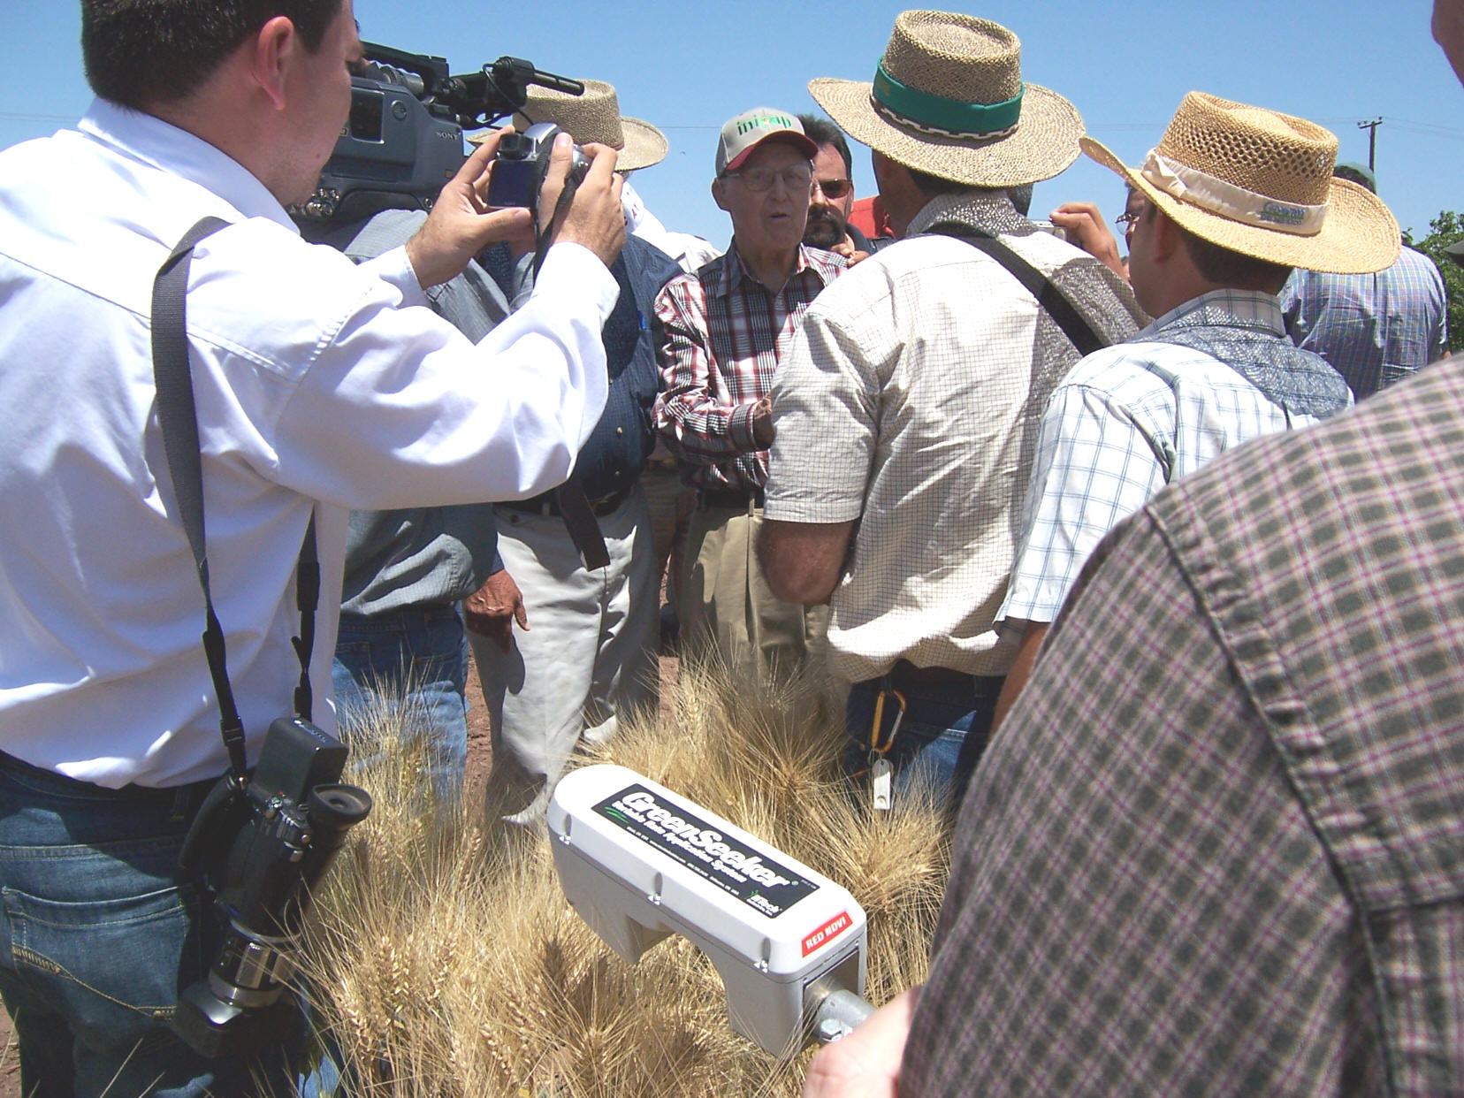
April 16, 2007
Dr. Norman Borlaug
Mr. Chris Dowswell
Ciudad Obregon, MX

Slide 7

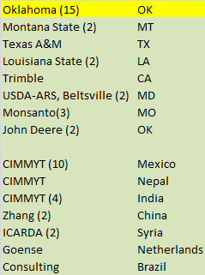
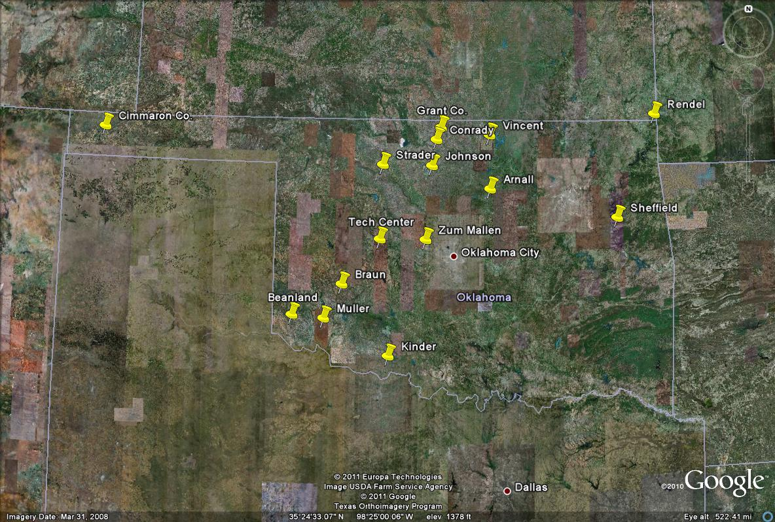
Pocket Sensor-2012

Slide 8
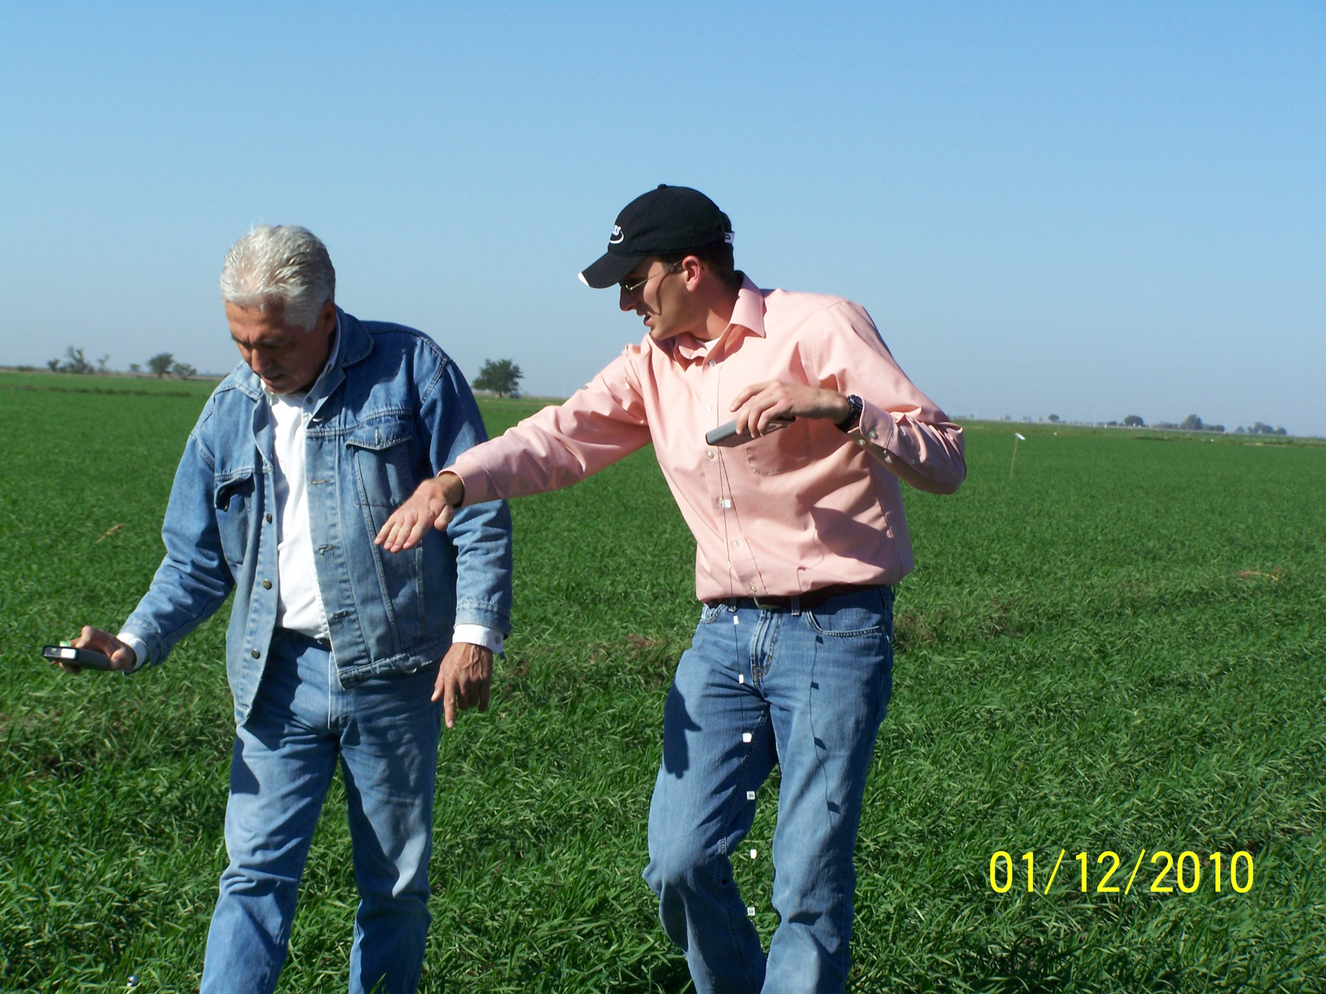
Farm advisor in Ciudad Obregon, manages 2500 ac using GreenSeeker technology

Slide 9
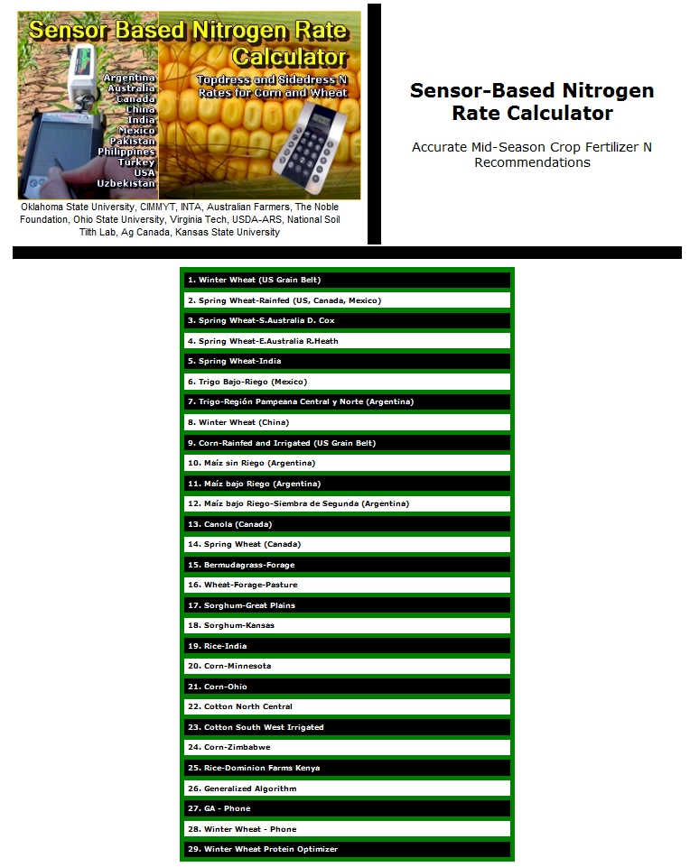
http://www.soiltesting.okstate.edu/SBNRC/SBNRC.php
currently 29 options,
New-protein optimizer

Slide 10
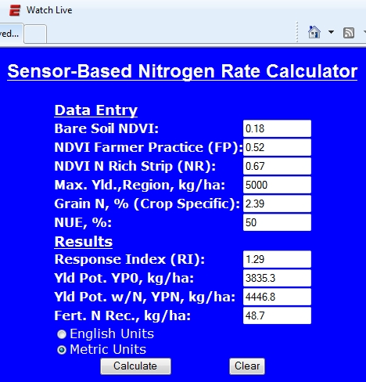
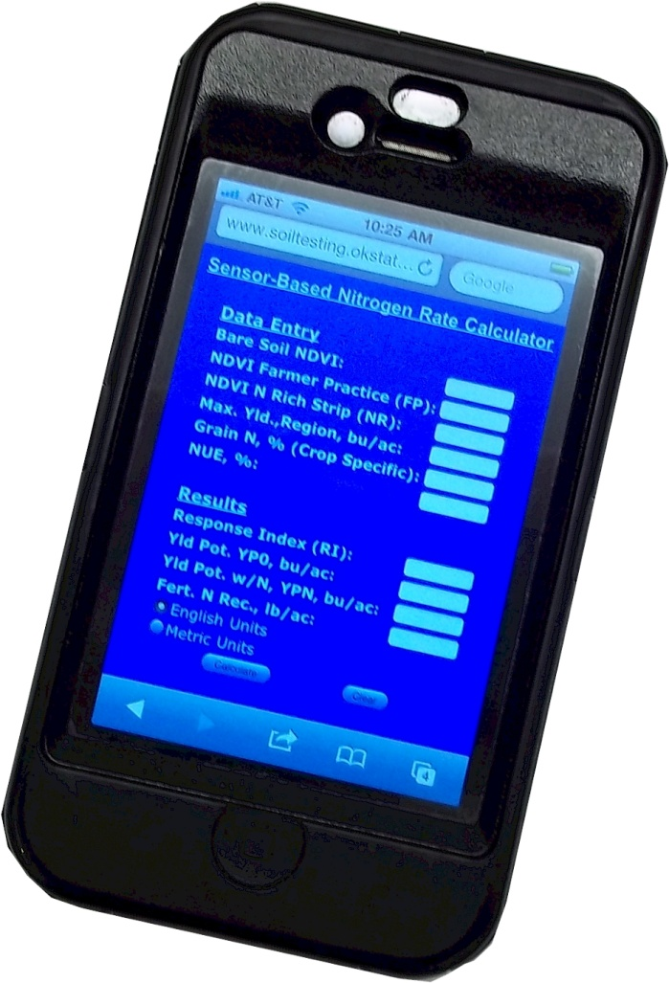

Slide 11
Ammonia Loss Calculator
(Macnack et al., 2012) Applied Model for Estimating Potential Ammonia Loss from Surface Applied Urea (wind speed, temp, pH)
http://nue.okstate.edu/N_Fertilizers/Urea.htm
Protein Predictor
(Macnack et al., 2012) In Season Prediction of NUE and Grain Protein in Winter Wheat

Slide 12
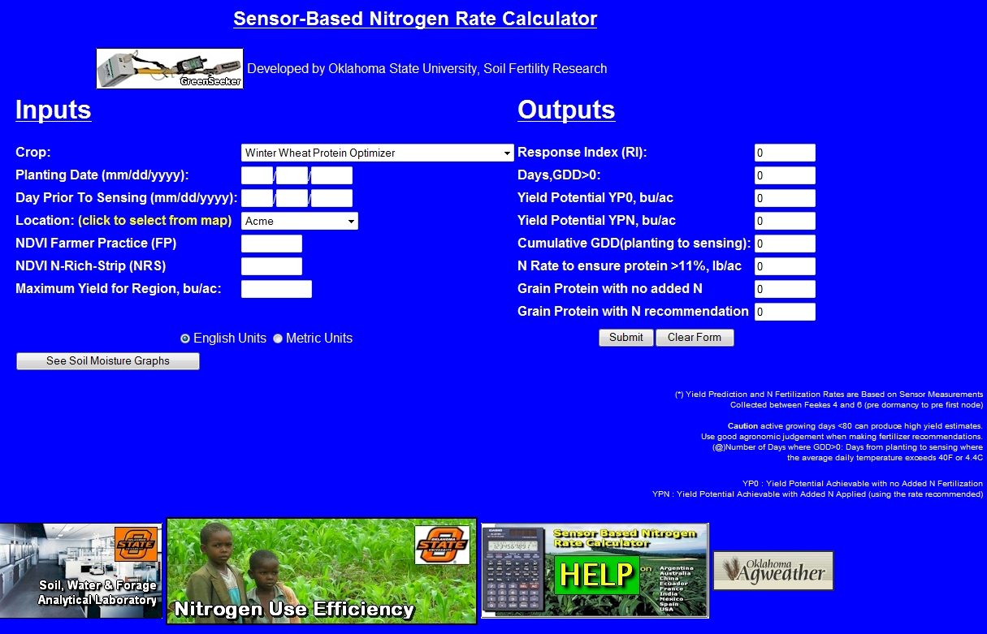
Winter Wheat Protein Optimizer

Slide 13
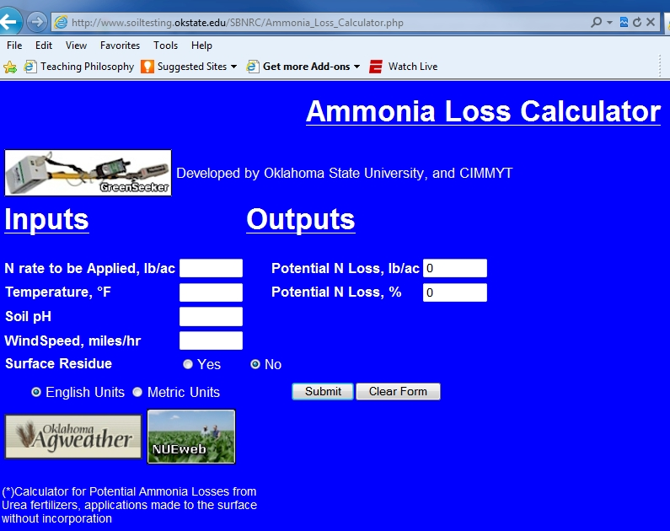

Slide 14
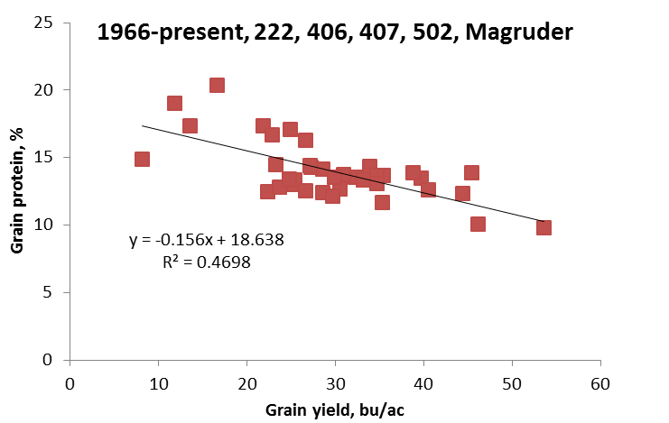

Slide 15
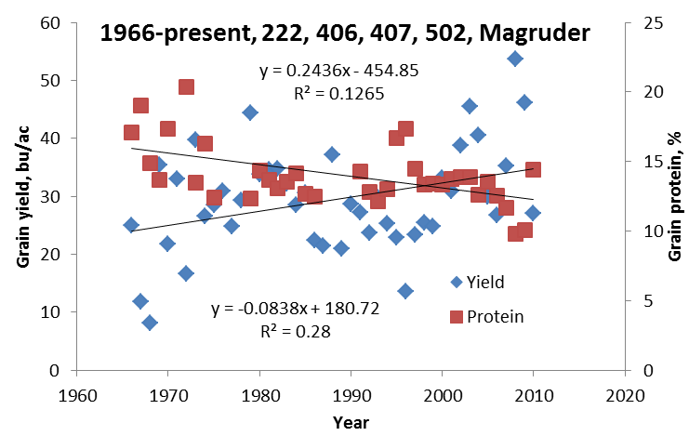

Slide 16
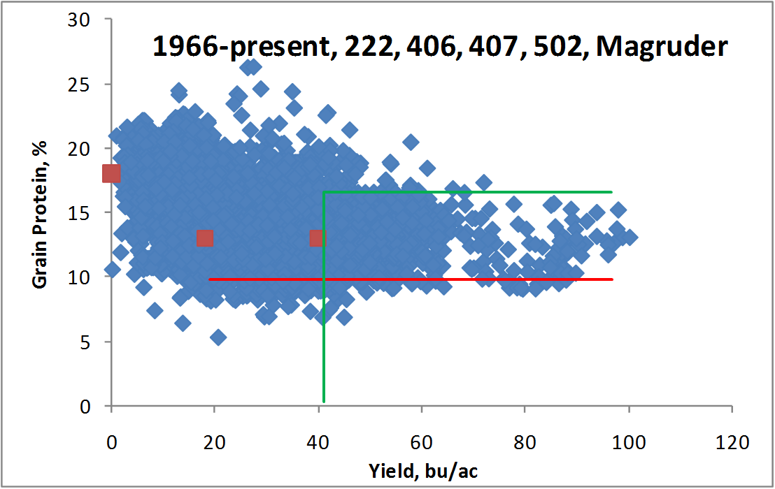

Slide 17
Foliar N Trials
  UAN, 9-18 lbs N/ac
  N-Sure (urea-triazone, slow release)
  S (CaSO4), 5 lbs/ac
  Droplet size (fine/medium/coarse) w/wo adjuvant

Slide 18
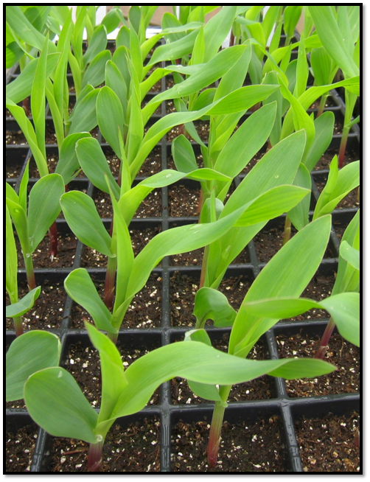
Seed Placement and Leaf Orientation

Slide 19
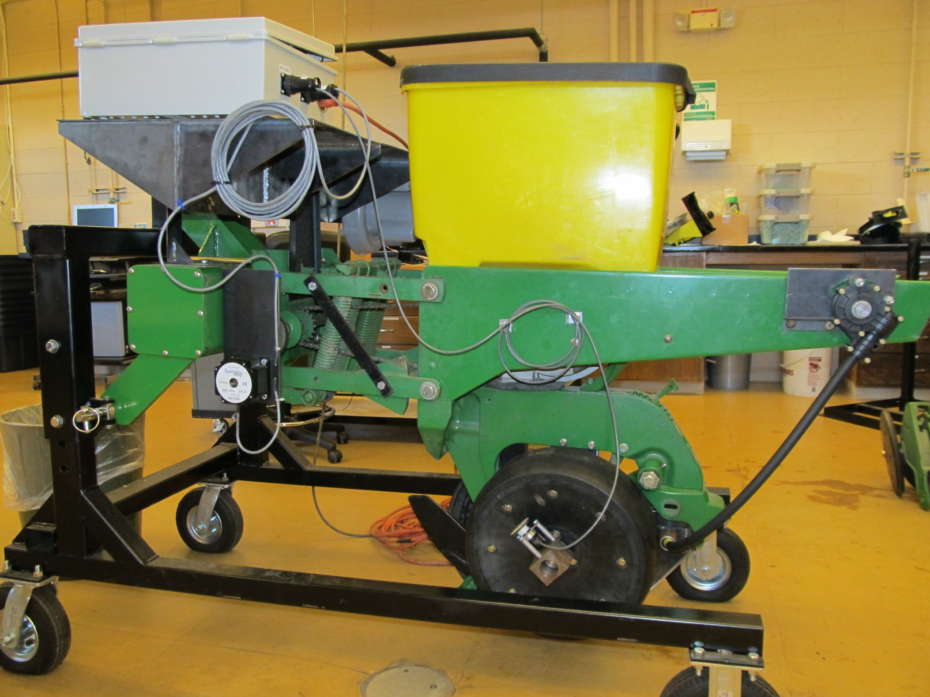
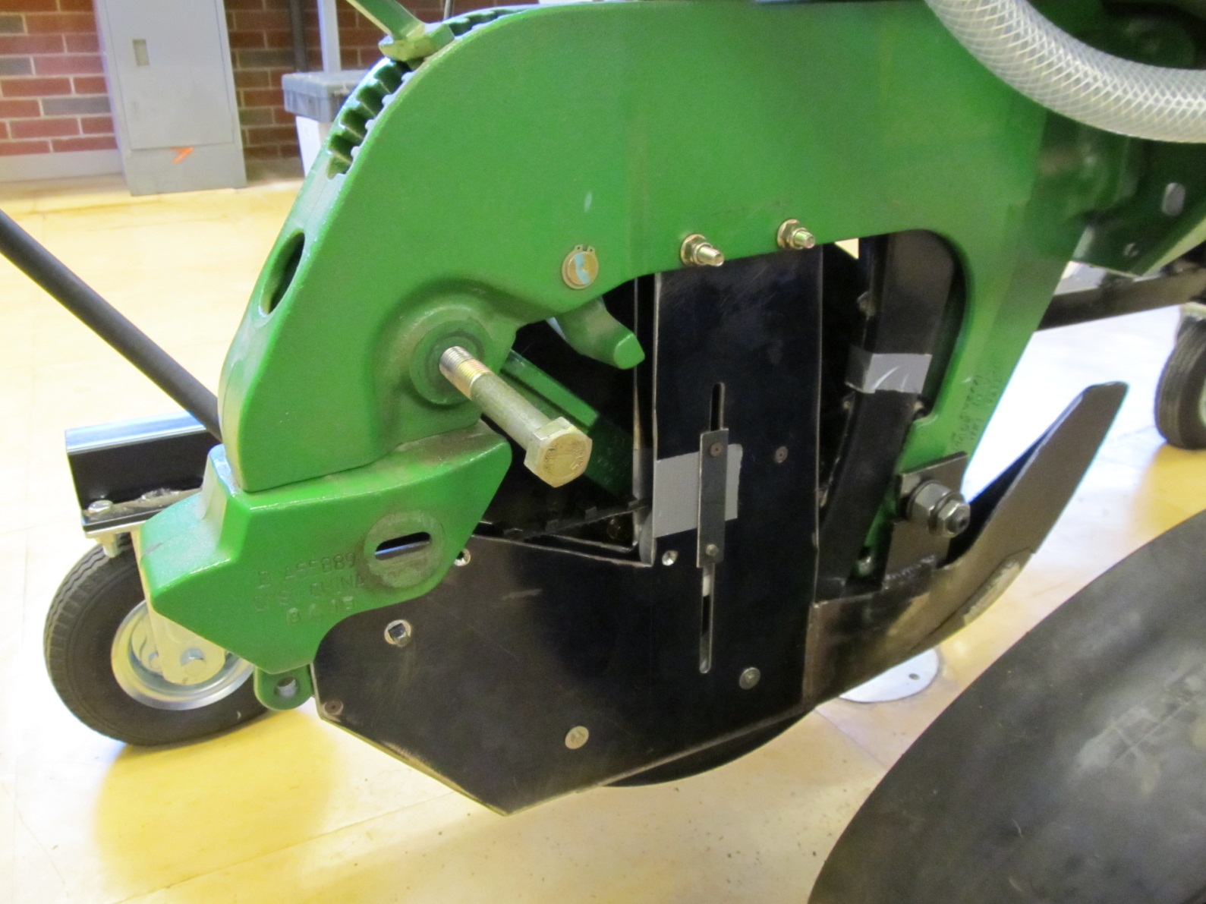

Slide 20
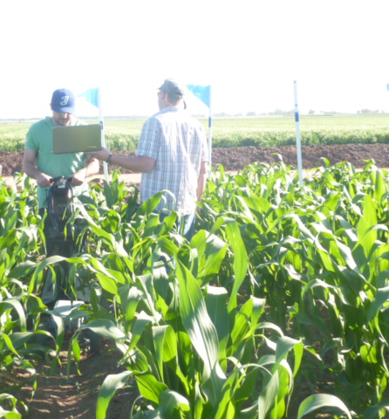
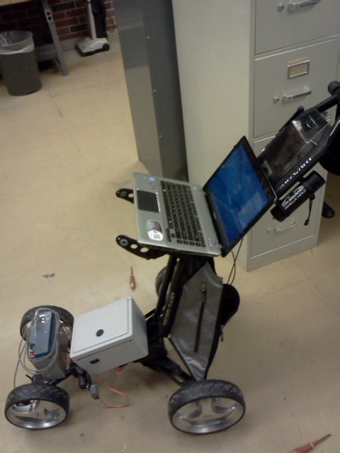
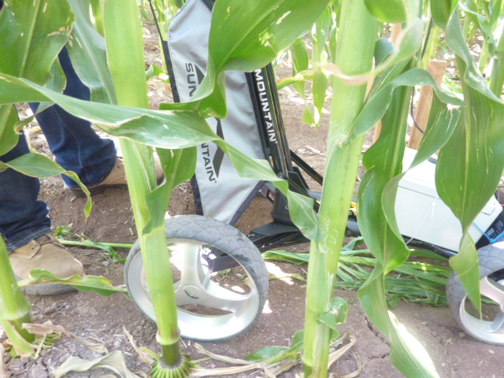
Sensing Corn Stalk Diameter as a Predictor of Grain Yield
On-the-go optical sensor

Slide 21
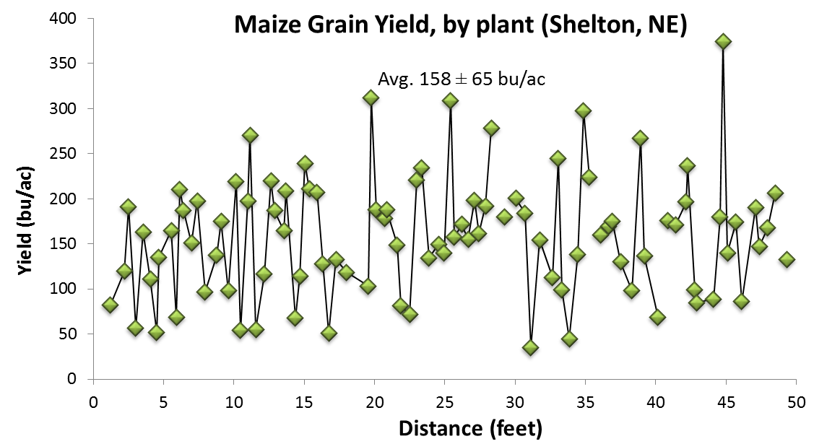
Agron. J. 97:1603-1611. “..regardless of yield level, plant-to-plant variability in corn grain yield can be expected and averaged more than 45 bu/ac over sites and years.
Argentina, Mexico, Iowa, Nebraska, Ohio, Virginia, and Oklahoma

Slide 22
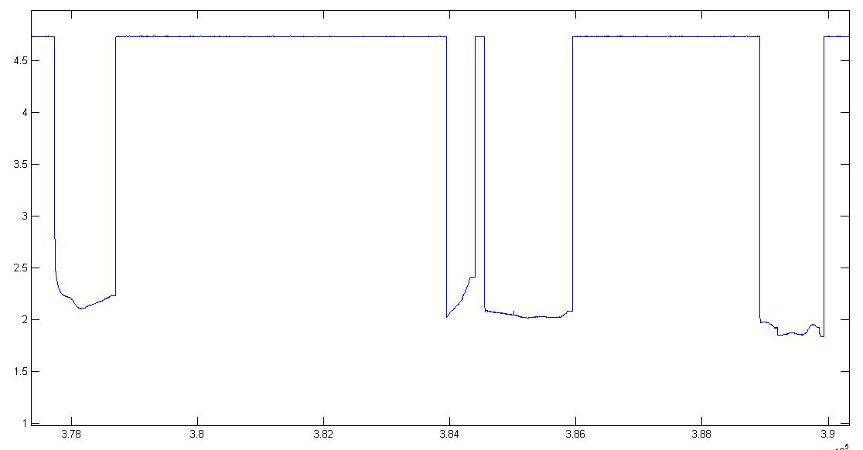
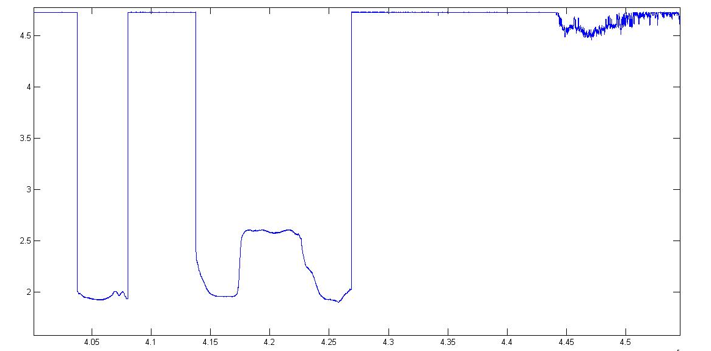
Leaf detection with distance sensor
Leaf next to plant
V
O
L
T
S
Plant
Plants
Leaf between plants
TIME

Slide 23
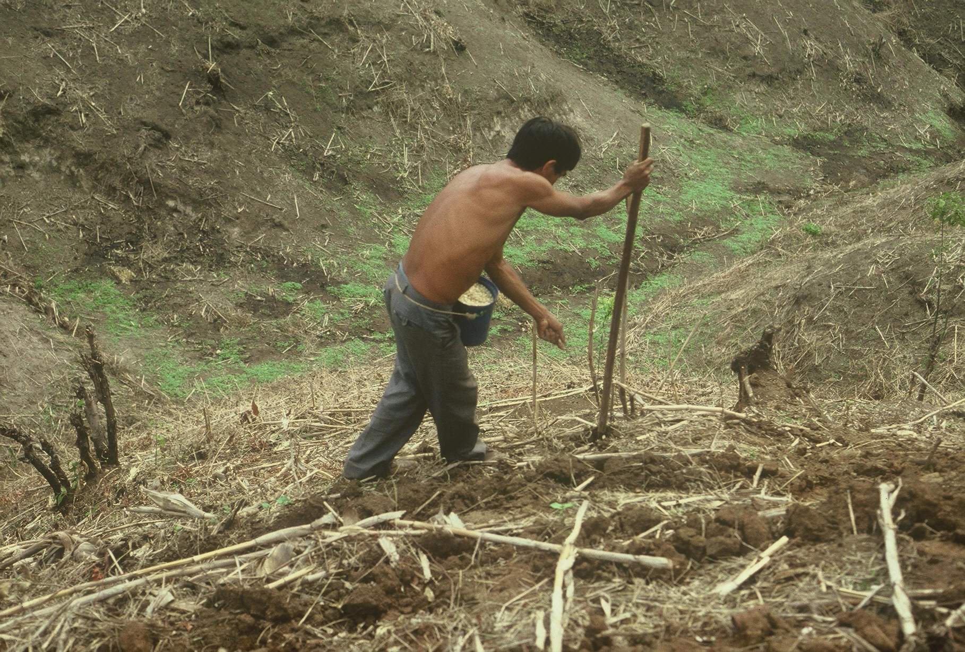

Slide 24
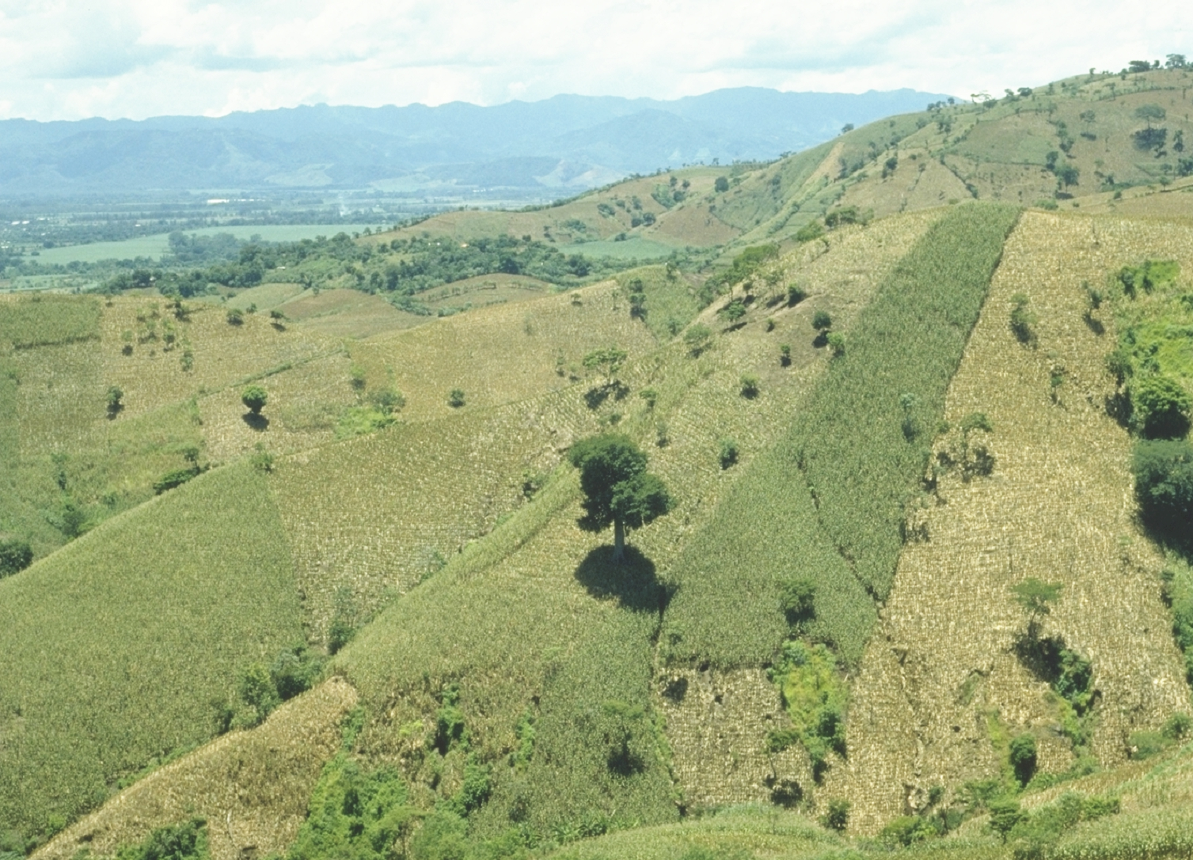

Slide 25
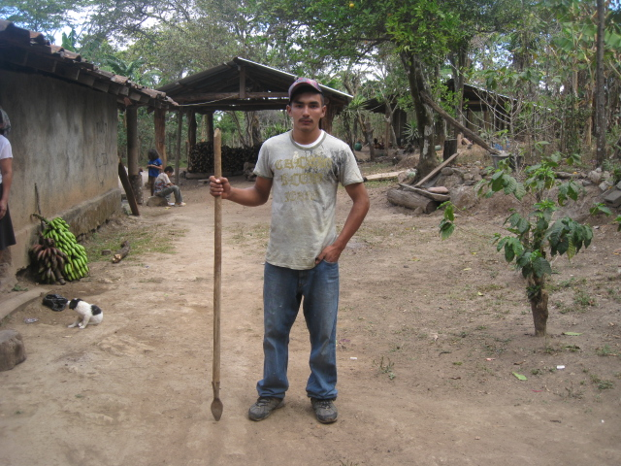
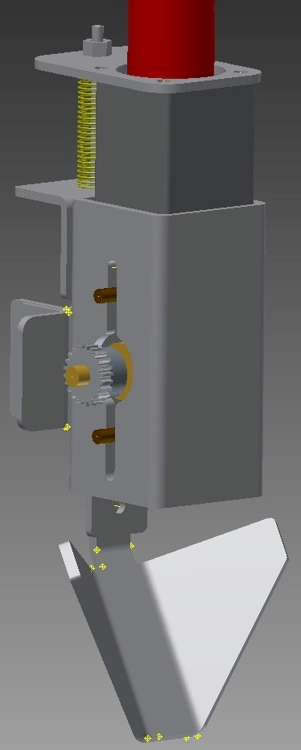
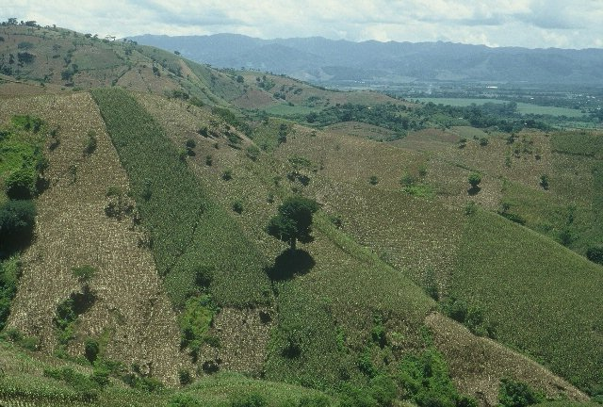
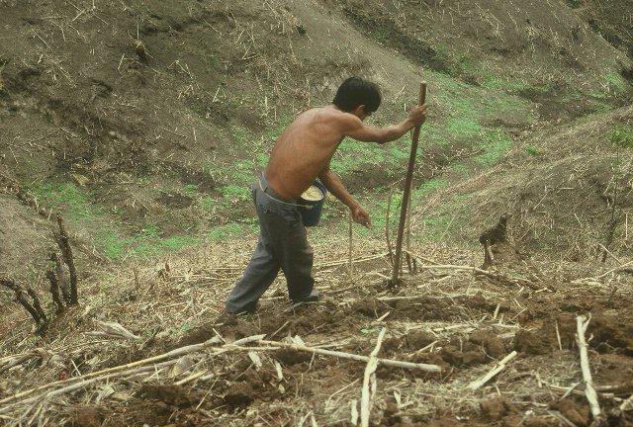
51,000,000 acres
Avg yield 30 bu/ac
50% yield increase (10% land)
$ ½ billion

Slide 26
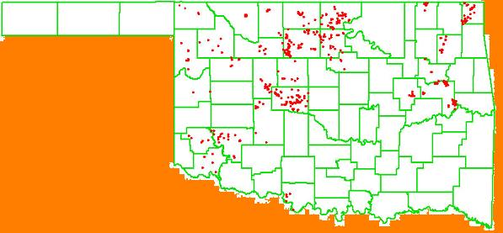
Year OSU Dealer/Producer
2005 80 400
2006 586 Ramps -
2007 512 Ramps 2000
2008 15 -
2009 20 3500
2010 20 3800
2011 60 4000 (includes canola)
Strategy: Have to have experience seeing the different responses from one year to the next
2006

Slide 27
Brent Rendel, May 7, 2012
“GreenSeeker reduced my topdress N use by almost 50,000 lb of actual N across 1400 acres… worked out to 35.53 fewer lb of N per acre… My UAN cost was $366 per ton = $0.573 per lb of N… N savings >$20/ac this year.. wheat yield should meet or beat the heavy N fields. If lodged wheat losses are only 3-4 bu/ac (and I bet they are much higher) you can add another $20/ac bump. Hmmmm....1400 acres...$20/ac to $40/ac advantage. That $15,000 investment in an RT-200 was pretty cheap.

Slide 28
Mexico: Results of the validation trials showed that on an average over all locations, farmers were able to save 69 kg N/ha, without any yield reduction. At the price of US$0.9 per unit of N in the Yaqui valley when these experiments were established, this represented savings to the farmers of US$62/ha ($25/ac).

Slide 29
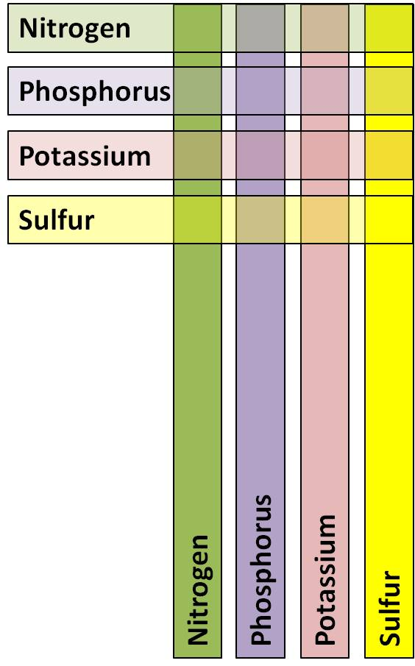
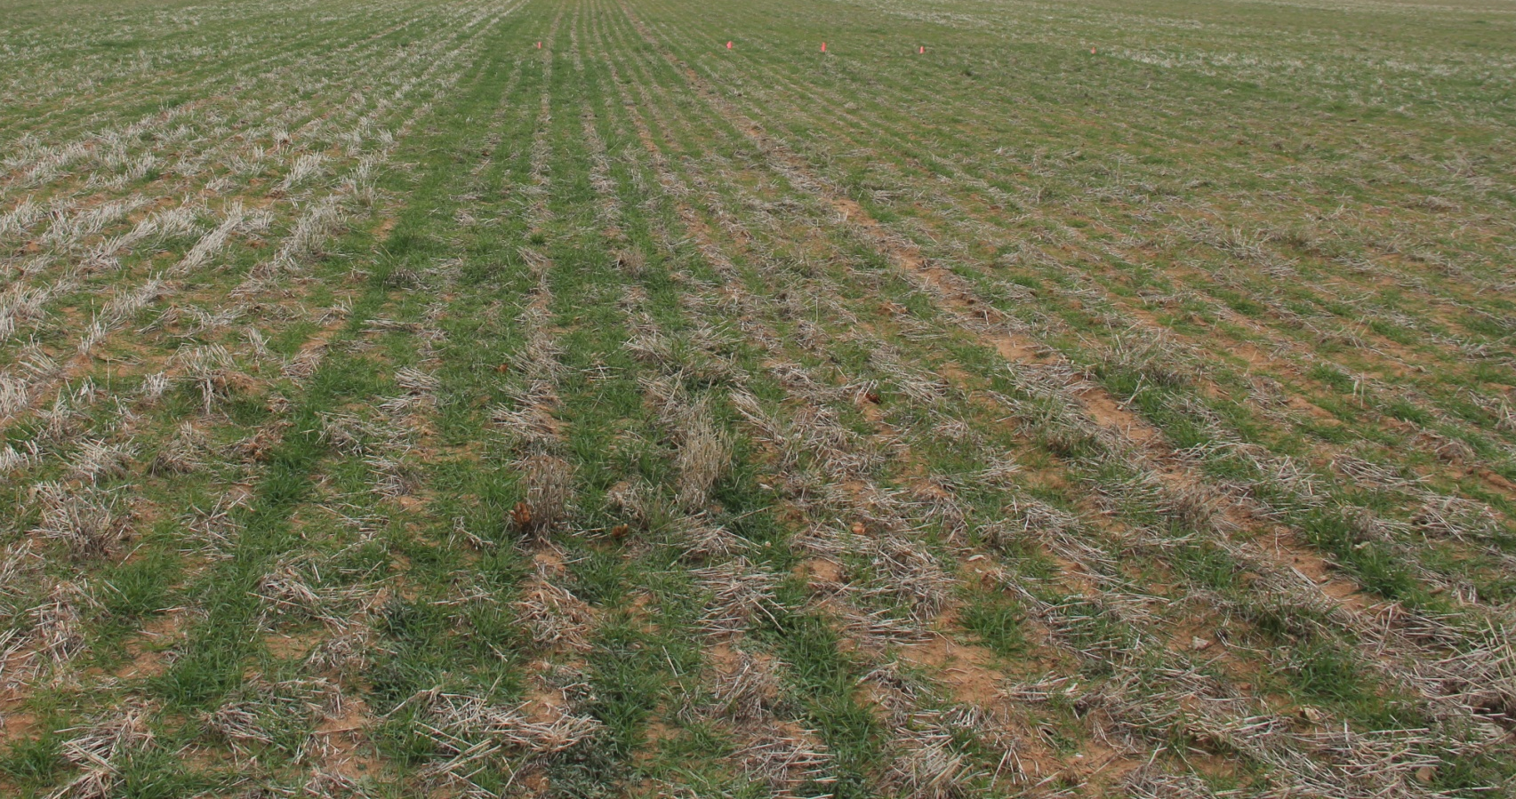
NPKS response Strips
43 Locations in Winter Wheat
10 Locations in Corn, Sorghum, Soybean (so far)
Soil samples and Field History collected every site
Currently Harvesting Wheat.

Slide 30
Secondary and Micros in Canola
Applied Foliar S and B treatments at all Canola Variety Demo Locations
  Soil samples and Tissue samples collected.
  Plots will/are be taken to yield.
Ran Tissue Analysis on Canola.
  Applied foliar Ca and K for evaluation

Slide 31
Impact of Soil pH on Yield
Completed
  Grain Sorghum
  Sunflower
Currently
  6 Canola varieties and hybrids
  Sesame
  Bermudagrass
Establishing
  6 winter wheat cultivars: Dual purpose/grain only.

Slide 32
Product Evaluation 2011-2012
Avail
Nutrisphere
Agrotain Ultra
Agrotain Plus
ESN
Super U
CoRoN
MESZ

