Slide 1

Soil Fertility Research and Education Advisory Board Meeting,
Thursday June 29, 2017
Building 615, Agronomy Experiment Station
Stillwater, OK 74078
Agenda
11:30 am Convene at the Soil Fertility Shop, Lunch will be served
12:00 Opening Remarks, Dr. Brian Arnall
12:15 Soil Fertility Progress Report and Overview
Raun, Arnall, Zhang
12:30 Update on current projects
12:40 Student input/progress
12:50 Agronomic applications, iPhone apps
1:00 New Projects/Approval
1:15 Open Discussion
2:00 Adjourn

Slide 2
Fertilizer Advisory Board will meet in the spring of each year. The primary purpose of the Fertilizer Advisory Board is to ensure that fertilizer dealers and fertilizer manufacturers, farmers that use fertilizers, and other clientele that SB-432 (previously SB-314) serves, have a mechanism for input to suggest priority research areas that (a) benefit agricultural producers in the state of Oklahoma; (b) promote efficient use of fertilizers in agronomic crop and forage production while protecting the environment and groundwater supplies; and (c) fulfill the spirit and intent of SB-432.
1. Fertilizer Advisory Board Chair, Rick Howard
2. Fertilizer manufacturer,
3. Fertilizer retail dealer (1) Mike Rosen, Wheeler Brothers
4. Fertilizer retail dealer (2) Kevin Brown, WB Johnston Grain Co.
5. Fertilizer retail dealer (3) Allan Nusser
6. Producer/Farmer, at large (1) Jimmy Kinder
7. Producer/Farmer, at large (2) Brent Rendel
8. CCA Board Chair, Jeff Ball
9. OARA President and CEO, Joe Neal Hampton
10. OARA Board Chair, Randy Gilbert, Bayer CropScience, Bethany, OK
11. Oklahoma Farm Bureau, Marla Peek
12. American Farmers and Ranchers, Terry Detrick
13. Oklahoma Department of Agriculture, Food and Forestry, Lance Kunneman
14. Oklahoma Department of Environmental Quality, Robert Huber

Slide 3
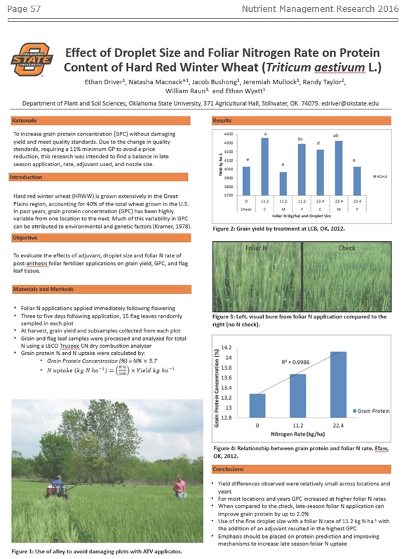
Soil Fertility Research Highlights
Research Highlights 2016
http://nue.okstate.edu/checkoff.htm
58 pages
- Reduce preplant N
- Extend SBNRC (32)
- N Rich Strip

Slide 4
Summary for 2016
i-phone, algorithms developed (3)
Soil Fertility Handbook completed (8th Edition)
Trimble Greenseeker Hand Held Crop Sensors manufactured and sold all over the world.
Graduate students placed in leadership positions with Mosaic, Monsanto, IPNI, IITA, Potash Corp, Virginia Tech, Kansas State, Univ. Idaho, Louisiana State University, Washington State University, University of Wisconsin, Bayer CropScience, Dupont-Pioneer, University of Wisconsin, and Oklahoma State University.
14th International NUE Conference, Aug 8-10, Boise, ID
Research Highlights, 2016, 58p. (http://nue.okstate.edu/checkoff.htm)
CSA NEWS, Cover story, March 2016

Slide 5
Products 2016:
10 students completed Graduate Degrees (9 M.S., 1 Ph.D)
18 refereed Journal Publications
9 students traveled to Ciudad Obregon, Mexico, to collect added spring wheat data and to assist in refining present algorithms with CIMMYT personnel.
Handheld GreenSeeker sensors distributed to County level OCES
Web-based dissemination of field scale N fertilization rates based on our optical sensor-based technology (http://www.nue.okstate.edu)
One algorithm added (SBNRC)
5 mobile apps released, 11 apps in total
13 graduate students, to support from the Soil Fertility Research and Education Advisory Board. These students are paid on average $15,660 per year, working full time in the summer and ½ time in the fall and spring semesters. Work coming from this group is the fuel needed for any viable research program

Slide 6
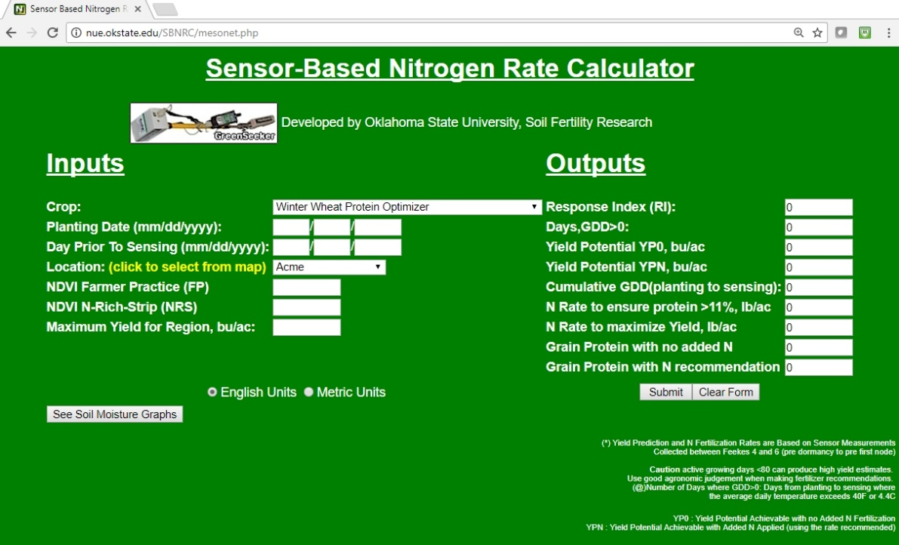
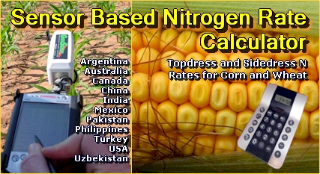
Predicting Grain Protein
Woolfolk, C.W., W.R. Raun, G.V. Johnson, W.E. Thomason, R.W. Mullen, K.J. Wynn, and K.W. Freeman. 2002. Influence of late-season foliar nitrogen applications on yield and grain nitrogen in winter wheat. Agron. J. 94:429-434
Freeman, K.W., W. R. Raun, G.V. Johnson, R.W. Mullen, M.L. Stone, and J.B. Solie. 2003. Late-season prediction of wheat grain yield and grain protein. Commun. Soil Sci. Plant Anal. 34:1837-1852.
Macnack, Natasha, Bee Chim Khim, Jeremiah Mullock, and William Raun. 2014. In season prediction of nitrogen use efficiency and grain protein in winter wheat, Triticum aestivum L.. Commun. Soil Sci. Plant Anal. 00:1-15. DOI:10.1080/00103624.2014.904337.
Wyatt, Ethan, Jacob Bushong, Jeremiah Mullock, Natasha Macnack, Randy Taylor, and William Raun. 2014. Effect of adjuvant, nitrogen rate, and spray droplet size on protein content of hard red winter wheat (in press)
SBNRC, Option 4, Winter Wheat Protein Optimizer (2011)

Slide 7
Woolfolk, Agron. J. 94:429-434
Grain protein averaged over years and locations in control plots was 14.9% with 16.5 and 16.3%, respectively, for pre-flowering, and post-flowering
Foliar N applications just before and following flowering can significantly enhance grain N content and, thus, percent protein in winter wheat
Macnack,. 00:1-15. DOI:10.1080/00103624.2014.904337
In-Season Prediction of Nitrogen Use Efficiency and Grain Protein in Winter Wheat (Triticum aestivum L.)
NDVI and rainfall explained 45% of the variability in Grain Protein at F7 growth stage. Preplant N, NDVI, rainfall and growing degree days (GDD) combined explained 76% (r2 = 0.76) of the variability in GP at F3. Mid-season climatic data improved the prediction of GP and should be considered for refining fertilizer recommendations when GP levels are expected to be low.
Wyatt. (in press)
Use of the fine droplet size with a foliar N rate of 11.2 kg N ha⁻¹ applied post anthesis and with the addition of an adjuvant resulted in the highest grain protein concentration (13.8 to 14.8 % protein)

Slide 8


Long-term Study on the Impact of Manure on Winter Wheat Grain Yields
EFFECT OF MANURE APPLICATIONS COMPARED TO COMMERCIAL FERTILIZER FOR TOTAL NITROGEN IN DRYLAND WINTER WHEAT (TRITICUM AESTIVUM L.)
Jeremiah Butler
Objective
Evaluate the long-term impact of manure on winter wheat grain yields and total available nitrogen
Years after application | 120 lbs ac⁻¹ |  | 240 lbs ac⁻¹
 | N contribution | N availability | N contribution | N availability
 | lb ac⁻¹ | % | lb ac⁻¹ | %
1 2 3 4 | 13.42 24.23 17.27 21.59 | 11 20 14 18 | 42.87 39.86 30.79 25.88 | 18 17 13 11
Total | 76.51 |  | 139.40
NUE |  | 64 |  | 58
Treatment | Description | Nitrogen Source | N applied (lbs ac⁻¹)
 |  |  | 1932-1967 | 1968-2015
Manure | Manure applied every four years | Cattle feedlot manure | 120 | 240
NPKL | N, P, and K applied each year + lime applied when soil pH < 5.5 | Sodium nitrate (16-0-0) | 33 | -
 |  | Ammonium nitrate (34-0-0) Urea (46-0-0) | - | 60
Check | No nutrient applied | - | - | -
Jeremiah Butler

Slide 9
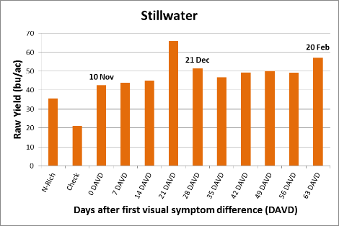
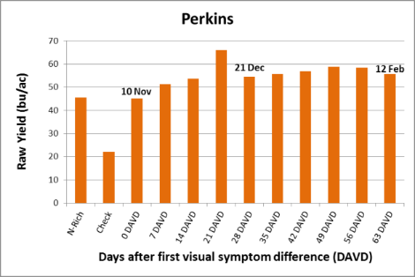
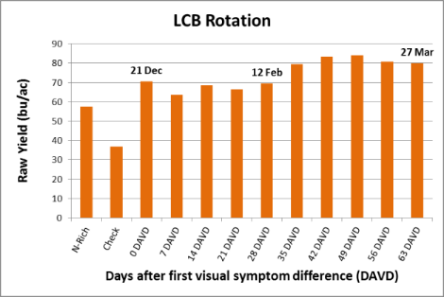
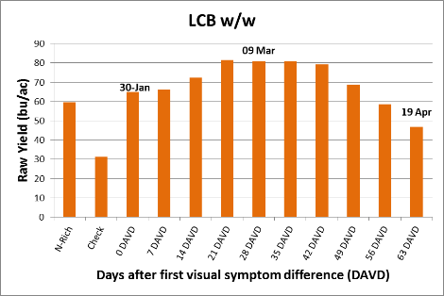

Top-dress N application timing in winter wheat
Joao Luis Bigatao Souza
Objective: Determine the impact of delaying top-dress application of nitrogen in winter wheat after visual response from the N-rich strip has been documented.
Joao Luis Bigatao Souza

Slide 10
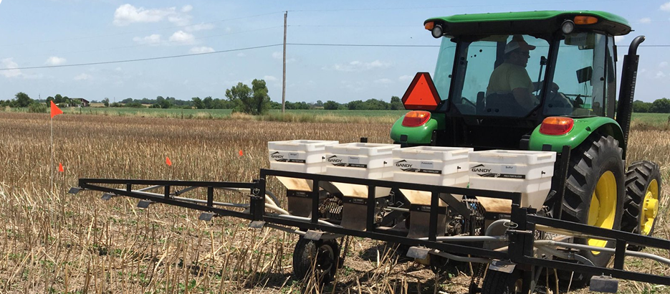
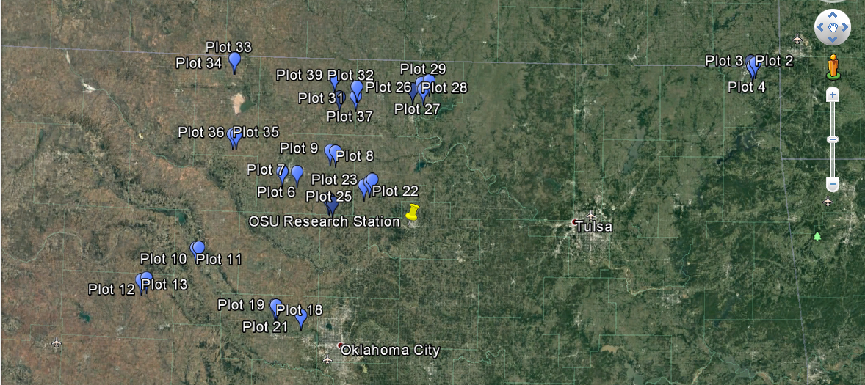

On-farm evaluation of Double Crop Fertility Management in Oklahoma
Vaughn Reed
Objective: To evaluate NPKS fertilizer management strategies of Oklahoma double crop producers.
Currently in the second year
2016:
  40 plots applied (as seen in the map)
  30 plots harvested:
    4 sorghum
    2 sunflower
    24 soybean
2017:
  Aim to apply 50 plots, and harvest 40, adding corn and more sunflower and sorghum plots.

Slide 11


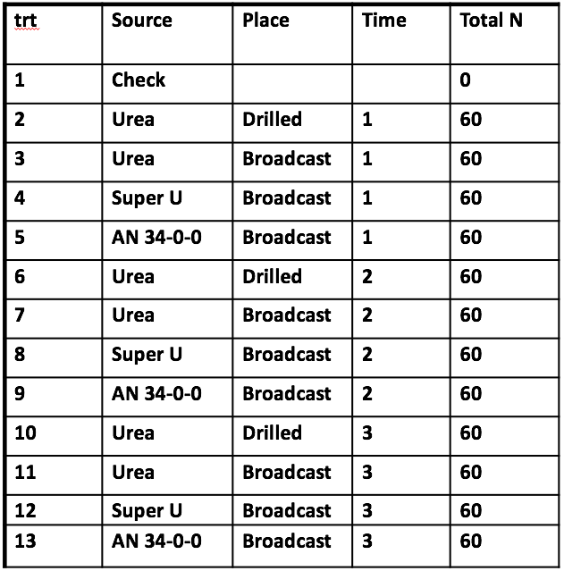
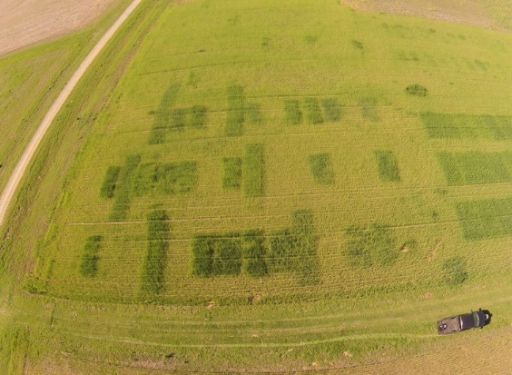
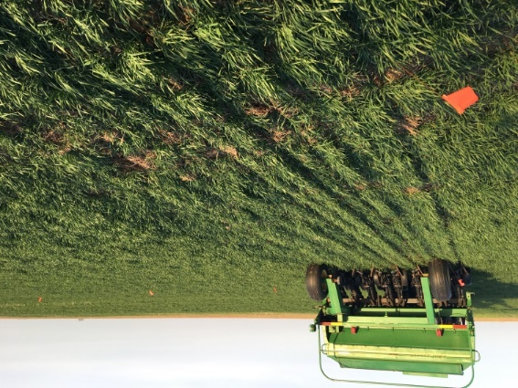
Drilled Topdress Nitrogen
Brent Ballagh
Objective: This study is being conducted to determine if placing nitrogen fertilizer in a band below the soil surface will help to decrease nitrogen volatilization, increase crop yields per unit of nitrogen, and not cause a negative impact on the wheat plant itself due to drill damage.

Slide 12
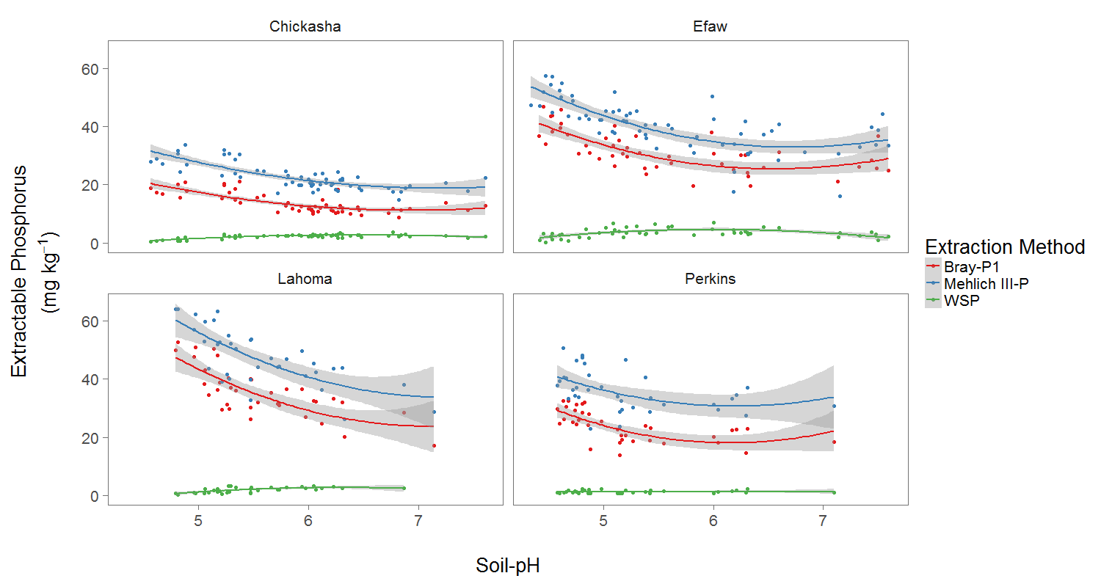

Impact of Soil-pH on Extractable Soil-P
Bryan Rutter
Objective: Investigate the relationship between soil-pH and soil test-P using various extraction methods

Slide 13
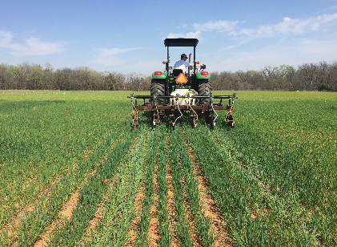

Effect of Timing and Placement of Nitrogen on Winter Wheat
(Triticum aestivum L.) Grain Yield and Plant Nitrogen loss
Jagman Dhillon
TRT | Preplant (kg N/ ha) | Method | Top-dress (kg N/ha) (Fk 4-6) | Method
1 | 0 |  | 0
2 | 90 | Surface | 0
3 | 90 | 5”D | 0
4 | 45 | Surface | 45 | Surface
5 | 45 | Surface | 45 | 5”D
6 | 45 | Surface | 45 | Foliar
7 | 45 | 5”D | 45 | Surface
8 | 45 | 5”D | 45 | 5”D
9 | 45 | 5”D | 45 | Foliar
10 |  |  | 90 | Surface
11 |  |  | 90 | 5”D
12 |  |  | 90 | Foliar
Objective: To determine the ideal timing and method of N placement for Winter Wheat
Crop | Location | Preplant N | Planting | Top-dress | GDD >0
Wheat | Efaw | 10/01/2016 | 10/14/2016 | 03/21/2017 | 118
Wheat | Perkins | 10/01/2016 | 10/19/2016 | 03/09/2017 | 109
Jagman Dhillon

Slide 14
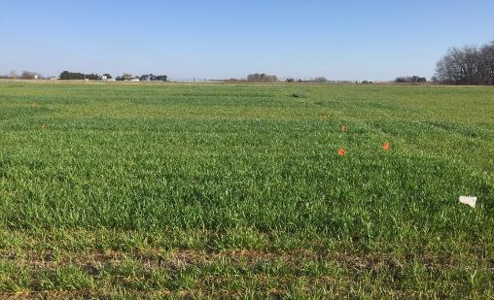

Effect of Timing and N rate on Winter Wheat (Triticum aestivum) Grain Yield
Jagman Dhillon
Objective: To determine the ideal GDD>0 to apply N fertilizer when no N is applied pre-plant
Treatment | Timing, days, GDD>0 | Rate
1 | Check | 0
2 | Preplant | 90
3 | 65 | 30
4 |  | 60
5 |  | 90
6 | 80 | 30
7 |  | 60
8 |  | 90
9 | 95 | 30
10 |  | 60
11 |  | 90
12 | 110 | 30
13 |  | 60
14 |  | 90
Crop | Location | Preplant N | Planting | Top-dress | GDD >0
Wheat | Efaw | 10/01/2016 | 10/14/2016 | 01/12/2017 02/06/2017 02/23/2017 03/10/2017 | 65 80 95 110
Wheat | Perkins | 10/01/2016 | 10/19/2016 | 01/12/2017 02/06/2017 02/23/2017 03/10/2017 | 65 80 95 110

Slide 15
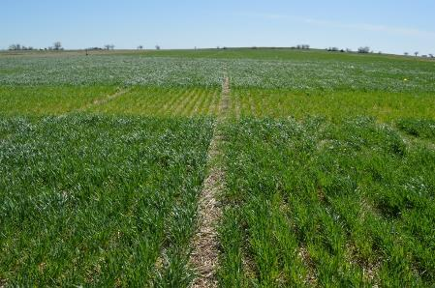
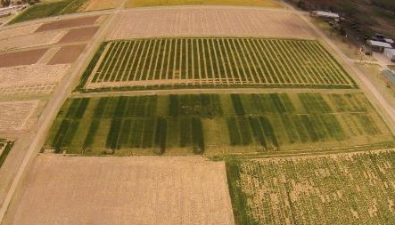

Sequential NDVI Measurements in Winter Wheat for Improved
Prediction of Winter Wheat Grain Yield and Mid-Season N Rate
Bruno Morandin Figueiredo
Experiment 222, Stillwater, OK
11 NDVI readings were taken from Dec. 21, 2015 to April 12, 2016
Experiment 502, Lahoma, OK
10 NDVI readings were taken from Dec. 18, 2015 to April 07, 2016
Bruno Morandin
Figueiredo

Slide 16

PLATEAU | INTERCEPT | SLOPE | JOINT | RSQ
0.87955 | -0.88423 | 0.01593 | 110.723 | 0.80
X | Y
55.61006 | 0
110.723 | 0.87955

Slide 17

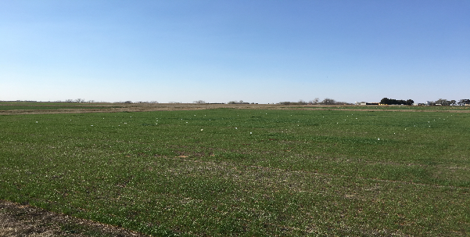

Optimum Preplant and Sidedress Nitrogen Rates for Winter Wheat
Robert Lemings
Treatment | Preplant (lb N/ ac) | Sidedress N (lb N/ac
1 | 0 | 0
2 | 15 | 0
3 | 30 | 0
4 | 45 | 0
5 | 60 | 0
6 | 90 | 0
7 | 0 | 30
8 | 30 | 30
9 | 60 | 30
10 | 60 | 60
11 | 90 | 30
12 | 0 | 60
Objective: To determine the optimum preplant and sidedress N rates for winter wheat grain yield and NUE
Crop | Location | Pre-plant N | Planting Date | Topdress N | Sensor Dates | days GDD>0
Wheat | Perkins | 9/30/2016 | 20/1/2016 | 3/8/2017 | 2/23/2017 | 125
 |  |  |  |  | 3/8/2017
Wheat | Lahoma | 10/13/2016 | 10/18/2016 | 3/17/2017 | 3/9/2017 | 100
 |  |  |  |  | 3/16/2017

Slide 18
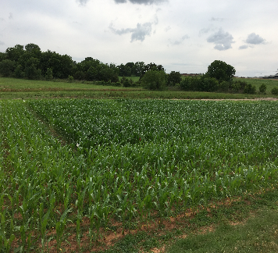

Optimum Preplant and Sidedress Nitrogen Rates for Corn
Robert Lemings
Treatment | Preplant N (lb/ac) | Sidedress N (lb/ac)
1 | 0 | 0
2 | 30 | 0
3 | 60 | 0
4 | 90 | 0
5 | 120 | 0
6 | 15 | 15
7 | 30 | 30
8 | 45 | 45
9 | 60 | 60
10 | 0 | 30
11 | 0 | 60
12 | 0 | 90
13 | 0 | 120
Objective: To determine the optimum preplant and sidedress N rates for corn grain yield and NUE
Crop | Location | Pre-plant N | Planting Date | Topdress N | Sensor Dates | Sum of GDD
Corn | Efaw | 4/13/2017 | 4/13/2017 | 6/8/2017 | 5/26/2017 | 915
 |  |  |  |  | 6/7/2017
 |  |  |  |  | 6/16/2017
Corn | LCB | 4/13/2017 | 4/13/2017 | 6/8/2017 | 5/26/2017 | 871
 |  |  |  |  | 6/7/2017
 |  |  |  |  | 6/16/2017

Slide 19

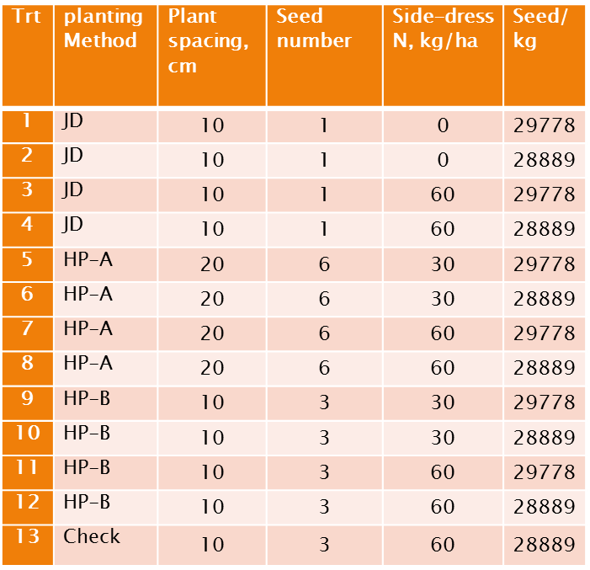
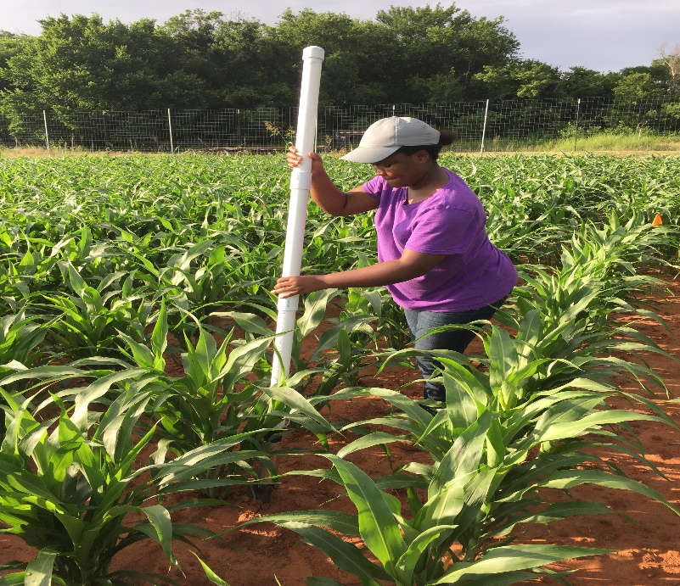
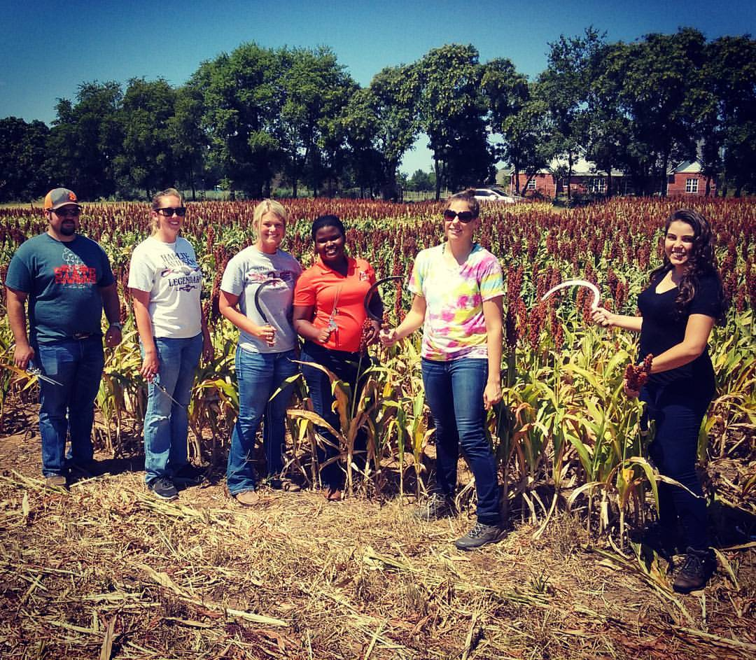

Effect of plant spacing and seeding density on Sorghum
(Sorghum bicolor L.) grain yields using the OSU hand planter
Eva Nambi
Objective: To determine the value of decreasing seeds/strike while maintaining the same plant population (6 , 3 and 1 seeds)
Treatment Structure
Lake Carl Blackwell
EFAW
Sorghum
Location | planting date | date before sensing | GDD
LCB | 4/26/2016 | 6/13/2016 | 675
 |  | 6/20/2016 | 876
 | 5/9/2017 | 6/21/2017 | 759
Efaw | 4/25/2016 | 6/13/2016 | 695
 |  | 6/29/2016 | 1153
 | 5/15/2017 | 6/21/2017 | 705

Slide 20
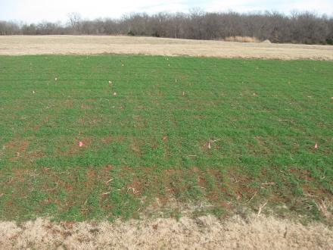

Residual N Effect Following Failed Crops (Wheat and Sorghum)
Tyler Lynch
Objective: Evaluate residual N effects following summer crops (sorghum) that fail
Treatment | Previous Crop | Previous Crop Pre N rate (lb N/ac) | Wheat Pre N Rate (lb N/ac)
1 | Sorghum | 0 | 0
2 | Sorghum | 30 | 0
3 | Sorghum | 60 | 0
4 | Sorghum | 90 | 0
5 | Sorghum | 120 | 0
6 | Sorghum | 150 | 0
7 | Sorghum | 60 | 30
8 | Sorghum | 60 | 60
9 | Sorghum | 60 | 90
10 | Sorghum | 60 | 120
11 | Sorghum | 60 | 150
Preplant N | Planting | FK7 GDD | Harvest
9/30/2017 | 10/20/2017 | 121 | 6/13/2017
Tyler Lynch

Slide 21



South Central Great Plains
Winter Wheat N Algorithm
Treatment | N - Rate (lb N/ac) | Yield (bu/ac) | Net Return ($/ac)
Split Application | 100 | 35 ± 16 | 154 ± 100
SBNRC | 45 ± 21 | 34 ± 16 | 172 ± 94
Average Difference |  |  | 12 ± 25
 |  |  | Max: 66
 |  |  | Min: -52
Fertilizer Price (28-0-0) = $0.56/lb N
Grain Price = $5.00/bu
http://nue.okstate.edu/SBNRC/mesonet.php
Option 3: Winter Wheat, South Central Great Plains
Tyler Lynch, Bruno Figueiredo

Slide 22
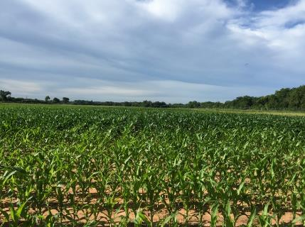

Maize Regional Trials
Jagman Dhillon
Preplant: ATV UAN spray
Sidedress: Drop down nozzles
Objective: Refinement of the OSU sensor based N rate calculator (SBNRC) and Optimum Fertilizer N rates
Treatment | Preplant N (lb N/ac) | Sidedress N (lb N/ac) | Method of Application
1 | 0 | 0 | Check
2 | 200 | 0 | N Rich Strip
3 | 40 | 0
4 | 40 | 30
5 | 40 | 60
6 | 40 | 90
7 | 40 | 120
8 | 40 | 150
9 | 40 | 180
10 | 80 | 0
11 | 120 | 0
12 | 160 | 0
Crop | Location | Preplant N | Planting | Top-dress | Sum of GDD
Maize | Efaw | 04/13/2017 | 04/13/2017 | 06/08/2017 | 915
Maize | Lake Carl Blackwell | 04/13/2017 | 04/13/2017 | 06/08/2017 | 871
Jagman Dhillon

Slide 23
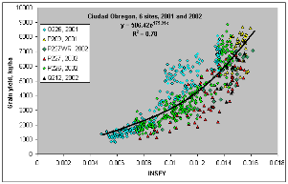
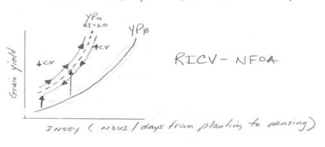
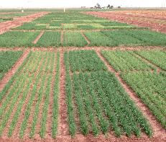
Use of Coefficient Variation (CV) from NDVI, to Improve Yield Prediction
Bruno Morandin Figueiredo
Objective: To refine the use of CV (coefficient variation) data coming from Normalized Difference Vegetative Index (NDVI) readings for predicting wheat grain yield
Bruno
Morandin
Figueiredo

Slide 24
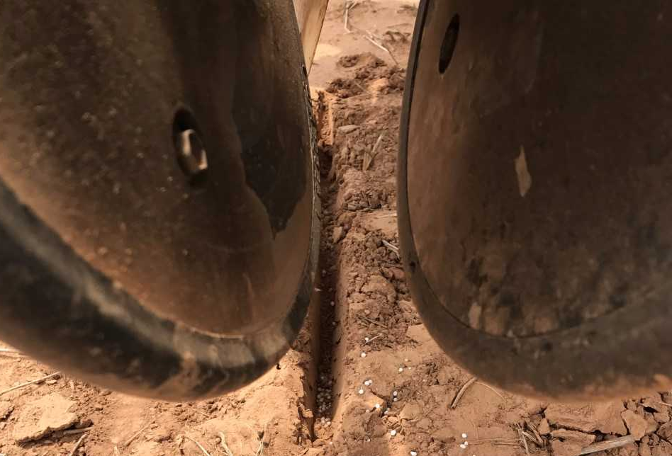

Effect of Applying Nitrogen with Sorghum Seed (Sorghum bicolor)
on Emergence and Final Grain Yield
Elizabeth Eickhoff
Objective: Evaluate the impact of applying different rates of nitrogen with the seed on seedling emergence, and final grain yield in sorghum with different populations.
Treatment | Pre-Plant N (kg/ha) | N with Seed (kg/ha) | Mid-Season N (kg/ha) | Population (seeds/ha)
1 | 0 | 0 | 0 | A
2 | 0 | 0 | 0 | B
3 | 0 | 0 | 0 | C
4 | 0 | 10 | 0 | A
5 | 0 | 10 | 0 | B
6 | 0 | 10 | 0 | C
7 | 0 | 20 | 0 | A
8 | 0 | 20 | 0 | B
9 | 0 | 20 | 0 | C
10 | 0 | 30 | 0 | A
11 | 0 | 30 | 0 | B
12 | 0 | 30 | 0 | C
13 | 30 | 0 | 0 | B
14 | 0 | 0 | 30 | B
Populations
A = 100,000 seeds / ha
B = 150,000 seeds / ha
C = 200,000 seeds / ha
Crop | Location | Preplant N Trt 13 | Planting Date | Sensor Dates | Sum of GDD
Sorghum | Efaw | 06/02/2017 | 06/02/2017 | 06/16/2017 06/21/2017 | 356 496
Sorghum | LCB | 06/02/2017 | 06/02/2017 | 06/16/2017 06/21/2017 | 368 504
Elizabeth Eickhoff

Slide 25
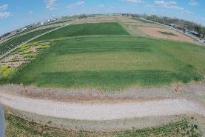
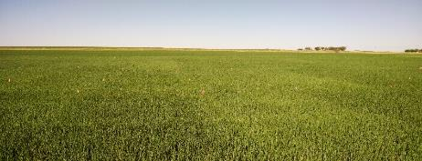

Environmental Variability in Check Plot Yields
Alimamy Fornah
Experiment 502 (Lahoma)
Objective: To evaluate the relative influence of the environment on check plot yields.
TRT | Pre-plant N rate (lb N / ac) | Pre-plant P rate (lb P2O5 / ac) | Pre-plant K rate (lb K2O / ac)
1 | 0 | 0 | 0
2 | 0 | 40 | 60
3 | 20 | 40 | 60
4 | 40 | 40 | 60
5 | 60 | 40 | 60
6 | 80 | 40 | 60
7 | 100 | 40 | 60
8 | 60 | 0 | 60
9 | 60 | 20 | 60
10 | 60 | 60 | 60
11 | 60 | 80 | 60
12 | 60 | 60 | 0
13 | 100 | 80 | 60
14 | 60 | 40 | 60 (Sul-Po-Mag)
Magruder Plots (Stillwater)
(6) Nitrogen, Phosphorus, Potash, and Lime 60-30-30+Lime
(5) Nitrogen, Phosphorus, and Potash 60-30-30
(4) Nitrogen and Phosphorus 60-30-0
(3) Phosphorus 0-30-0
(2) Check
(1) Manure every 4 years at 240 lbs N/A

Slide 26
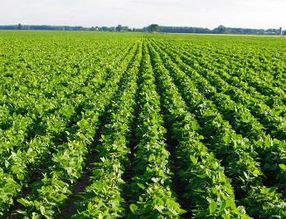
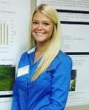
Optimum Sulfur Application for Soybeans in Oklahoma
Gwen Wehmeyer
Trt | Fertilizer | Timing | kg S ha -1 | kg carrier N ha -1 | kg/ha total product
1 | check | . | 0 | 0 | 0
2 | Ammonium Nitrate | Preplant | 0 | 14 | 68
3 | Ammonium Sulfate | Preplant | 5 | 5 | 23
4 | Ammonium Sulfate | Preplant | 11 | 10 | 45
5 | Ammonium Sulfate | Preplant | 16 | 14 | 68
6 | Ammonium Sulfate | Sidedress | 5 | 5 | 23
7 | Ammonium Sulfate | Sidedress | 11 | 10 | 45
8 | Ammonium Sulfate | Sidedress | 16 | 14 | 68
Objective: To determine the effect of applied sulfur on soybean grain yields, grain protein and oil quality
Gwen Wehmeyer

Slide 27
NEW PROJECTS
N Source, Method and Timing on Yield and Protein (Wheat)
Phosphorus Rich strip for P recommendations (Wheat and Corn)
Use of data from UAVs for Sensor Based Nitrogen Rate Calculator (Wheat and Corn )
Refinement of sumGDD, days from planting to sensing GDD>0, threshold temperature for GDD, use of live Mesonet data in SBNRC (Wheat and Corn)
On Farm NPKS Response strips (Wheat, Corn, Sorghum)
Use of Indicator Crops for Deciphering Nitrogen Response in Corn
Timing of cover crop termination/impact on Nutrient cycling and weed control
On Farm NPKS Response strips
Sulfur and Potassium Fertilization, Response and yield prediction (Soybean)
Impact of soil acidity on new herbicides (different chemistry)
Expanding SBNRC Algorithms (outreach)

Slide 28
ATMOSPHERE
GLOBAL WARMING
15-40 kg/ha
N₂O
NO
N₂
INDUSTRIAL
FIXATION
LIGHTNING,
RAINFALL
CH_{4 ,} N₂O
N2 FIXATION
HABER BOSCH
PLANT AND ANIMAL
RESIDUES
SYMBIOTIC
NON-SYMBIOTIC
(1200°C, 500 atm)
MESQUITE
RHIZOBIUM
ALFALFA
SOYBEAN
BLUE-GREEN ALGAE
AZOTOBACTER
CLOSTRIDIUM
3H₂ + N₂ 2NH₃
MATERIALS WITH N
CONTENT > 1.5%
(COW MANURE)
MATERIALS WITH N
CONTENT < 1.5%
(WHEAT STRAW)
10-80 kg/ha
FERTILIZATION
PLANT
LOSS
AMINO
ACIDS
MICROBIAL
DECOMPOSITION
0-50 kg/ha
NH₃
IMMOBILIZATION
AMMONIA
VOLATILIZATION
AMINIZATION
ORGANIC
MATTER
HETEROTROPHIC
R-NH₂ + ENERGY + CO₂
BACTERIA (pH>6.0)
FUNGI (pH<6.0)
R-NH₂ + H₂O
pH>7.0
NH₂OH
AMMONIFICATION
FIXED ON
EXCHANGE
SITES
IMMOBILIZATION
R-OH + ENERGY + 2NH₃
Pseudomonas, Bacillus,
Thiobacillus Denitrificans,
and T. thioparus
N₂O₂⁻
MICROBIAL/PLANT
SINK
2NH₄⁺ + 2OH⁻
MINERALIZATION
+ NITRIFICATION
NO₂⁻
+O₂
DENITRIFICATION
Nitrosomonas
NO₃⁻
POOL
NITRIFICATION
OXIDATION STATES
DENITRIFICATION
LEACHING
LEACHING
VOLATILIZATION
NITRIFICATION
Nitrobacter
+ O₂
2NO₂⁻ + H₂O + 4H⁺
NH₃ AMMONIA -3
NH₄⁺ AMMONIUM -3
N₂ DIATOMIC N 0
N₂O NITROUS OXIDE 1
NO NITRIC OXIDE 2
NO₂⁻ NITRITE 3
NO₃⁻ NITRATE 5
TEMP 50°F
Joanne LaRuffa
Wade Thomason
Shannon Taylor
Heather Lees
Department of Plant and Soil Sciences
Oklahoma State University
ADDITIONS
LEACHING
LEACHING
LOSSES
LEACHING
OXIDATION REACTIONS
pH 7.0
0-40 kg/ha
REDUCTION REACTIONS

Slide 29
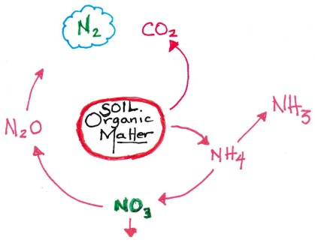
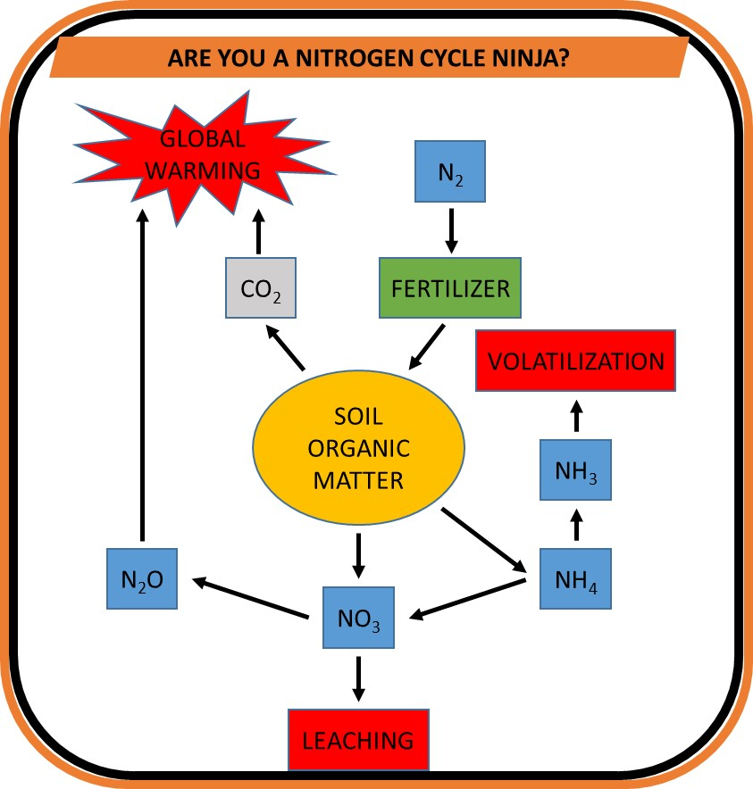
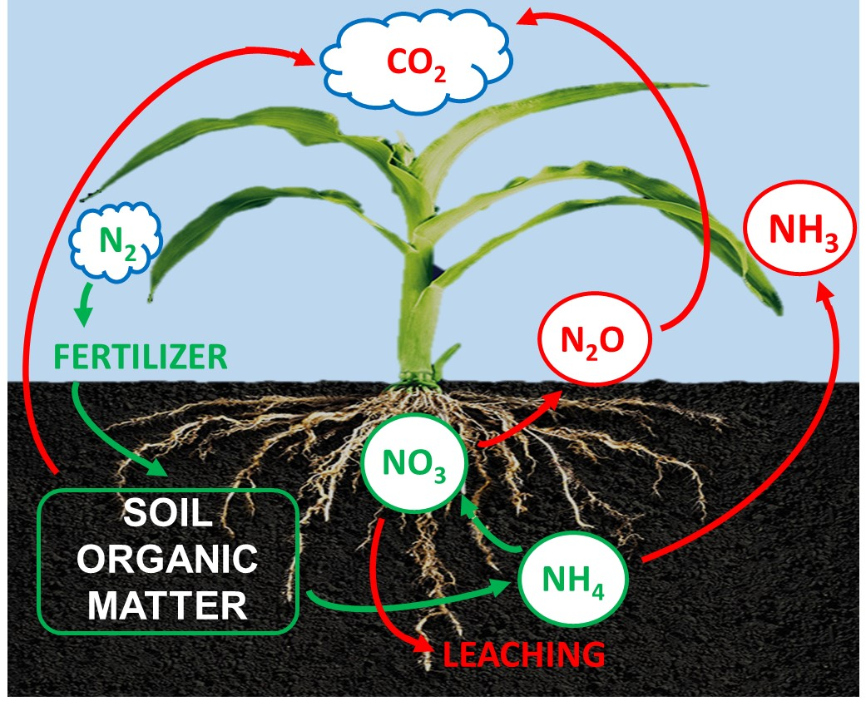
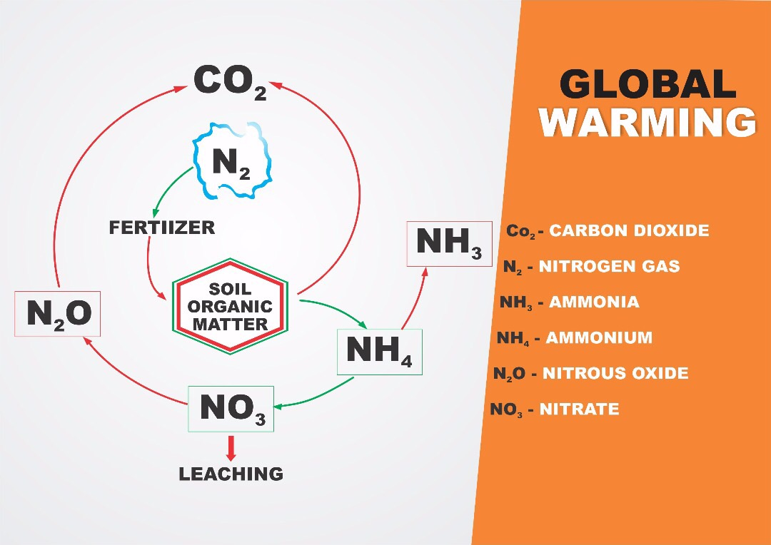
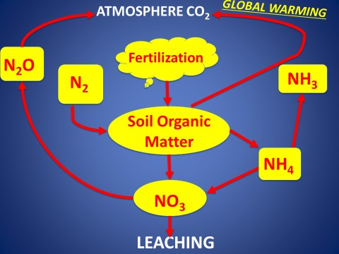

Slide 30
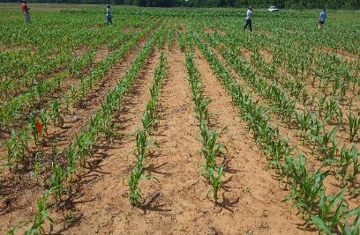

Row Spacing , Seeding Density & Nitrogen Rate on
Maize (Zea mays L.) Grain Yield
Alimamy Fornah
Objective: To evaluate the effect of row spacing and seeding density with different rates of N, using the OSU hand planter and a simulated farmer practice
TRT | Side dress N kg/ha | Plant to plant spacing | Row spacing | Planter | Seeding density, seeds/ha
1 | 0 | 0.15 | 0.51 | Check-FP | 130,718
2 | 0 | 0.15 | 0.76 | Check-FP | 87,719
3 | 60 | 0.15 | 0.51 | HP | 130,718
4 | 60 | 0.15 | 0.76 | HP | 87,719
5 | 60 | 0.3 | 0.51 | HP | 65,359
6 | 60 | 0.3 | 0.76 | HP | 48,859
7 | 60 | 0.15 | 0.51 | FP | 130,718
8 | 60 | 0.15 | 0.76 | FP | 87,719
9 | 60 | 0.3 | 0.51 | FP | 65,359
10 | 60 | 0.3 | 0.76 | FP | 48,859
11 | 120 | 0.3 | 0.51 | HP | 65,359
12 | 120 | 0.3 | 0.76 | HP | 48,859
13 | 120 | 0.15 | 0.51 | HP | 130,718
14 | 120 | 0.15 | 0.76 | HP | 48,859
Crop | Location | Planting Date | Sensing Date | Days GDD>0
Corn | Perkins | 4/19/2017 | 6/8/2017 | 816
 |  |  | 6/15/2017 | 1015
 |  |  | 6/20/2017 | 1143
Corn | LCB | 5/9/2017 | 6/8/2017 | 581
 |  |  | 6/15/2017 | 778
 |  |  | 6/20/2017 | 901

Slide 31

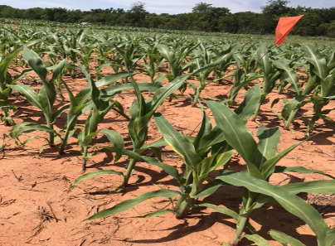

Maize Grain Yield Response to Method of Nitrogen Fertilization with
Indigenous and Precision Planters
Fikayo B. Oyebiyi
Objective :To evaluate conventional methods of N fertilizer application using indigenous planting/fertilization methods, and the OSU Hand Planter
TRT | Planter | Side-dress (Methods) | N, kg/ha
1 | Check-HP | -- | 0
2 | OSU-HP | OSU-HP | 60
3 | OSU-HP | OSU-HP | 120
4 | OSU-HP | Dribble | 60
5 | OSU-HP | Dribble | 120
6 | OSU-HP | Broadcast | 60
7 | OSU-HP | Broadcast | 120
8 | FP | OSU-HP | 60
9 | FP | OSU-HP | 120
10 | FP | Dribble | 60
11 | FP | Dribble | 120
12 | FP | Broadcast | 60
13 | FP | Broadcast | 120
14 | FP | -- | 0
Crop | Location | Planting Date | Sensor Date | Sum of GDD
Corn Perkins 04/19/2017 06/08/2017 816
06/15/2017 1015
06/20/2017 1143
Corn LCB 05/09/2017 06/08/2017 581
06/15/2017 778
06/20/2017 901
Fikayo B. Oyebiyi

Slide 32
Figure 2. Relationship between the coefficient of determination (r²) and GDD>0, for NDVI data collected over time, Exp. 222, Stillwater, OK, 2016.
When can mid-season NDVI reveal N Response in Winter Wheat
PLATEAU | INTERCEPT | SLOPE | JOINT | RSQ
0.91511 | -0.73019 | 0.015767 | 104.351 | 0.92
X | Y
46.21519 | 0
104.351 | 0.91511

Slide 33
Figure 1. Relationship between the coefficient of determination (r²) and GDD>0, for NDVI data collected over time, Exp. 502, Lahoma, OK, 2016.
When can mid-season NDVI reveal N Response in Winter Wheat
PLATEAU | INTERCEPT | SLOPE | JOINT | RSQ
0.84543 | -1.21492 | 0.18319 | 112.471 | 0.94
X | Y
66.38798 | 0
112.471 | 0.84543

Slide 34
Hand Planter (uses)
Mosquito abatement USEPA, Northfield, IL
https://www.epa.gov/mosquitocontrol
Squash production, Valley Center, KS
Pumpkin production, Stillwater, OK
Wildlife food plots,
Home gardeners
Mid-row, maize, coffee plantations, Colombia

