Slide 1
Minnesota Corn Growers Association
738 1st Ave. E.
Shakopee, MN 55379
(952)460-3606 Phone
(952)356-4962 Cell
(952)233-0420 Fax maanum@mncorn.org
June 15, 2011

Slide 2
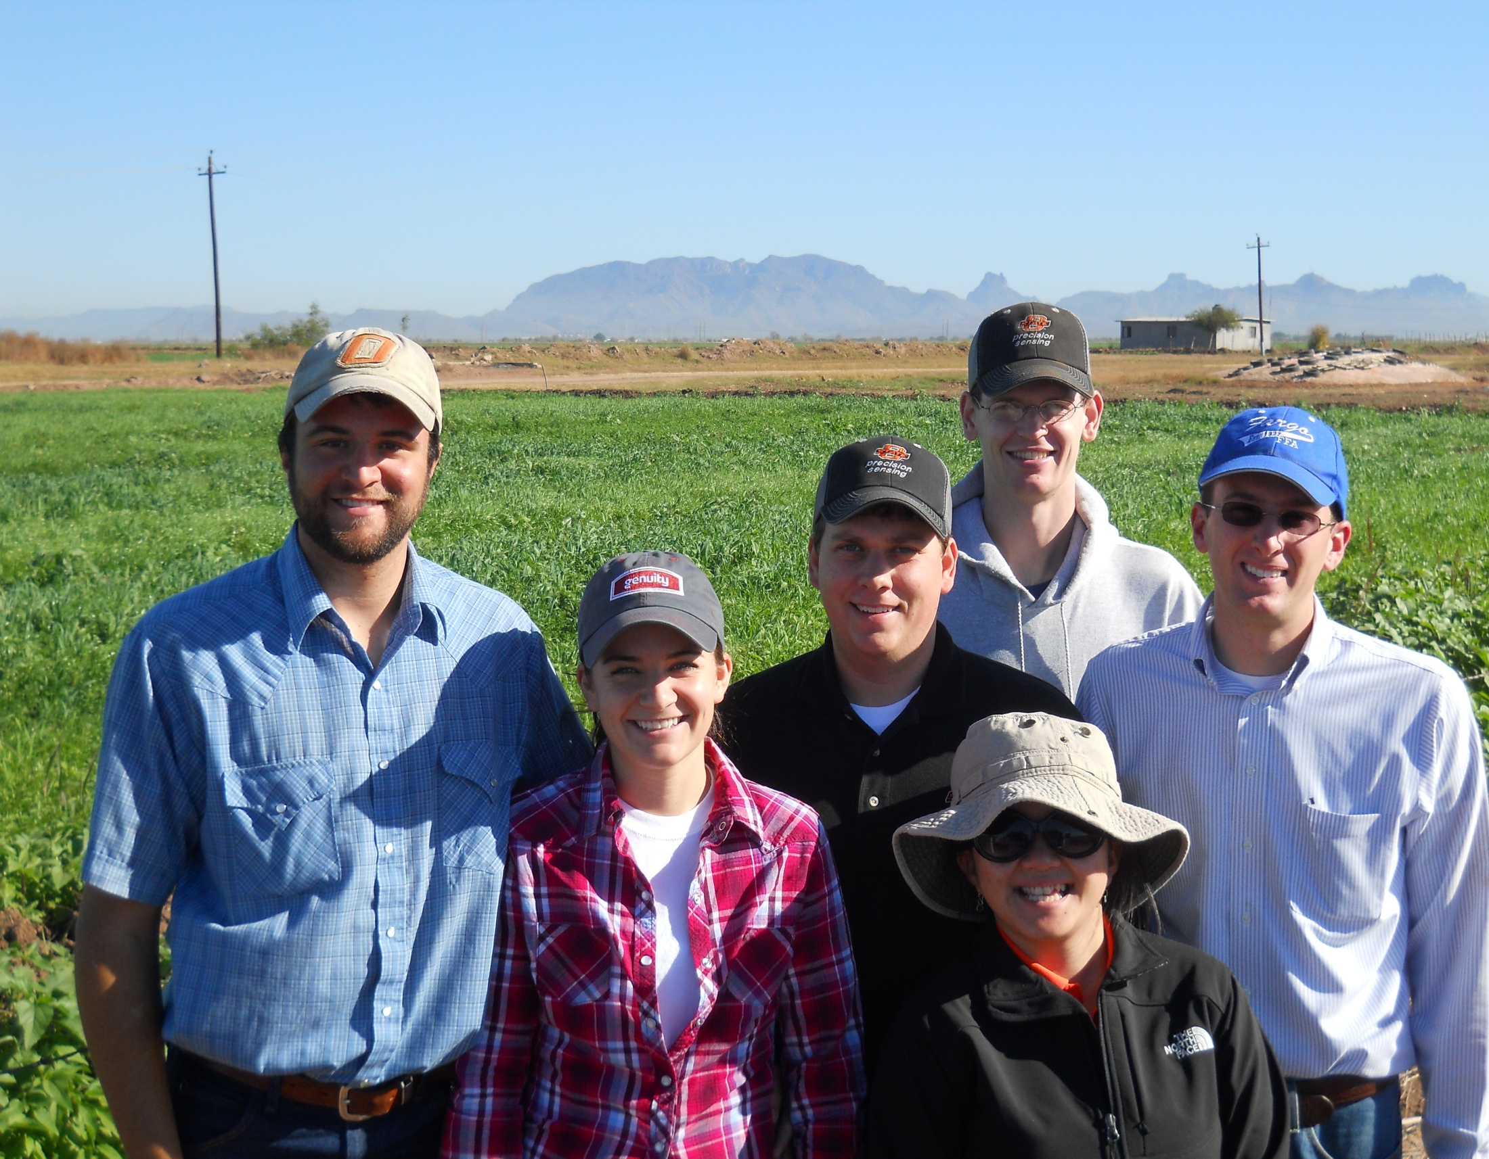
Students

Slide 3
1989-present
67 graduates MS, PHD
18 – faculty level positions
 | Graduated Students (1992-2011) | Where are they Now?
1 | Ascencio, Edgar Noel. 1992. M.S. | CARE, San Salvador, El Salvador
2 | Attefat, Mehdi. 1992. M.S. | Iraq,
3 | Sembiring, Hasil. 1993. M.S. | Indonesia, National Program
4 | Jojola, Michael E. 1994. M.S.
5 | Morales, Sonia. 1994. M.S.
6 | Kanampiu, Fred Kaburu. 1995. Ph.D. | CIMMYT, Kenya
7 | Ascencio, Edgar Noel. 1995. Ph.D. | CARE, San Salvador, El Salvador
8 | Gavi-Reyes, Francisco. 1995. Ph.D. | Univ. Post Graduados, Chapingo
9 | Ball, Jeff B. 1995. M.S. | Bayer Crop Science
10 | Phillips, Steven B. 1995. M.S. | Staff, IPNI
11 | Taylor, S.L. 1996. M.S. | USDA-ARS
12 | Chen, J. 1997, M.S. | Ford Motor Co.
13 | Keahey, D.A., 1997, M.S. | Private Enterprise
14 | Lees, H.L., 1997, M.S.
15 | Sembiring, H. 1997, Ph.D. | Indonesia, National Program
16 | Thomason, W.E. 1998, M.S. | Faculty, Virginia Tech
17 | Lukina, E.V. 1998, M.S. | Lab Assistant
18 | LaRuffa, Joanne M. 1999, M.S.
19 | Phillips, S.B. 1999, Ph.D. | Staff, IPNI
20 | DeLeon, Micah, 1999, M.S. | Graduate Student
21 | Dennis, Jeremy, 1999, M.S. | NRCS
22 | Woolfolk, Curt, 1999, M.S. | SST, Stillwater, OK
23 | Cossey, Doug, 1999, M.S. | Servi-Tech, Dodge City, KS
24 | Mullen, R.W. 2001, M.S. | Prof. Ohio State University
25 | Wynn, K. 2001, M.S. | SCS
26 | Thomason, W.E. 2001, Ph.D. | Faculty, Virginia Tech
27 | Lukina.E.V. 2001, Ph.D. | Lab Assistant
28 | Freeman, Kyle W. 2001, M.S. | Mosaic, MN
29 | Teal, Roger, 2002, M.S.
30 | Moges, Shambel, 2002, M.S. | Accurate Environmental Labs
31 | Mullen, Robert, 2002, Ph.D. | Prof. Ohio State University
32 | Micah Humphreys, 2003, M.S. | Faculty, Northwest College, Wyoming
33 | Paul Hodgen, 2003, M.S.
34 | Jason Lawles, 2004, M.S. | Western Mechanical, Weatherford, OK
35 | Jagadeesh Mosali, 2004, Ph.D. | Noble Foundation, Ardmore, OK
36 | Keri, Brixey, 2004, M.S. | NRCS Kansas
37 | Brian Arnall, 2004, M.S. | Faculty, Oklahoma State University
38 | Kefyalew Desta, 2004, Ph.D. | Faculty, Oklahoma State University
39 | Roger Teal, 2005, Ph.D.
40 | Kent Martin, 2005, M.S. | Faculty, Kansas State University
41 | Kyle Freeman, 2005, Ph.D. | Mosaic, MN
42 | Shambel Moges, 2005, Ph.D | Accurate Labs
43 | Clint Mack, 2006, M.S. | Farmer/Consultant, OK
44 | Kyle Lawles, 2006, M.S. | Monsanto, Iowa
45 | Olga Walsh, 2006, M.S. | Faculty, Montana State Univeristy
46 | Brenda Tubana, 2007, Ph.D. | Faculty, Louisiana State University
47 | Byungkyun, Chung, 2007, Ph.D. | Faculty, McNeese State University
48 | Clint Dotson, 2007, M.S. | Monsanto, Kansas
49 | Starr Holtz, 2007, M.S. | Monsanto, Nebraska
50 | Brian Arnall, 2008, Ph.D. | Faculty, Oklahoma State University
51 | Pam Turner, 2008, M.S. | Dept. Environmental Quality
52 | Brandon England, 2008, M.S. | OSDA
53 | Cody Daft, 2008, M.S. | Pioneer, Nebraska
54 | Daniel Edmonds, 2008, M.S. | Private
55 | Brian Arnall, 2008, Ph.D. | Faculty, Oklahoma State University
56 | Birehane Desta, 2009, M.S. | Univ. Minnesota
57 | Olga Walsh, 2009, Ph.D. | Faculty, Montana State University
58 | Yumiko Kanke, 2009, M.S. | Louisiana State University
59 | Jake Vossenkemper, 2009, M.S. | Pioneer, Missouri
60 | Guilherme Torres, 2010, M.S. | Graduate Student, OSU

Slide 4
Students
Argentina
Brazil
China
El Salvador
Ethiopia
India
Indonesia
Iraq
Kenya
Korea
Mexico
Philippines
Russia
Suriname
Uzbekistan
Asst., Assoc, Full Professors
  Brenda Tubana, Louisiana State University
  Robert Mullen, Potash Corp
  Wade Thomason, Virginia Tech
  Olga Walsh, Montana State University
  Kent Martin, Kansas State University
  Byungkyun Chung, McNeese State University
  Brian Arnall, Oklahoma State University
  Kefyalew Desta, Washington State University
  Steve Phillips, IPNI
  Fred Kanampiu, CIMMYT-Kenya
  Shannon Osborne, USDA-ARS
  Edgar Ascencio, CARE- El Salvador
  Erna Lukina, Lab Director, AZ
  Hasil Sembiring, NARS Indonesia
  Francisco Gavi-Reyes, Chapingo, MX
  Kyle Freeman, Mosaic
  Paul Hodgen, Monsanto
  Jagadeesh Mosali, Noble Foundation
  Shambel Moges, Accurate Labs
NRCS, Pioneer, Monsanto, John Deere, Servi-Tech, SST, SCS

Slide 5
Faculty Level Staff

Slide 6
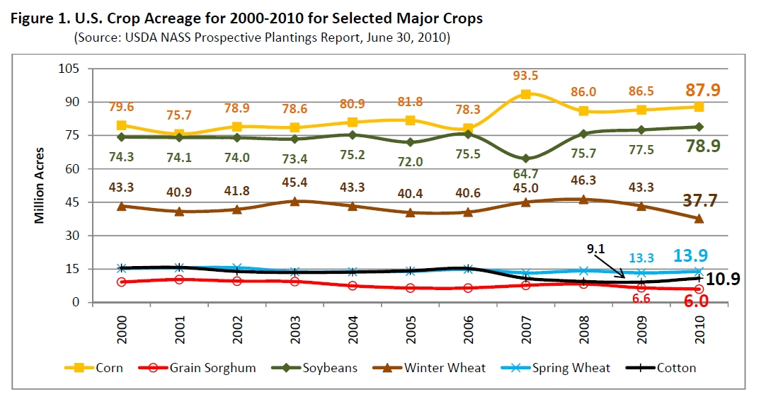
USA Acreage

Slide 7
2009 World Production, Mt
    Corn Soybeans Wheat
    USA 333,010,910 91,417,300 60,314,290
    China 163,118,097 14,500,141 114,950,296
    Brazil 51,232,447 56,960,732 4,964,665
    Mexico 20,202,600 120,900 4,148,000
    Argentina 13,121,380 30,993,379 7,573,254
    India 17,300,000 10,217,000 80,680,000

Slide 8
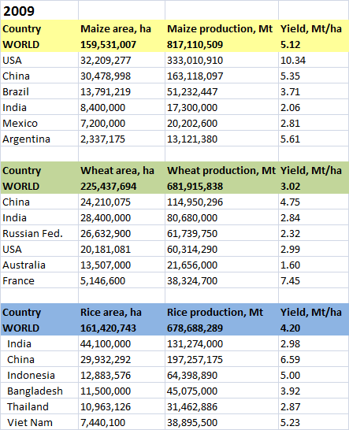


Slide 9
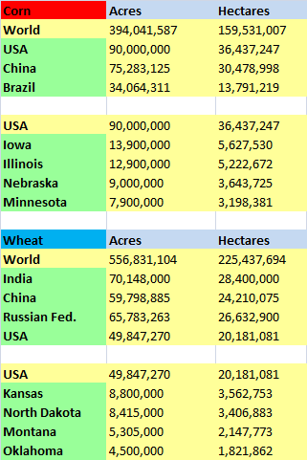

Slide 10
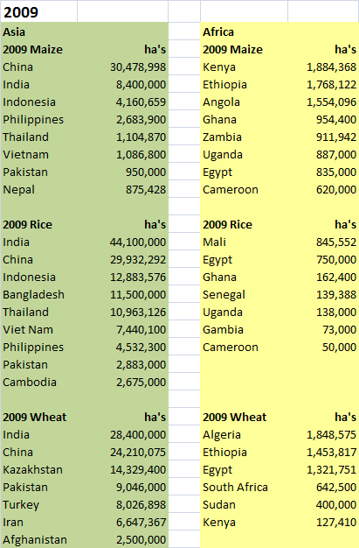

Slide 11
Minnesota Corn Growers Association
Riley Maanum, Research & Project Director
Tim Gerlach
Gyles Randall
George Rehm
John Lamb

Slide 12

Soil Fertility Research and Education Department of Plant and Soil Sciences
044 N. Ag Hall
Stillwater, OK 74078
405 744-64141989-2011
Robert L. Westerman
Asst. Vice President, DASNR

Slide 13
SB 314
History
Language
  Importance of projected revenue
  700,000 tons sold/year
Board-oversight

Slide 14
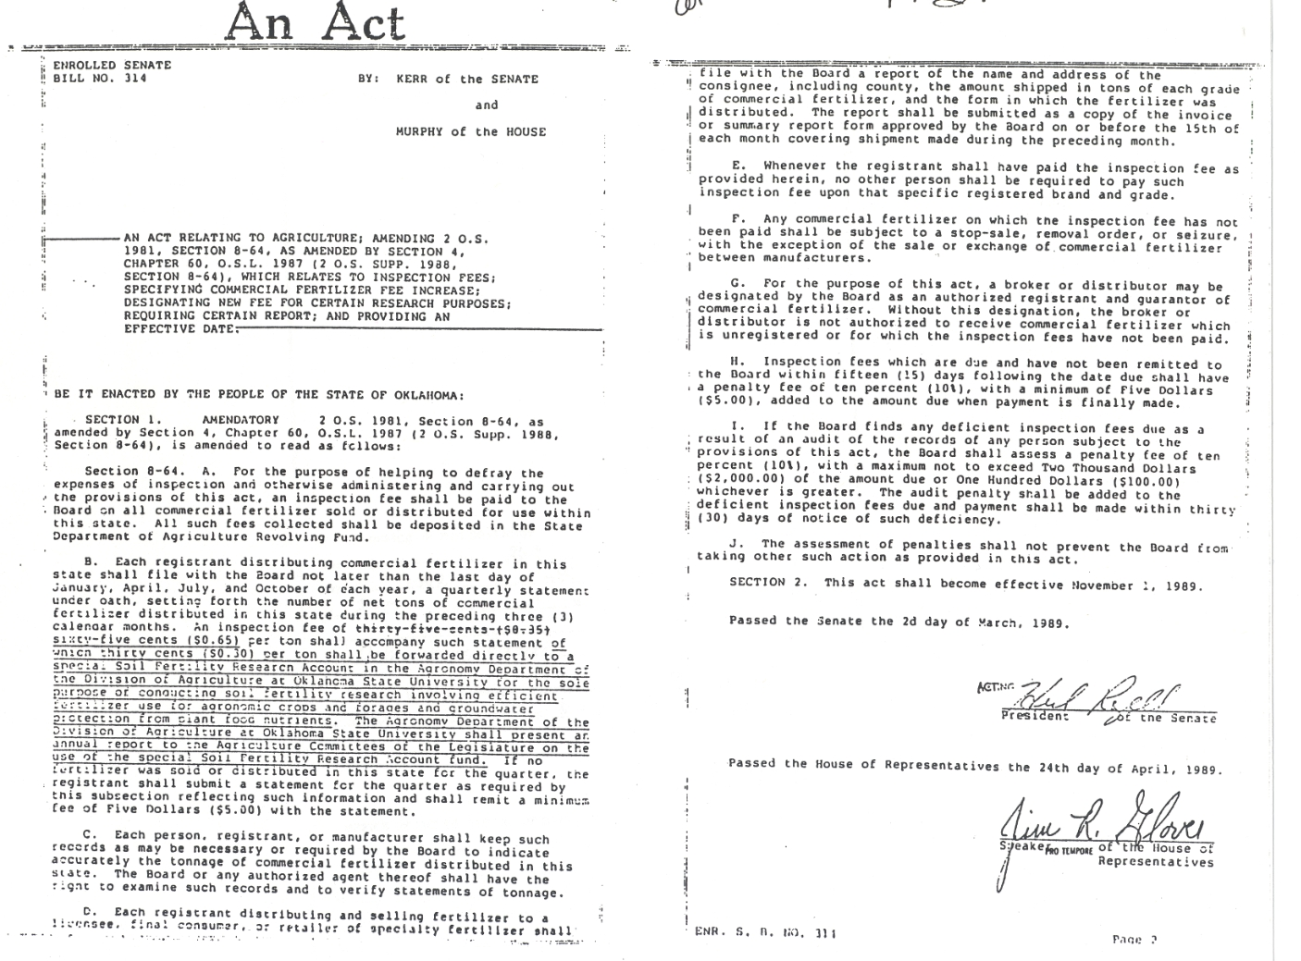
Senate Bill 314 (1989)

Slide 15
SB314 (1989)
An inspection fee of sixty-five cents (0.65) per ton shall accompany such statement of which thirty cents ($0.30) per ton shall be forwarded directly to a special Soil Fertility Research Account in the Agronomy Department of the Division of Agriculture at Oklahoma State University for the sole purpose of conducting soil fertility research involving efficient fertilizer use for agronomic crops and forages and groundwater protection from plant food nutrients. The Agronomy Department of the Division of Agriculture at Oklahoma State University shall present an annual report to the Agriculture Committees of the Legislature on the use of the special Soil Fertility Research Account fund.

Slide 16
SB 432 (2009)
pay an inspection fee of sixty-five cents ($0.65) One Dollar ($1.00) per ton of which thirty cents ($0.30) fifty cents ($0.50) per ton shall be forwarded directly to a special Soil Fertility Research Account in the Department of Plant and Soil Sciences Department of the Division of Agricultural Sciences and Natural Resources at Oklahoma State University for the sole purpose of conducting soil fertility research and extension involving efficient fertilizer use for agronomic crops and forages and groundwater and surface water protection from plant food nutrients. Oklahoma State University shall present an annual report to the Agriculture Committees of the Legislature on the use of the special Soil Fertility Research Account Fund.

Slide 17
Total Revenue
1989-2009
  5.4 million dollars (avg. $250,000/year)
  Competitive grants, same period (>7 million dollars)
2010-forward
  Expect >$400,000/year

Slide 18
Faculty
  Young
  Tested
  Applied
  Published
  Works well with others
  International experience

Slide 19
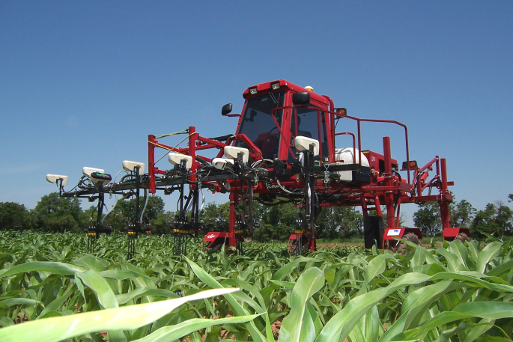
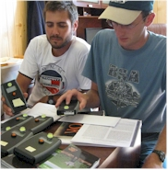
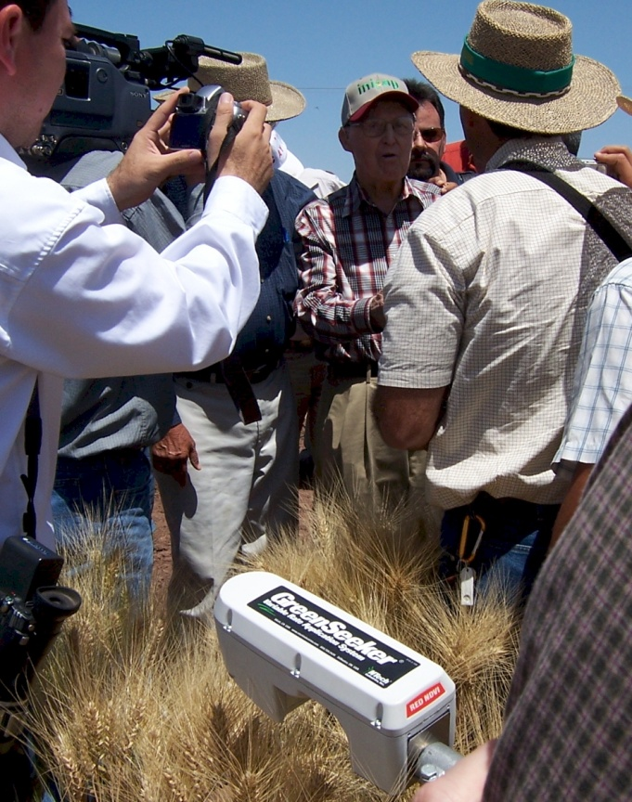
Products
1. From 2005 to 2011, 18,413 Nitrogen Rich Strips put on in Oklahoma (1,473,040 ac). Average profits of $10.00/ac for OK producers using the GreenSeeker and OSU N Rate recommendation, has resulted in positive economic impact of $13,610,400.
2. Greenseeker Nitrogen Fertilization System used on over 2,000,000 acres in the USA. Endorsed by the late Dr. Norman Borlaug, April of 2007.
3. OSU Pocket Sensors, developed. Projected retail value of around $250. Used all over the world to improve nutrient management.
4. Grain Protein Optimizer Released. Applied on-line calculator
5. Nine US Patents Come from OSU Sensor Team and the active sensor technology developed at Oklahoma State University.
6. First Web-Based N Recommendations for winter wheat, corn, cotton, bermudagrass, and canola. www.nue.okstate.edu
7. First Variable Rate Applicator capable of sensing and treating each 2 linear feet of row, developed at OSU.

Slide 20
Current Work
1. Winter wheat-sorghum continuous no-till rotation established by OSU in a 20 acre field just off of Highway 51 near Hennessey, OK. This highly visible site demonstrates the benefits of no-till rotations that better preserve soil moisture, and decrease weed pressure.
2. NH3 loss Calculator (http://nue.okstate.edu/N_Fertilizers/Urea.htm ). Farmers wishing to apply urea on the surface without incorporation can get an estimate of the potential N loss that they will encounter. Using the Mesonet data feed, temperature, relative humidity, and wind speed are automatically accessed at the station closest to that producer, and the predicted loss of N as NH3 reported. Based on the results, farmers can either chose to proceed, or delay their application.
3. Foliar Phosphorus for Wheat and Corn. Using various new products currently available, foliar P will prove to be a viable fertilization option when deficiencies are not severe. Diammonium phosphate or 18-46-0 can also be used, but that requires pre application processing.
4. P inefficient Wheat as a marker plant. A three year project with the international research center, CIMMYT has identified various wheat biotypes that ARE NOT P-efficient, and as a result show P deficiencies more prominently. By mixing in small amounts of this P inefficient wheat seed, P deficiencies can be visibly recognized.
5. NPKS Rich Strips. Using the strip applicator developed by OSU engineering, we will be applying N, P, K, and S Rich strips at all locations where current OSU variety testing is taking place and at other visible locations.
6. Use of plant stalk diameter to predict yield and adjust fertilizer rates. Using microwave technology, the stalk diameter of individual plants can be determined. We use this information to predict by-plant grain yield, and as function of these differing yield levels, adjust fertilizer rates on a by-plant basis.
7. Seed placement leads to fixed leaf orientation. OSU is developing a planter that will deliver controlled leaf orientation. When leaves are symmetrically oriented across the row, light interception increases, plant populations can be increased, and corn grain yields increase.
8. Alternative/Non-Conventional Product Evaluation. Nitrogen stabilizers, slow release N sources, P enhancers, and soil additives are being tested in wheat, sorghum, soybeans, corn and canola. Products being evaluated are available at www.NPK.okstate.edu.
9. Impact of Soil Acidity. OSU research has established critical soil pH levels for sorghum, sunflower, sesame, wheat and canola. Acid soil conditions leading to decreased production must be continually monitored and lime applications encouraged where needed.
Future work
-Sensor detection of P, K, and S deficiencies
-By-plant sensing/fertilization
-Agricultural phone applications
-External grants for added funding

Slide 21
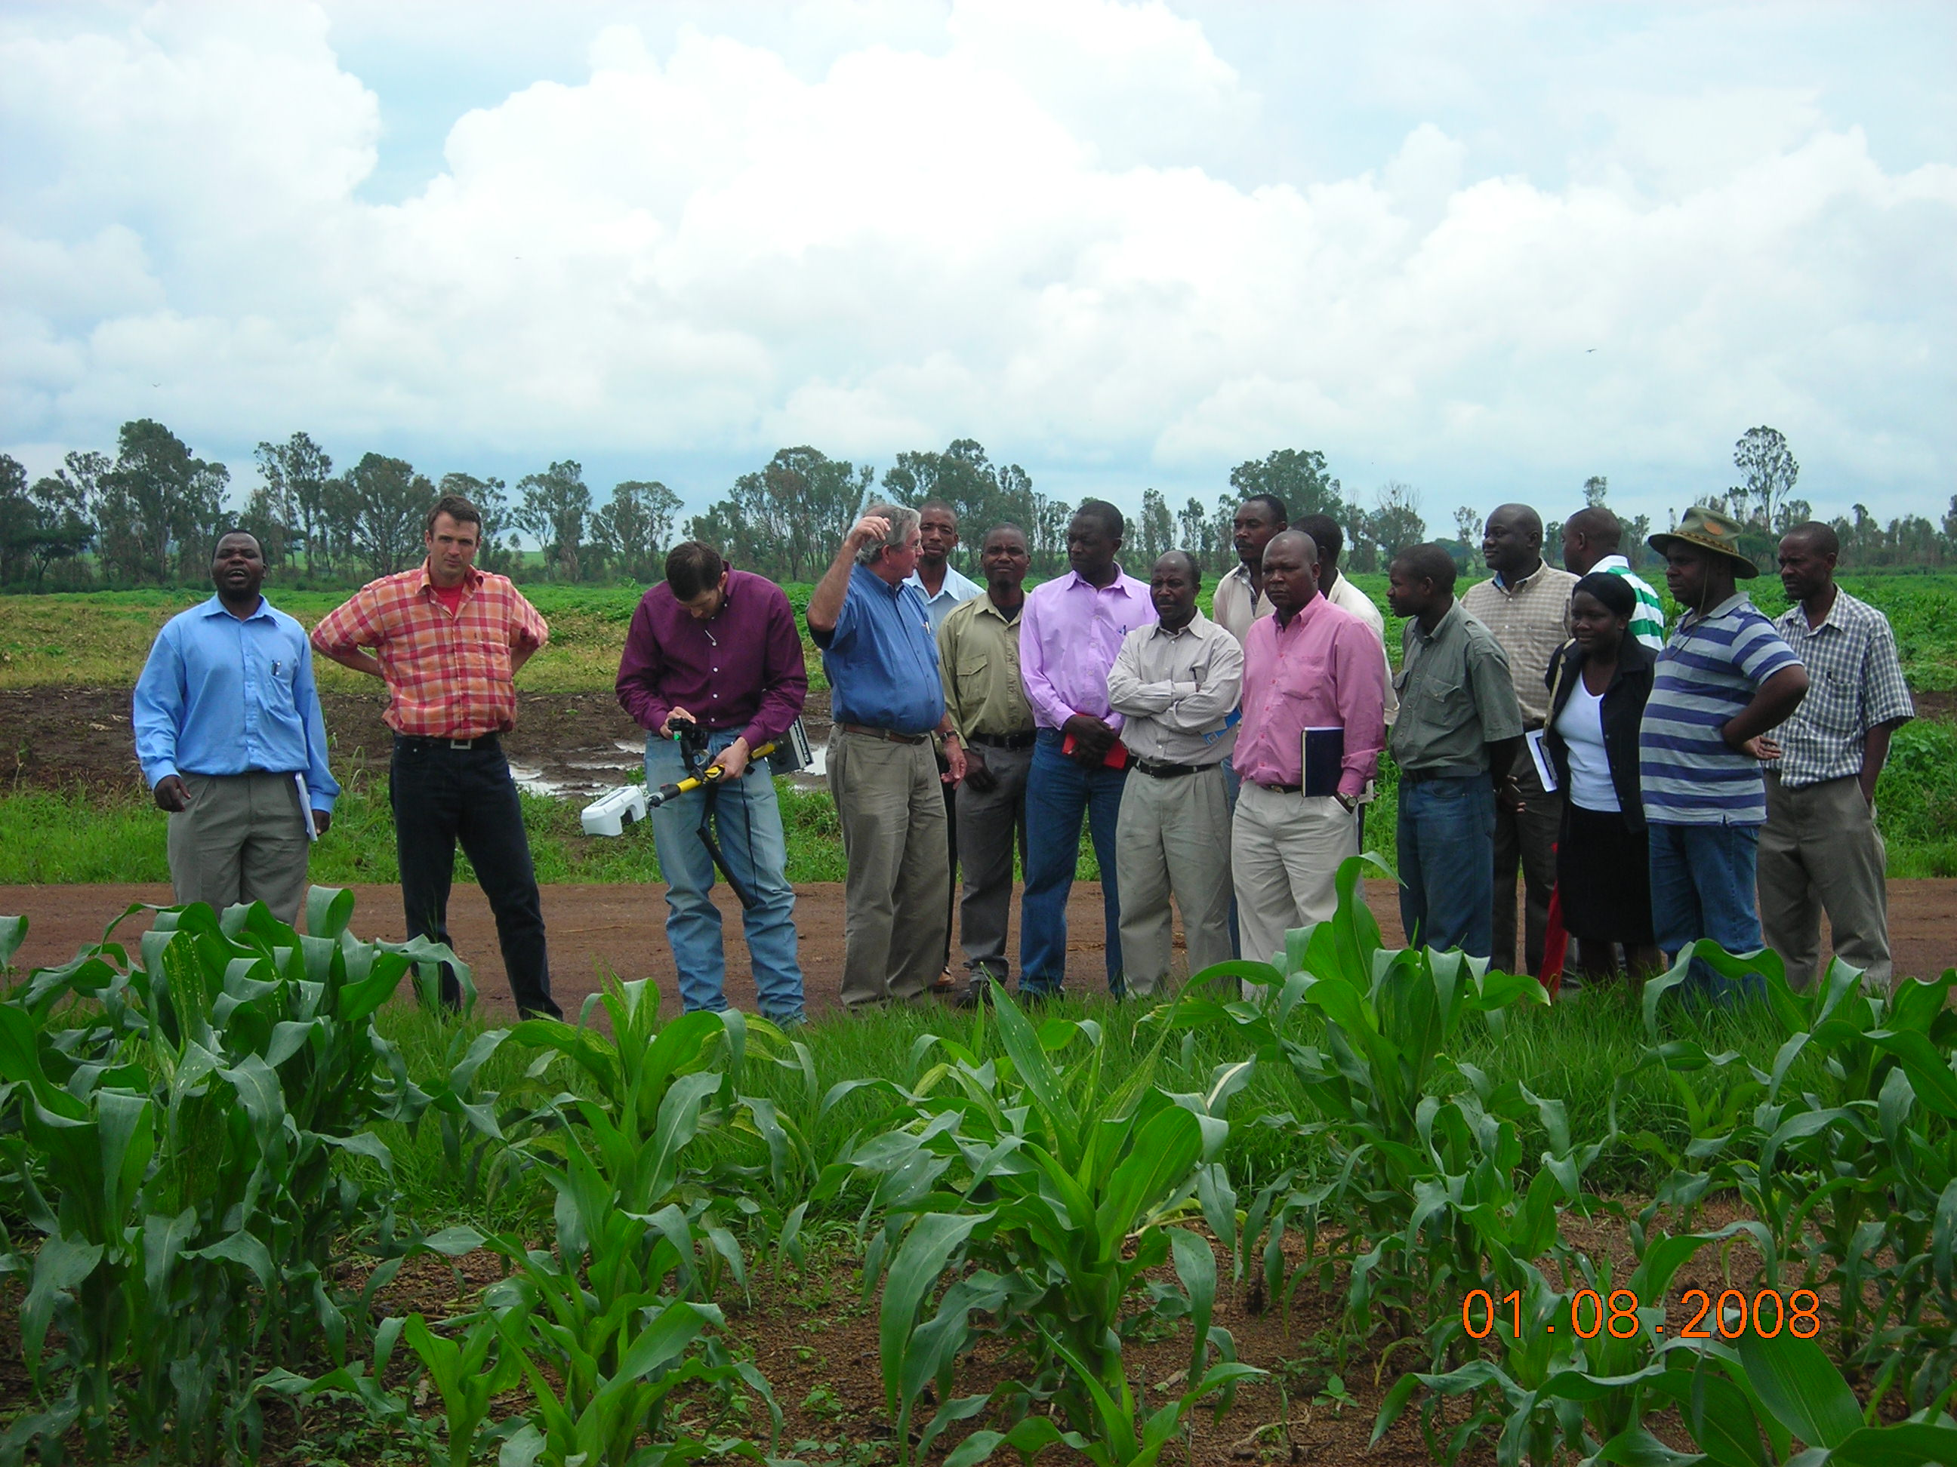
For SSA, NUE’s exceed 100%. In light of the low N application rates, high NUE’s speak to a much bigger and potentially damaging situation for cereal production in SSA. High NUE’s for SSA are a direct result of applying so little fertilizer N, at the ultimate expense of mining an already depleted soil resource.

Slide 22
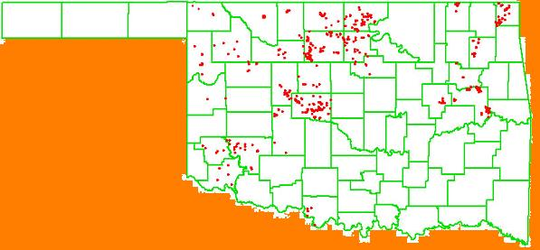
Year OSU Dealer/Producer
2005 80 400
2006 586 Ramps -
2007 512 Ramps 2000
2008 15 -
2009 20 3500
2010 20 3800
2011 60 4000 (includes canola)
Strategy: Have to have experience seeing the different responses from one year to the next
2006

Slide 23
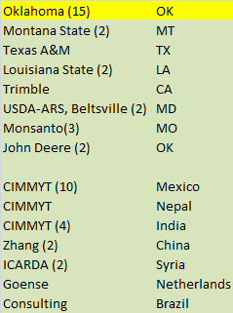
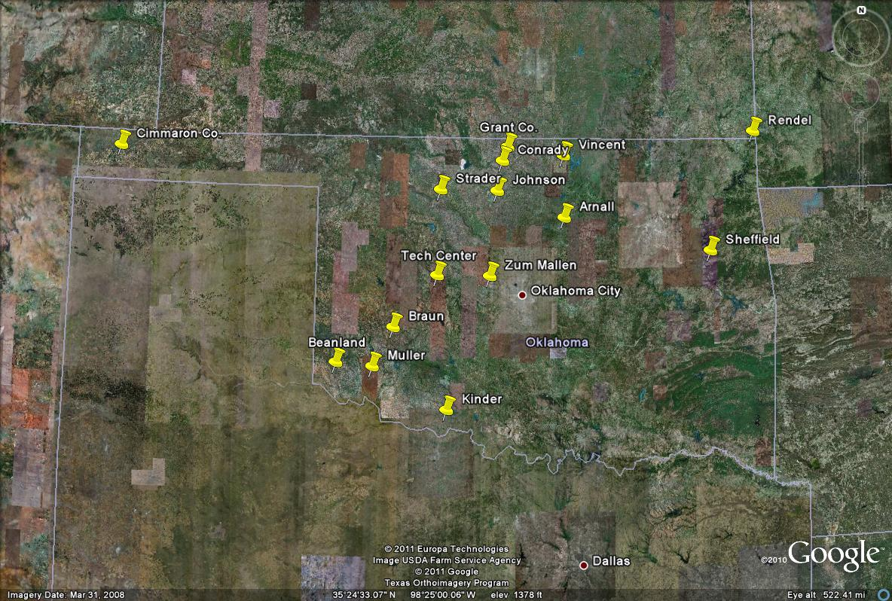
Pocket Sensor Locations

Slide 24
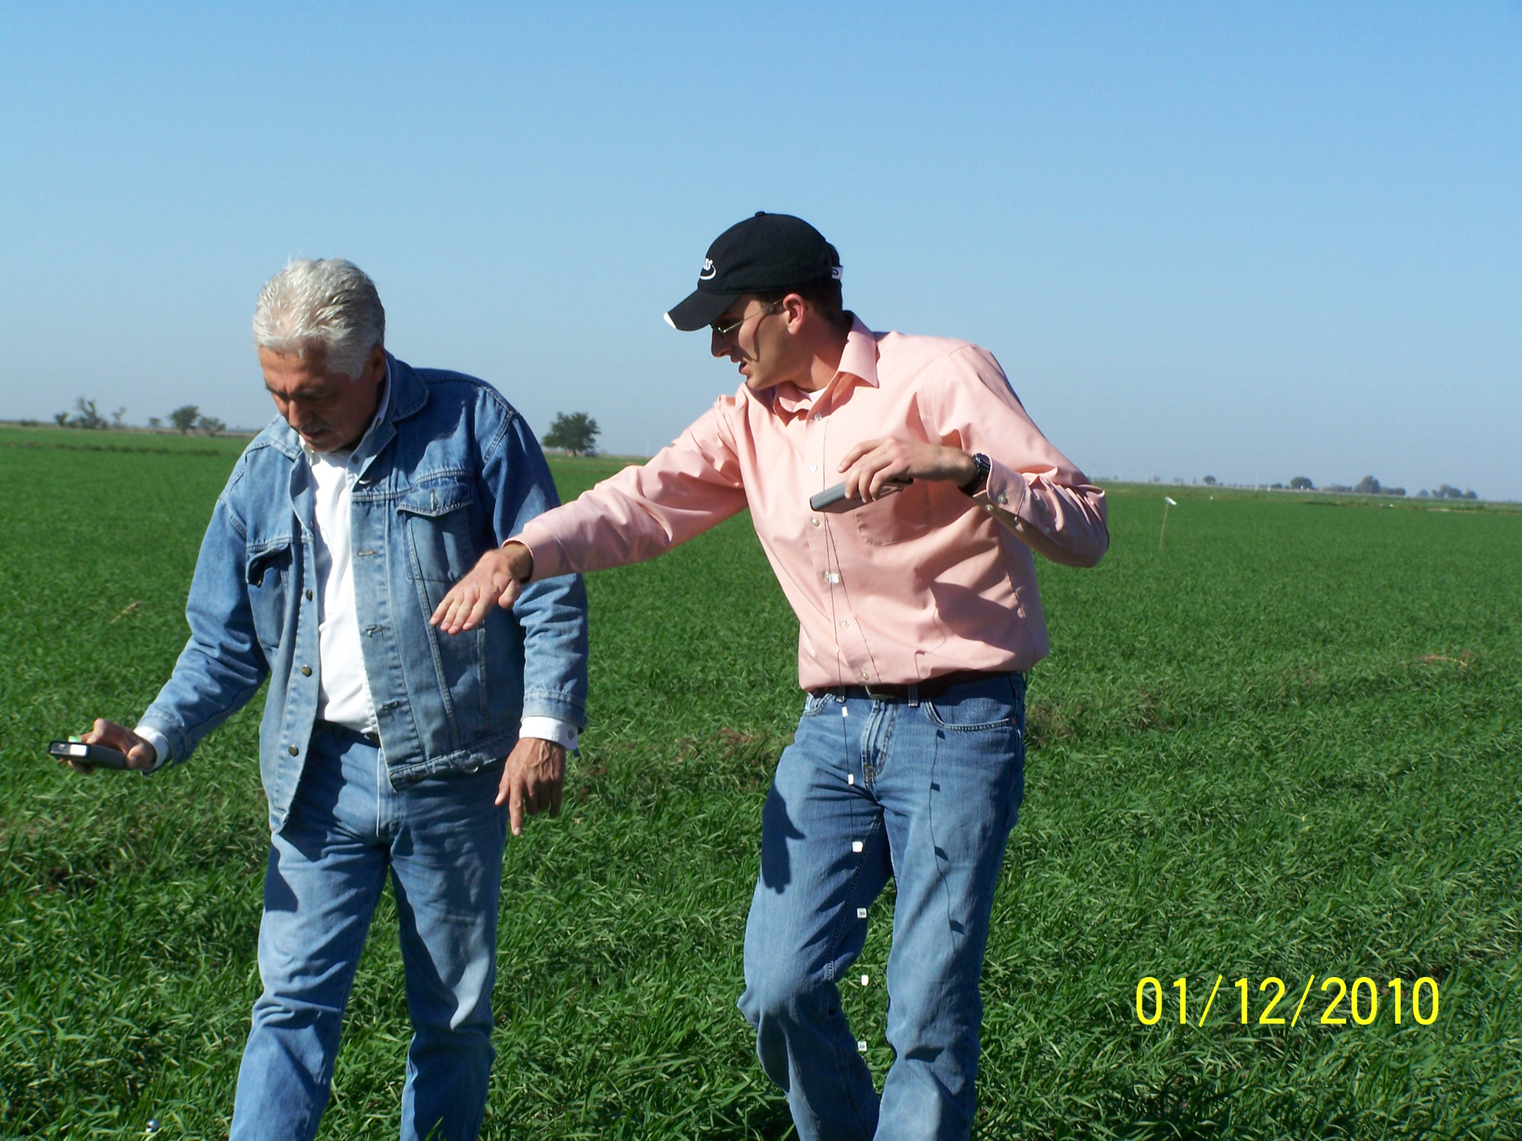
Farm advisor in Ciudad Obregon, manages 1000 ha using GreenSeeker technology

Slide 25
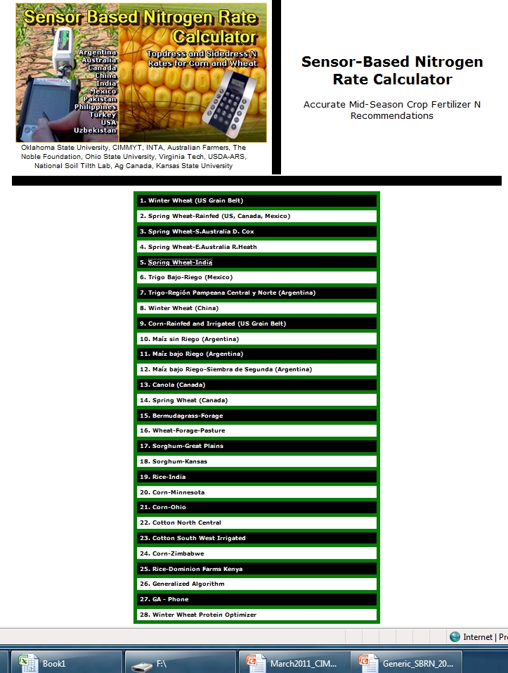
http://www.soiltesting.okstate.edu/SBNRC/SBNRC.php
currently 28 options,

Slide 26
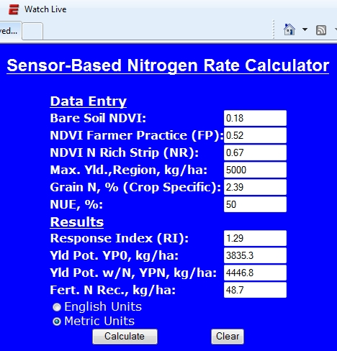
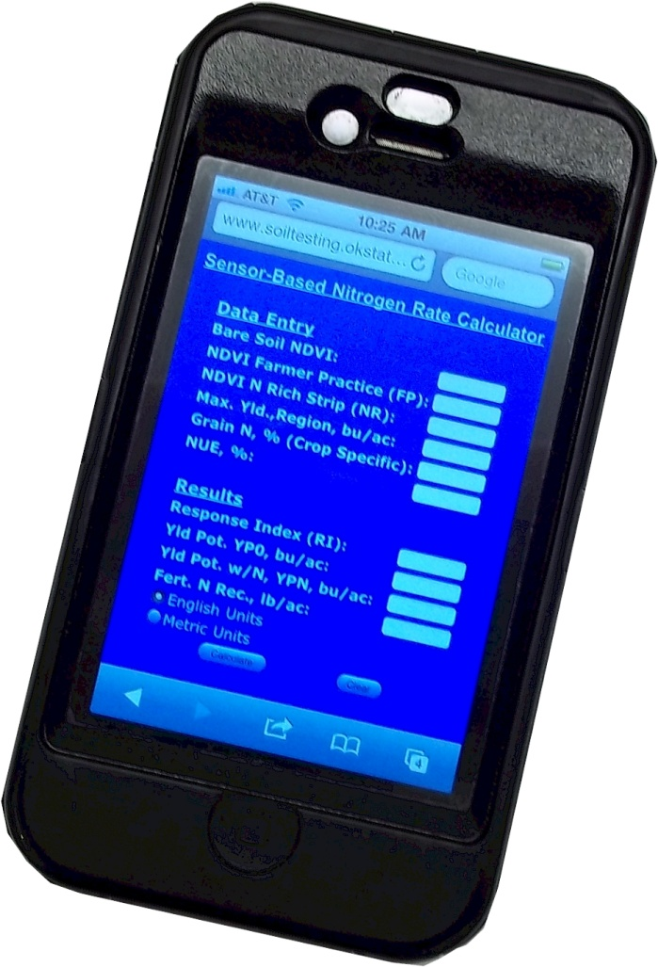

Slide 27
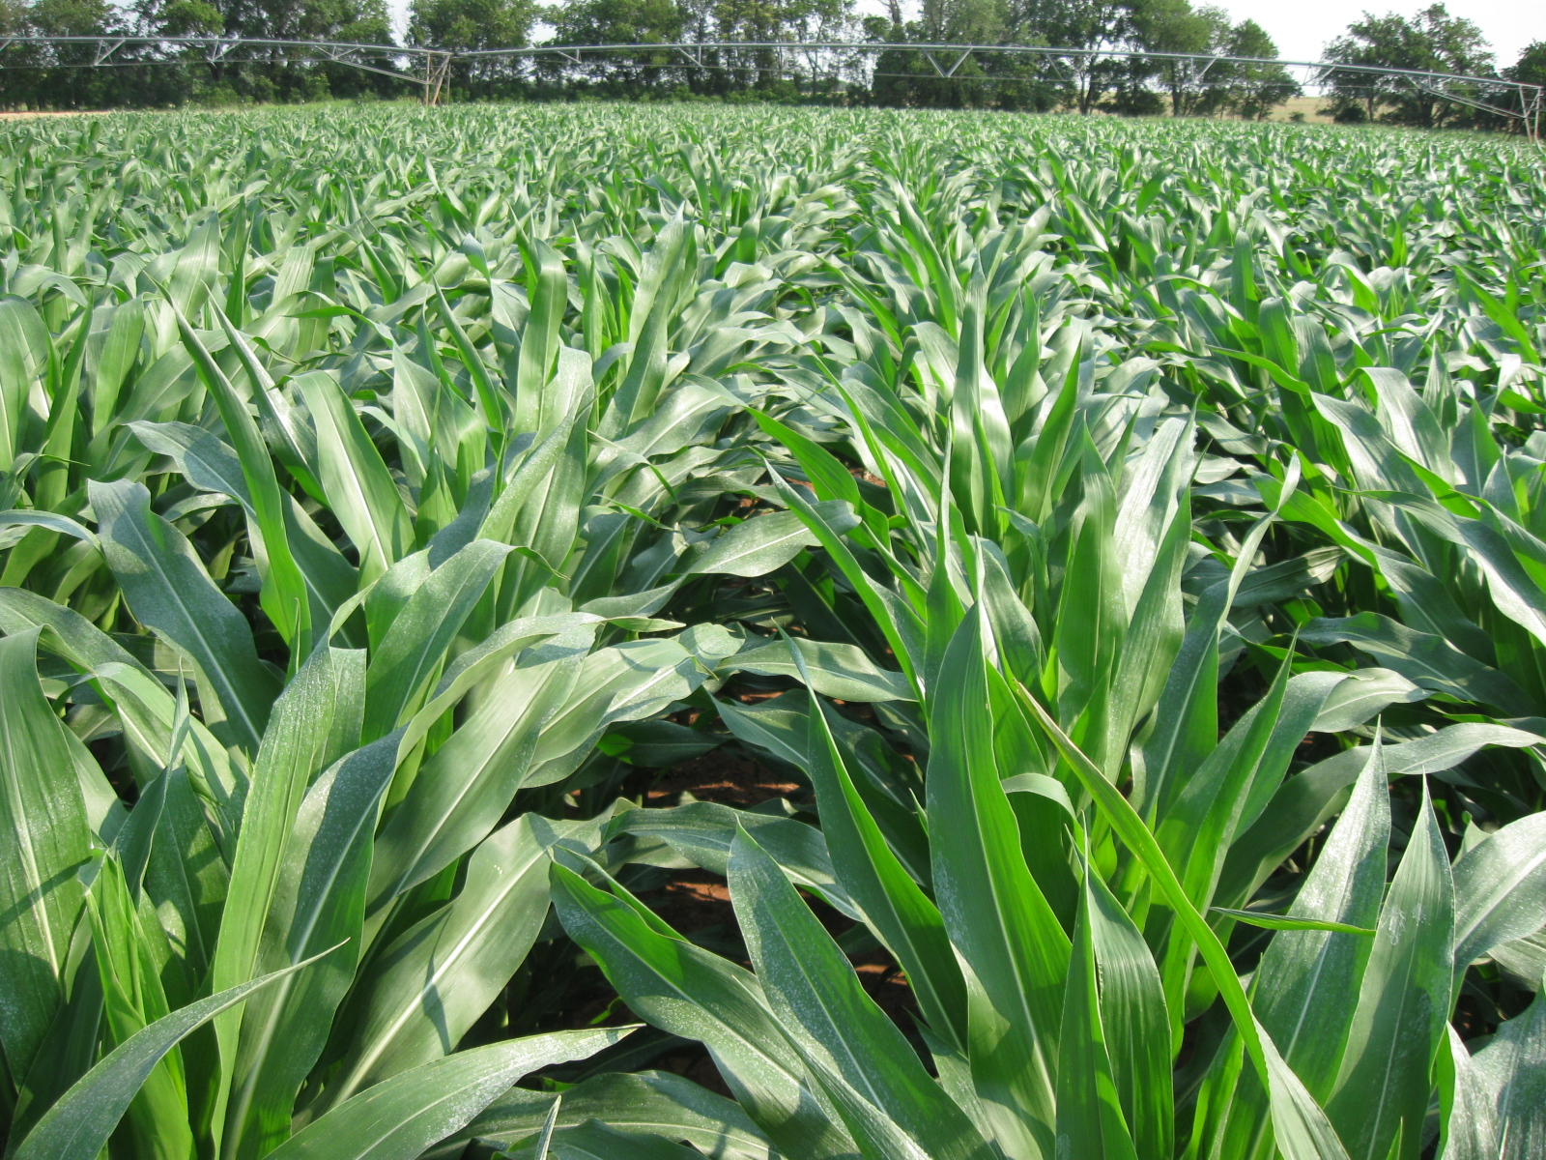
Foliar P
Mosali, J. Kefyalew Girma, R. K. Teal, K. W. Freeman, K.L. Martin, Jason W. Lawles, and William R. Raun. 2006. Effect of foliar application of phosphorus on winter wheat grain yield, phosphorus uptake and use efficiency. J. Plant Nutr. 29:2147-2163.
Girma, Kefyalew, K.L. Martin, K.W. Freeman, J. Mosali, R.K. Teal, W.R. Raun, S.M. Moges, and D.B. Arnall. 2007. Determination of optimum rate and growth stage for foliar applied phosphorus in corn. Commun. Soil Sci. Plant Anal. 38:1137-1154.

Slide 28
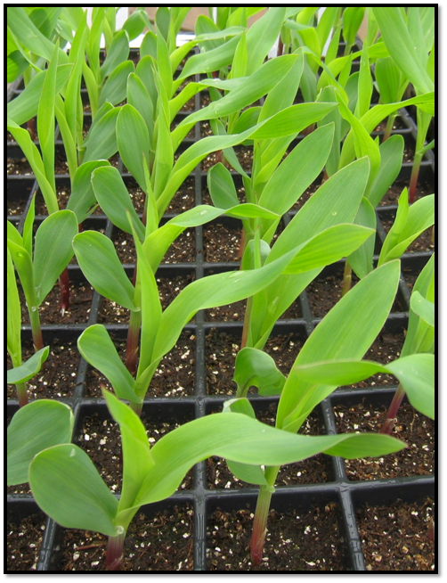
Seed Placement and Leaf Orientation

Slide 29
Hand Planter
159,531,007 hectares of maize in 2009
34,409,010 hectares in the developing world 60% was planted by hand
    = 20,645,000 hectares or 13% of the total maize area in the world

Slide 30
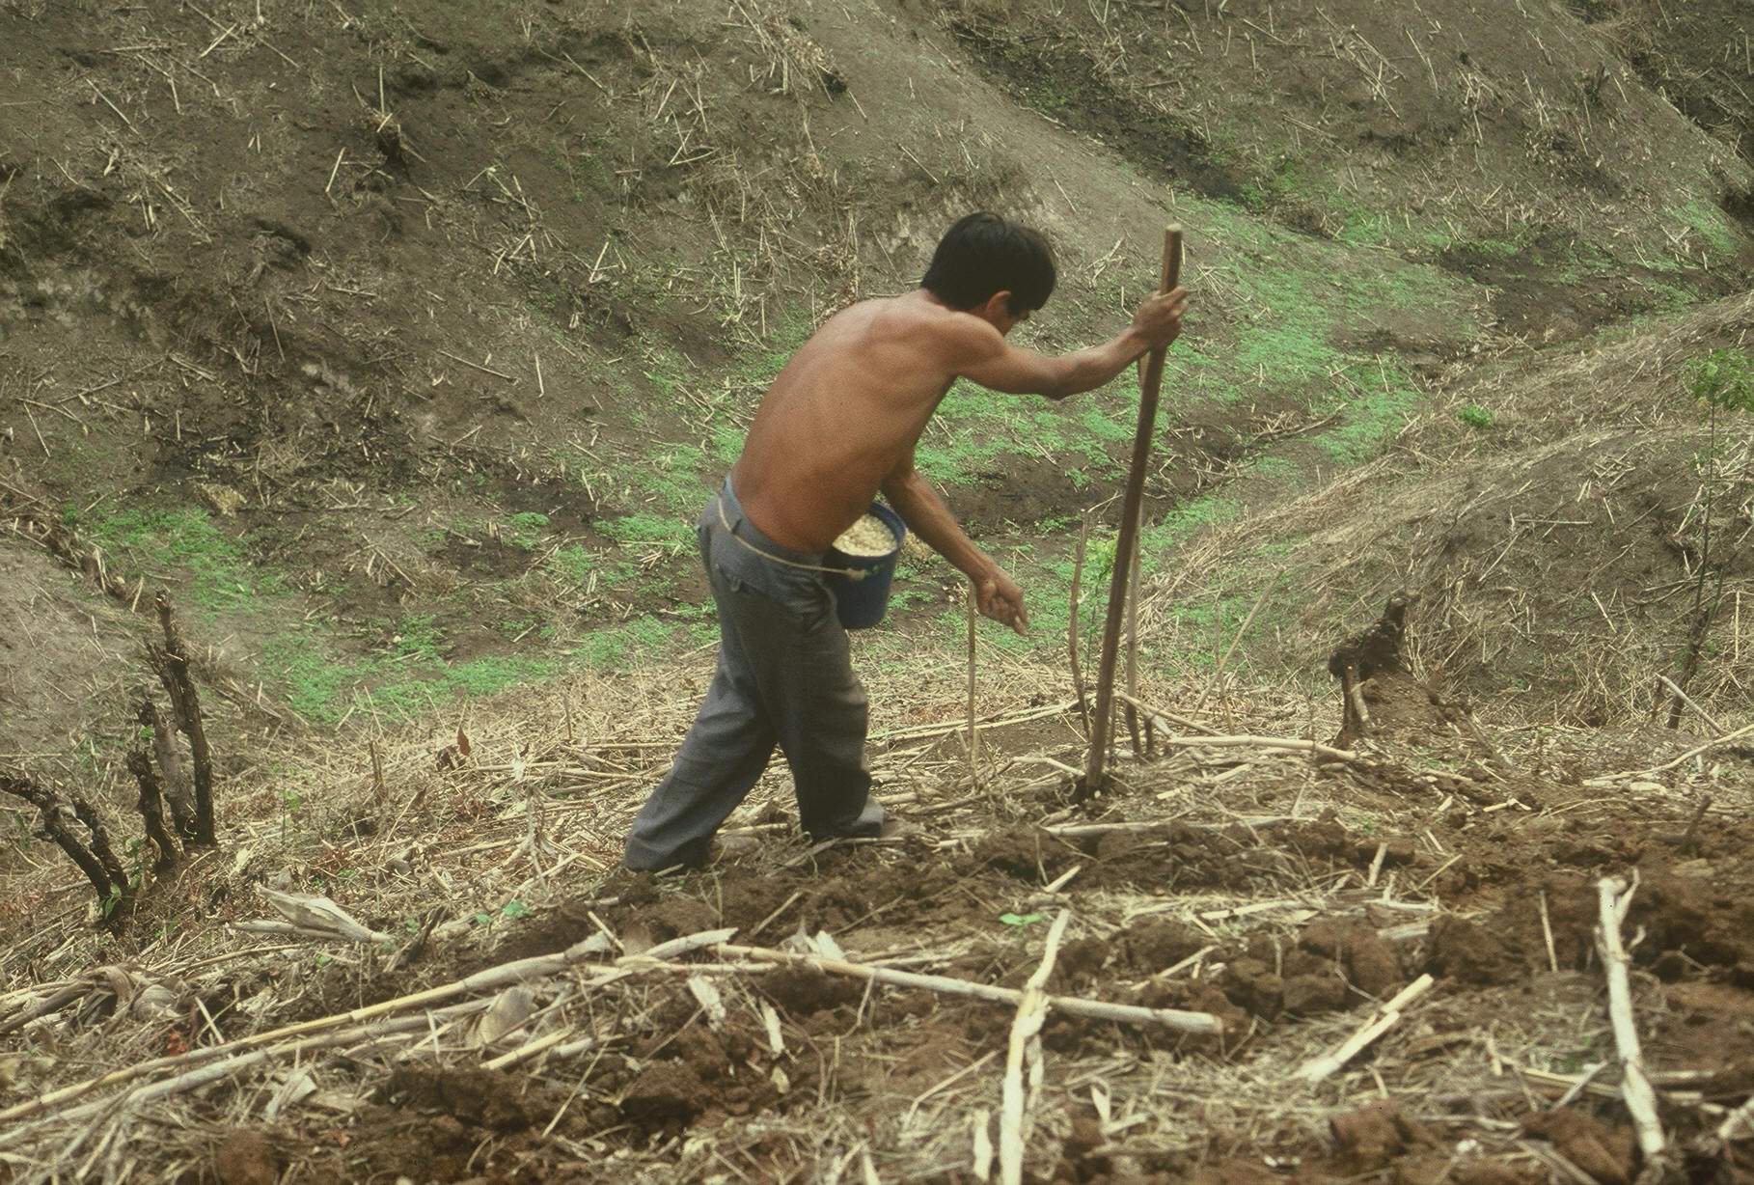

Slide 31
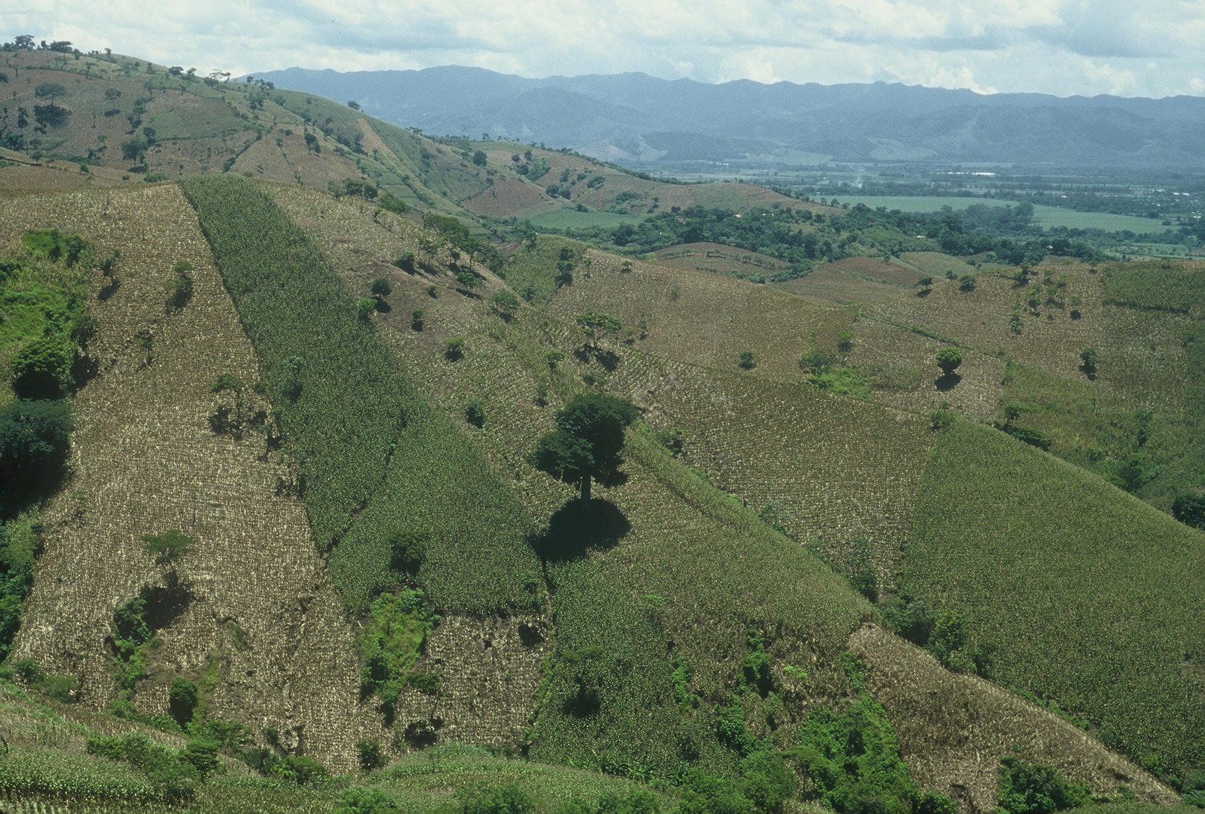

Slide 32
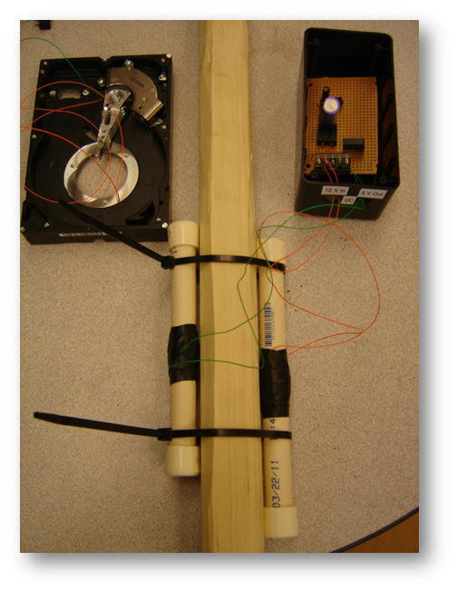
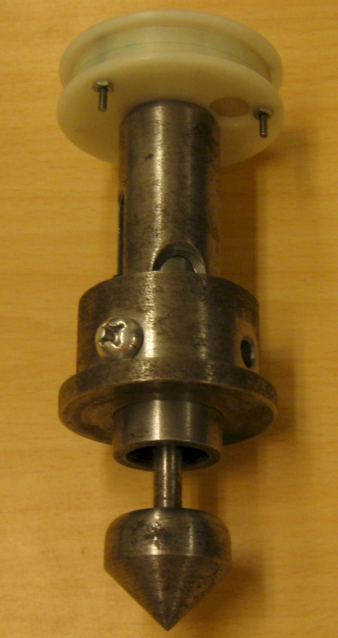
Power requirement to singulate seed
http://nue.okstate.edu/Hand_Planter.htm

Slide 33
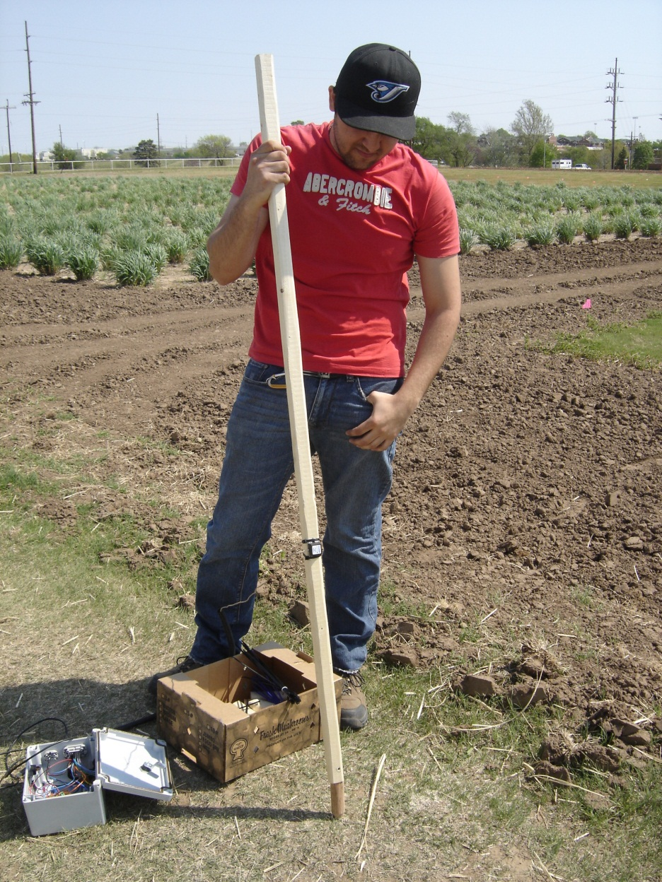
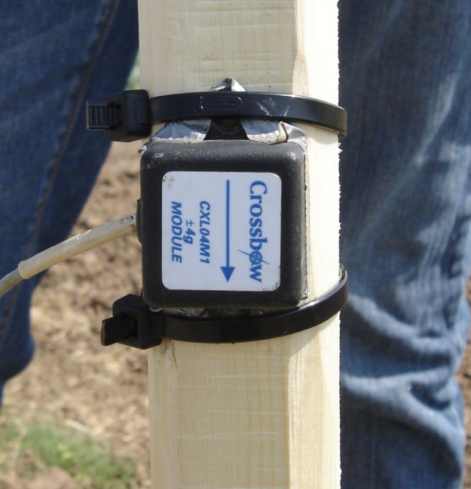

Slide 34
SB314, SB432
Goal: Provide a needed service to the state
Graduate student stipends
Need for sustained funding (continuity needed to solve a problem>3 years)
Equipment (field and lab)
International student support
Communication
Environmental value
Will deliver solutions

