Slide 1
Graduate Student Presentation
May 6, 2014

Slide 2
Drought tolerance in corn
Drought tolerant
Miller

Slide 3
Hybrid differences
Comparisons | Efaw | LCB
 | Grain Yield (bu/ac)
Drought tolerant vs. Non-drought tolerant | -7.7 | 0.6
Monsanto vs. Pioneer | 15.9 | 13.3
Droughtgard vs. AQUAmax | 22.0 | 14.6
Hybrid Pricing
Pioneer Hi-Bred
P1498 AQUAmax (2011 release date)
$320 per bag
P 1395 (2010 release date)
$315 per bag
Monsanto
DKC 63-55 (2012 release date)
$327 per bag
Same germplasm, without Droughtgard is $5 less per bag
At 25,000 seeds/ac:
$5 per bag difference costs $1.56 ac⁻¹
Miller

Slide 4
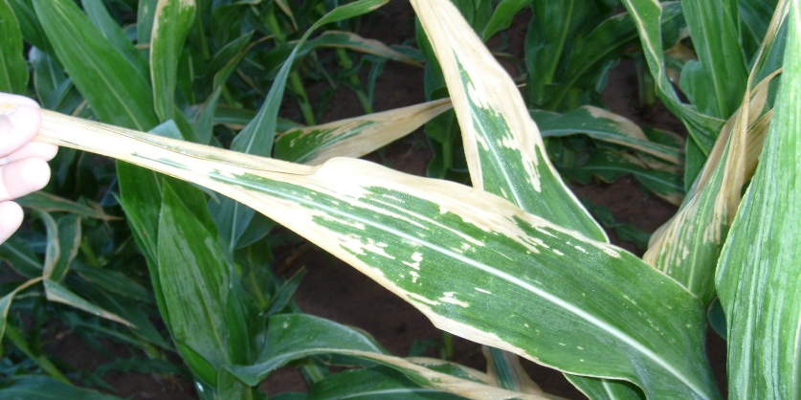
Lake Carl Blackwell – Leaf Burn
Percent Leaf Area Burned
Change in NDVI (Post-Pre)
Bushong

Slide 5
Summary
Site | Rain-fed | Rational | Irrigated | Rational
STW 2012 | Split Surface | -Mild leaf burn -Minimal late season moisture | Preplant or Split Surface | -Adequate late season moisture
LCB 2012 | Preplant | -Severe leaf burn -No late season moisture | Preplant or Split Surface | -Adequate late season moisture
STW 2013 | Split Foliar or Surface | ?????? | Preplant | -Early Season root growth -Adequate late season moisture
LCB 2013 | Split Foliar | -Saturated soil led to loss of N -Adequate late season moisture | Split Foliar | -Saturated soil led to loss of N -Adequate late season moisture
Bushong

Slide 6
Algorithm Evaluation Winter Wheat
Method | R² | Percent Under | Percent Over | Percent Within 15 lbs N/ac
SBNRC-current | 0.33 | 74 | 26 | 44
SBNRC-with soil moisture | 0.32 | 76 | 24 | 50
Gen. Algorithm | 0.34 | 53 | 47 | 41
Modified Gen. Algorithm | 0.33 | 50 | 50 | 41
Nitrate Soil Test* | 0.11 | 50 | 50 | 22
*Current non sensor based OSU recommendation
Bushong

Slide 7
Preplant N Placement from Corn Row
Objective: Evaluate preplant N placement at different distances from corn rows on grain yield.

Slide 8
Oklahoma-Kansas Sensor Based Algorithm
2010-2014 “regional” N trials
15 locations in OK; 8 locations in KS
Economic return with current OSU sensor based calculator
Treatment | N - Rate (lb N/ac) | Yield (bu/ac) | NUE (%) | Net Return ($/ac)
Preplant | 150 | 37 ± 15 | 16 ± 10 | 139 ± 93
Split Application | 100 | 37 ± 10 | 24 ± 9 | 166 ± 61
SBNRC | 45 ± 21 | 34 ± 12 | 35 ± 16 | 200 ± 61
Difference between SBNRC and Split Application |  |  |  | 34 ± 42 | Avg
 |  |  |  | 103 | Max
 |  |  |  | -30 | Min
Fertilizer Price (28-0-0) = $0.56/lb N
Grain Price = $6.00/bu

Slide 9
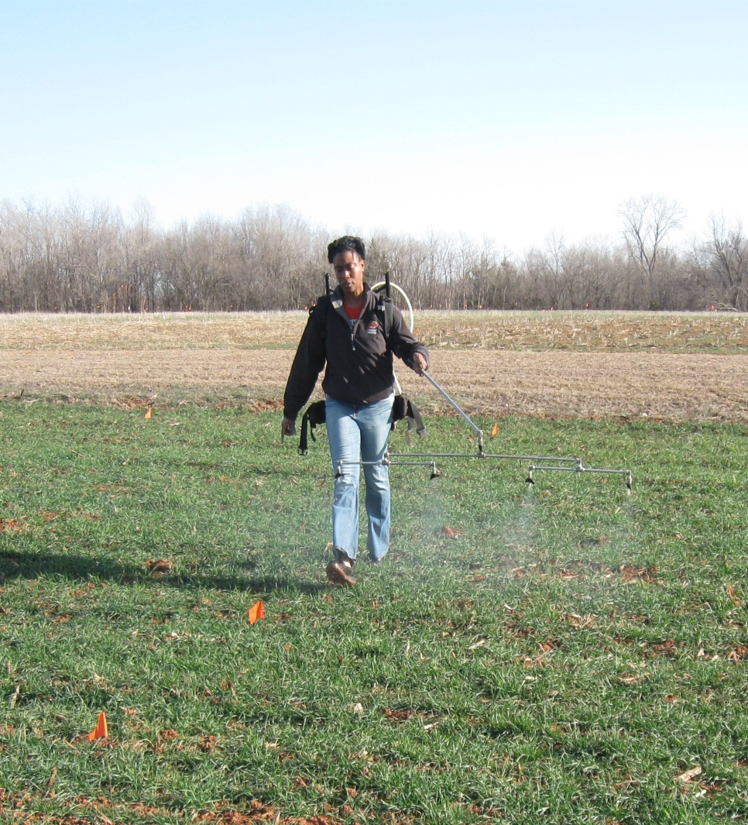
All-Foliar Nitrogen and Nitrogen Use Efficiency
Objective: Evaluate effect of
all foliar applied N on NUE
Locations: Lake Carl
Blackwell and Efaw in
Oklahoma
UAN and CoRoN
30, 60, 90 lbs N/acre
2,3,4 applications
Applied at F4, F7, F9, F10
CO₂ backpack sprayer

Slide 10
Results
LCB
Maximum grain yield – 70 bu/ac (60 lbs N/acre 3 sprayings)
NUE at LCB ranged from 15-67%
NUE>33%
Efaw
Maximum grain yield – 48 bu/ac
(30 lbs N/acre pre-plant)
NUE ranged from 3-22%
Grain protein at Efaw-19% (90 lbs N acre⁻¹, 3 sprayings)
NUE < 33%

Slide 11
In Season Application of N & S on Winter Wheat
Objective
Evaluate the interactions of foliar applied Nitrogen and Sulfur on winter wheat grain yield and protein
TRT | Pre-plant N lbs N/ac | Foliar N, (UAN) lbs N/ac | Foliar S (MAX in S) lbs S/ac
1 | 0 | 0 | 0
2 | 36 | 0 | 0
3 | 36 | 0 | 5.4
4 | 36 | 0 | 0
5 | 36 | 18 | 0
6 | 36 | 18 | 5.4
7 | 36 | 18 | 2.7
Methods
Three sites, Perkins, Lahoma & Lake Carl Blackwell, RCBD 3 reps and 7 treatments
Foliar N and S application at flag leaf stage with CO₂ backpack sprayer
Soil samples: Preplant, FK 5
Leaf samples: Feekes 5, flag leaf
NDVI readings: Feekes 3, 5, 7
Yield

Slide 12
Effect of Adequate Soil Moisture at Planting on Wheat Seed Density, and Nitrogen Rate
Can adequate soil moisture at planting lower optimum seed density
Adequate early moisture
 | 40 |  |  | 60 |  |  | 100
120 | 0 | 60
Methods:
Locations: LCB, EFAW
Moisture: main plot
Seed density: sub plot N rates
Measurements:
Soil Moisture, stand counts, NDVI, Yield
Limited early moisture
 | 40 |  |  | 100 |  |  | 60

Slide 13
Organic C and N in Long Term Trials
Objective: quantify changes in TN, OC and soil pH in long-term continuous winter wheat experiments that have received annual applications of fertilizer N (benchmark, 1993)
Experiments
222 N rates: 0, 40, 80 and 120 lb/ac
502 N rates: 0, 20, 40, 60, 80 and 100 lb/ac
Magruder Plots: 0, 240 lb/ac
16 soil cores collected per plot from each experiment
TN and OC; LECO dry combustion analyzer
Soil pH

Slide 14
TN and OC at 0-15 cm, as affected by long-term N fertilization in Experiment 502, Lahoma, OK.
Effect of N on TN and OC was significant at 0.1 and 0.05 probability levels, respectively
N rate (lb ac⁻¹) |  | TN OC, 2013 % |  | OC, 1993
0 |  | 0.106a† | 0.923a | 0.84 a
20 |  | 0.114ab | 0.937ab | 0.86 ab
40 |  | 0.124ab | 0.975ab | 0.88 abc
60 |  | 0.114ab | 1.036ab | 0.89 abc
80 |  | 0.119ab | 0.980ab | 0.91 bc
100 |  | 0.132b | 1.530b | 0.94 c

Slide 15
Micronutrient Response in Winter Wheat
Rates – current recommendations
Nutrient | Application | Nutrient Rate (lb/ac)
Check | - | -
Check | - | -
Calcium | Foliar | 0.07
Boron | Soil | 0.68
 | Foliar | 0.27
Chlorine | Soil | 10
 | Foliar | 5
Copper | Soil | 0.40
 | Foliar | 0.20
Zinc | Soil | 0.50
 | Foliar | 0.25
Evaluation, NDVI, Soil and tissue sampling, yield

