Slide 1
Research Projects
May 15, 2015

Slide 2
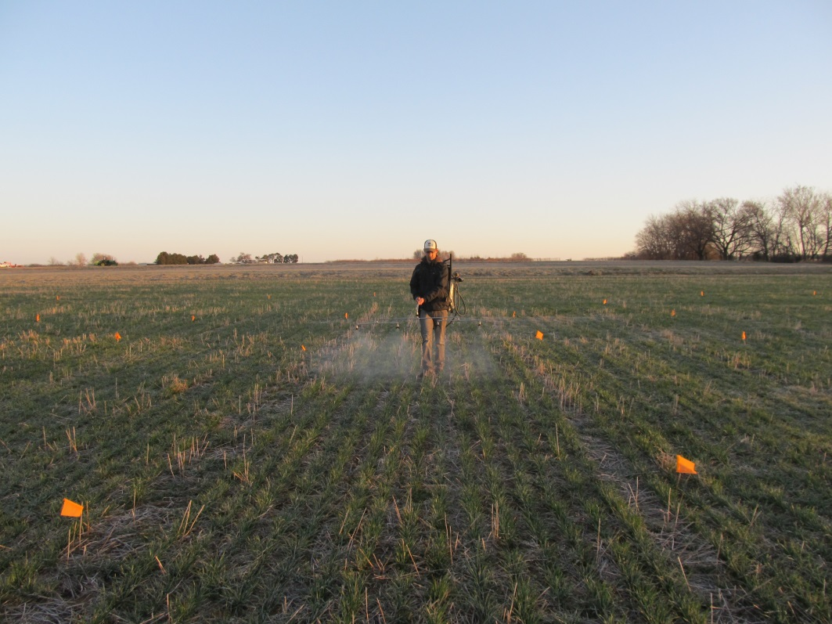
Micronutrient Response in Winter Wheat
Rates – current industry recommendations
Soil and Foliar Applied
  Boron, Chlorine, Copper, Zinc
  Calcium – Foliar only
NDVI, Soil, Tissue, Yield
4 site-years of data
Preliminary results
  no response to micros

Slide 3
Effect of Soil Moisture at Planting on Wheat Seed Density, and Nitrogen Rate
Preplant and early season irrigation
Seeding Rates – 40, 60 and 100 lbs seed/ac
N rates – 0, 60, 120 lb N/ac
Stand counts, head counts, NDVI, midseason biomass, final total biomass, grain yield

Slide 4
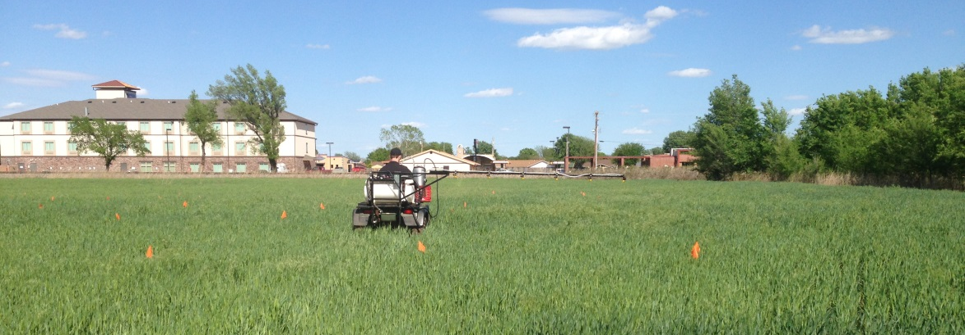
Foliar N
Hollow Stem – 0, 40, 80, and 120 lbs N/ac
Flag Leaf – 40 lbs N/ac
Pre and post application NDVI, grain yield

Slide 5
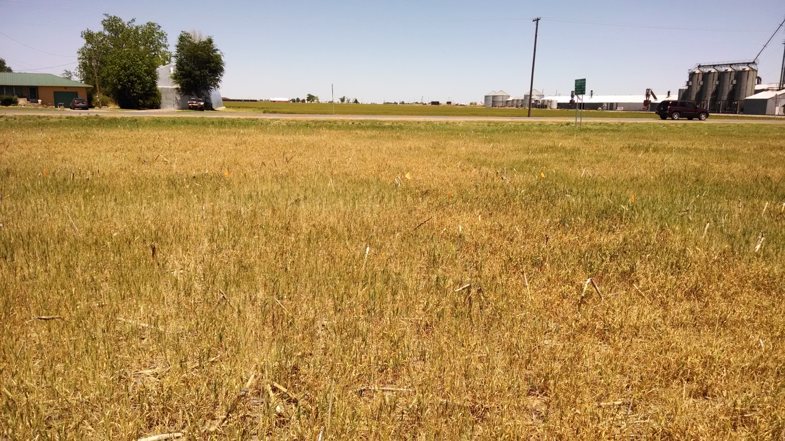
Residual N Effect Following Failed Crop (Wheat and Sorghum)

Slide 6
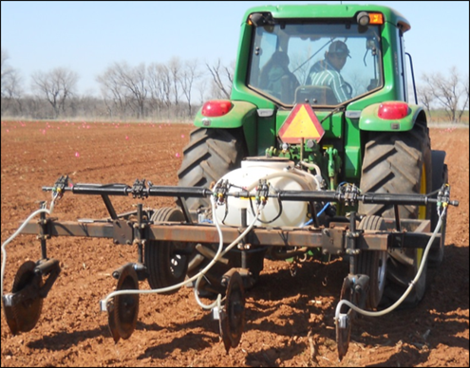
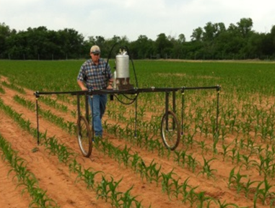
Depth Placement of Sidedress N
Surface, 3”, and 6” deep Sidedress N at V4
Rates of 40, 80, and 120 lb N/ac

Slide 7
Drought tolerance in corn

Slide 8
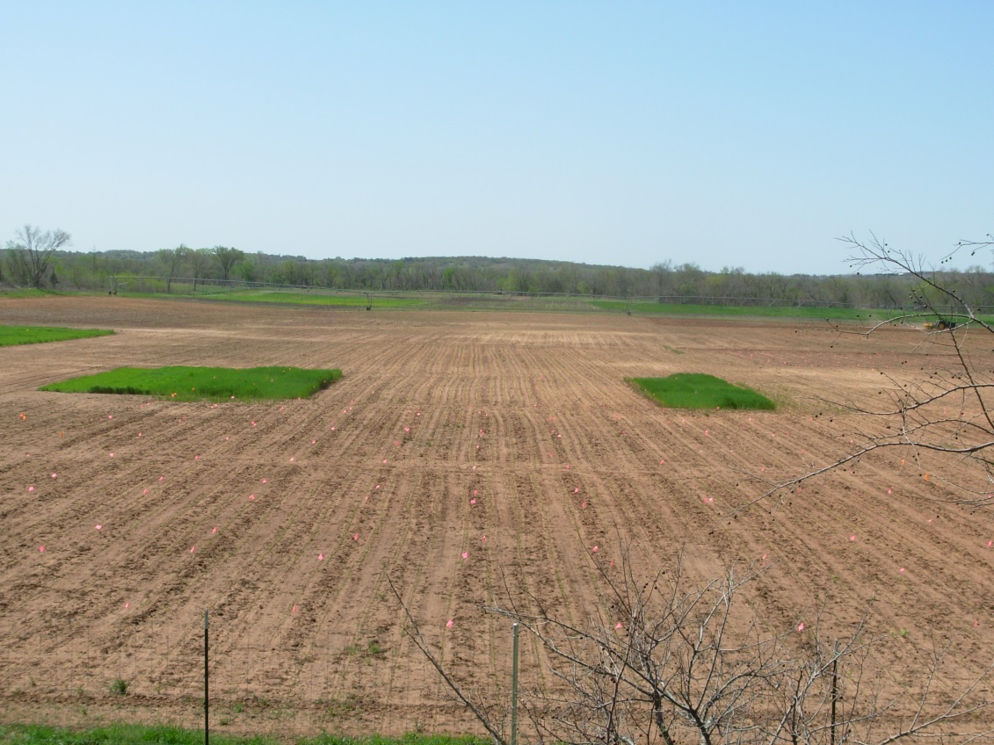
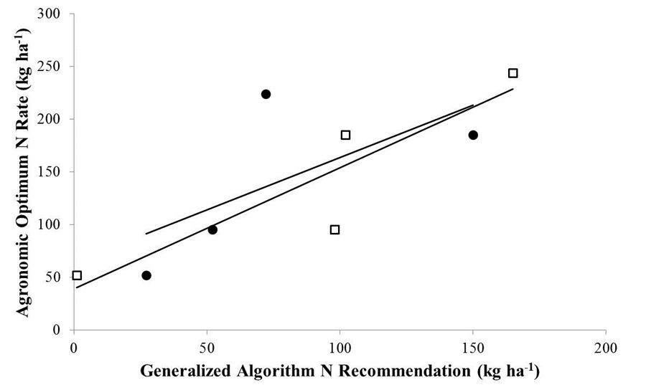
N rich Indicator Crop for Corn
Wheat
y = 0.99x + 64.5
R² = 0.44
P = 0.34
Barley
y = 1.15x + 38.9
R² = 0.80
P = 0.10

Slide 9
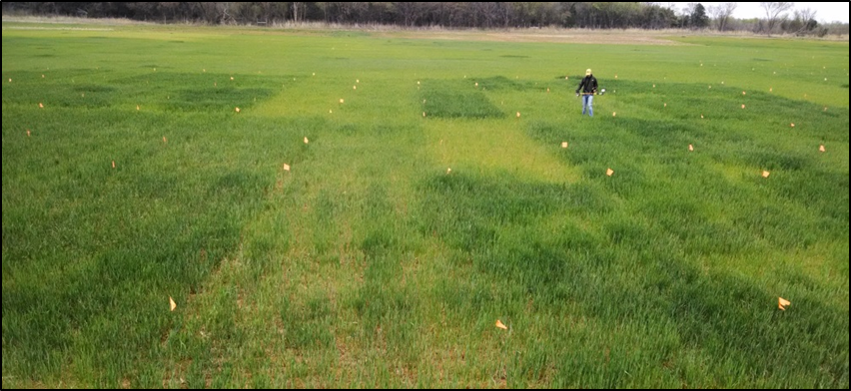
SB Algorithm Update
Wheat, Corn, Sorghum
2010-present (20 wheat sites)
Preplant N (Yield Potential): 0-200 lbs N/ac
Topdress N (Algorithm Validation): 0-125 lb N/ac

Slide 10


South Central Great Plains
Winter Wheat N Algorithm
Treatment | N - Rate (lb N/ac) | Yield (bu/ac) | Net Return ($/ac)
Split Application | 100 | 35 ± 16 | 154 ± 100
SBNRC | 45 ± 21 | 34 ± 16 | 172 ± 94
Average Difference |  |  | 12 ± 25
 |  |  | Max: 66
 |  |  | Min: -52
Fertilizer Price (28-0-0) = $0.56/lb N
Grain Price = $6.00/bu
http://nue.okstate.edu/SBNRC/mesonet.php
Option 3: Winter Wheat, South Central Great Plains

Slide 11
Preplant N Distance Placement in Corn
≤ 1 day
> 1 day
LCB Dryland- 2009
LCB Irrigated - 2009
Hennessey - 2013

